Slide 1
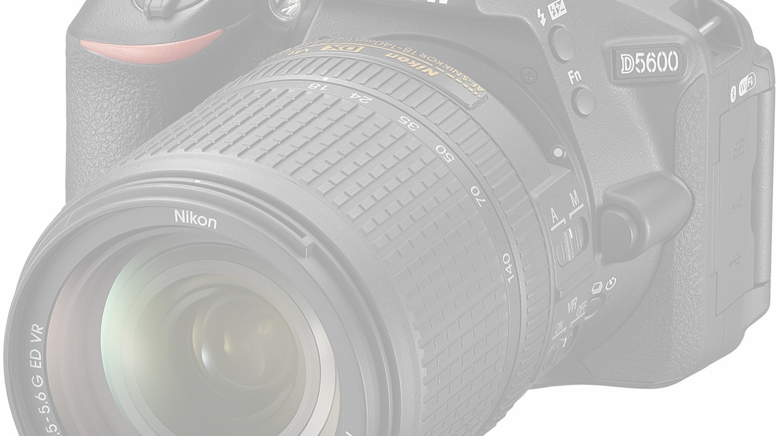
AQA GCSE Photography Exam 2019

Slide 2
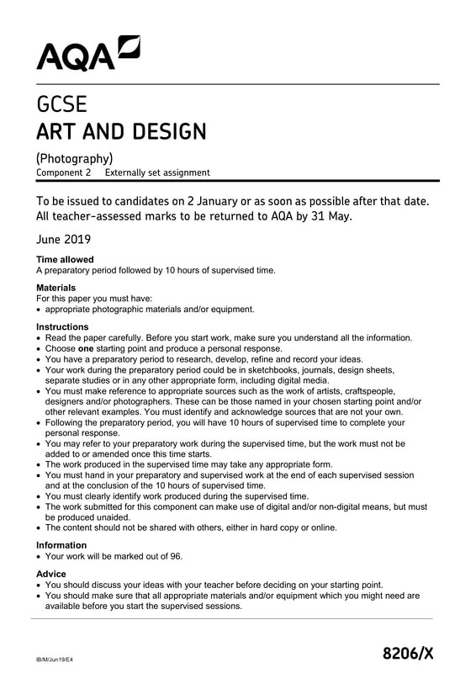
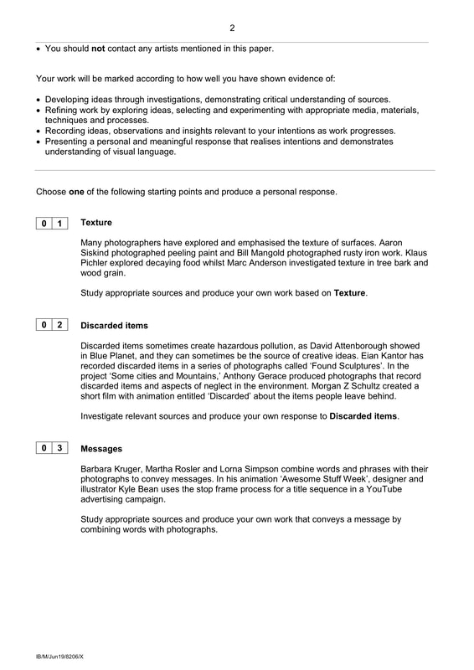
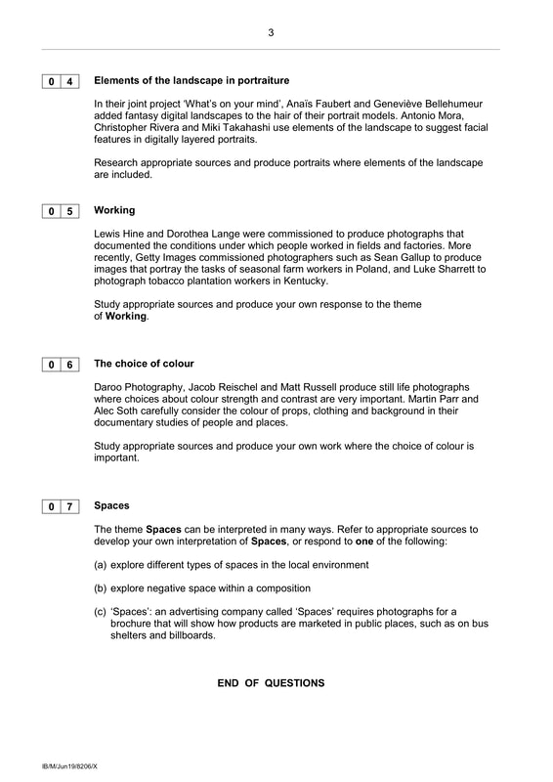

Slide 3
AQA GCSE Photography Exam 2019
• Following the preparatory period, you will have 10 hours of supervised time to complete your personal response.
• You may refer to your preparatory work during the supervised time, but the work must not be added to or amended once this time starts.

Slide 4
Here is some advice and a few things you should include in your response to the Externally Set Task:
Choose only ONE starting point. Choose carefully and don't change your mind later.
Read the prompts very carefully. Highlight the key words. Look at the named photographers' work. What aspects of photography are you being encouraged to explore - a genre or genres (e.g. still life, landscape, portraiture etc.), an aspect of visual language (e.g. colour, composition, pattern etc.), a social issue (the environment, human relationships, protest etc.) or something else?

Slide 5
Begin by writing down/mind-mapping your initial thoughts about this starting point.
These will probably change/develop during your research so it's a good idea to record your first thoughts so you can compare them with your later (more sophisticated) thoughts.

Slide 6
Research ALL of the named photographers in detail
Avoid superficial Google image searches and NEVER copy text from the Internet. Think hard about the photographer's work - what have you learned about it and how has this helped you develop your ideas?

Slide 7
Find useful quotations and respond to them.
You might not agree. You ought to have your own thoughts about them.

Slide 8
Try to add a new photo shoot (of 10-30 pictures) each week to your sketchbook
Evaluate your work thoughtfully identifying clearly what you have learned, what you might do more of and what you might avoid doing in future.

Slide 9
Refer to the Threshold Concepts and associated resources.
Which big ideas about photography are you investigating?

Slide 10
images
Select individual images (at high resolution), add them to your sketchbook and write about them in detail using this guide to help you.

Slide 11
Experiment thoughtfully
This could include: refining your photographs in Photoshop (remember to screen shot your process); printing and adapting/collaging your photographs using different media; thinking about the scale of your photographs; experimenting with the scanner/photocopier; projecting your photographs onto different surfaces at different sizes; working in the darkroom; making your own pinhole camera; working with film and analogue equipment; working with found/vintage photographs; creating slideshows/films/animations etc.

Slide 12
Leave plenty of time (at least two weeks) to prepare for the 10 hour Controlled Assessment.
You will have no access to the Internet during the Controlled Assessment so make sure your project ends sensibly e.g. with a plan for what you intend to do during the 10 hours. Make sure you have everything ready - all of the images you plan to use, a Powerpoint/Publisher document set up to document your work during the 10 hours (screenshots etc.), a USB key or hard drive to transfer images/files, bookings for particular equipment/resources you will need etc.

Slide 13
AQA GCSE Photography Exam 2019

Slide 14
Assessment Objectives
Your work will be marked according to how well you have shown evidence of:
AO1 - Developing ideas through investigations, demonstrating critical understanding of sources.
AO2 - Refining work by exploring ideas, selecting and experimenting with appropriate media, materials,
techniques and processes.
AO3 - Recording ideas, observations and insights relevant to your intentions as work progresses.
AO4 - Presenting a personal and meaningful response that realises intentions and demonstrates understanding of visual language.

Slide 15
Starting points
Choose one of the following starting points and produce a personal response.
1 - Texture
2 - Discarded items
3 - Messages
4 - Elements of the landscape in portraiture
5 - Working
6 - The choice of colour
7 - Spaces

Slide 16
1. Texture
Many photographers have explored and emphasised the texture of surfaces. Aaron Siskind photographed peeling paint and Bill Mangold photographed rusty iron work. Klaus Pichler explored decaying food whilst Marc Anderson investigated texture in tree bark and wood grain. Study appropriate sources and produce your own work based on Texture.

Slide 17
The camera should be used for a recording of life, for rendering the very substance and quintessence of the thing itself, whether it be polished steel or palpitating flesh. ​-- Edward Weston, 1924
Some other suggested resources: The Surface of Things PhotoPedagogy resource. Making sense of photography PhotoPedagogy resource. ​A large archive of Aaron Siskind images at the Centre for Creative Photography. Brassai's Graffiti series. Brett Weston's Abstractions series. Irving Penn's Cigarettes close-ups. Mel Bochner's Transparent and Opaque series. Billy Kydd's Decaying Leaves. Moyra Davey's Copperhead series. Stephen Gill's Hackney Flowers. A video about Nicholas Nixon's New Work, featuring close-up portraits of himself and his wife. The self portraits of John Coplans. John Batho's Papiers Lumières. Brendan Austin's Paper Mountains. Hélène Binet's Ground. Maija Savolainen's Arrangements.

Slide 18
Some questions
Why are photographs so good at recording the textured surfaces of things?
How does reflected light help us to see textures?
Which senses are activated by textures?
Can printed photographs have their own texture?

Slide 19
1: Texture
Many photographers have explored and emphasised the texture of surfaces.
Aaron Siskind photographed peeling paint

Slide 20
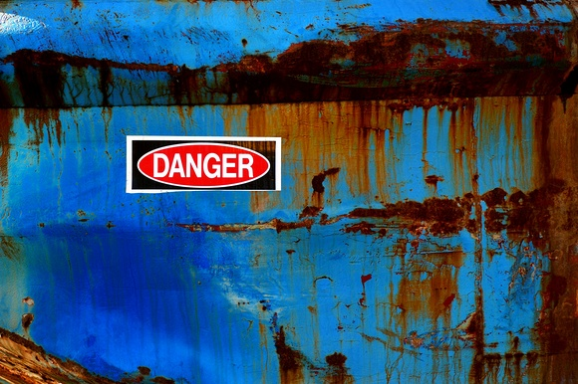
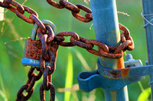
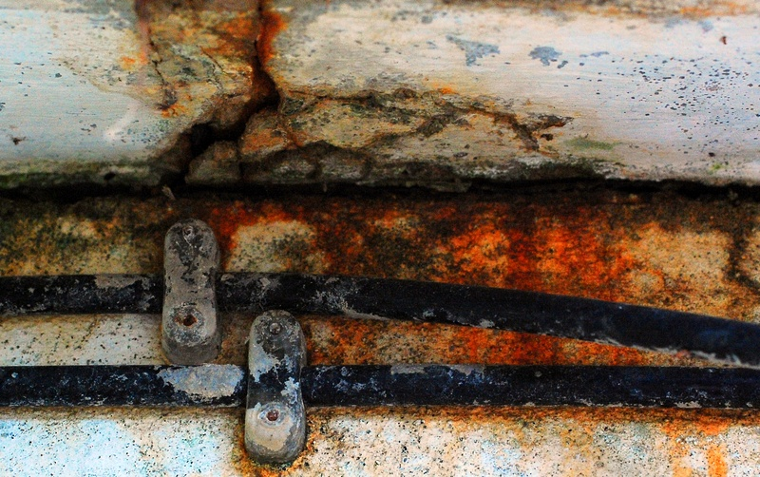
1: Texture
Bill Mangold photographed rusty iron work.

Slide 21
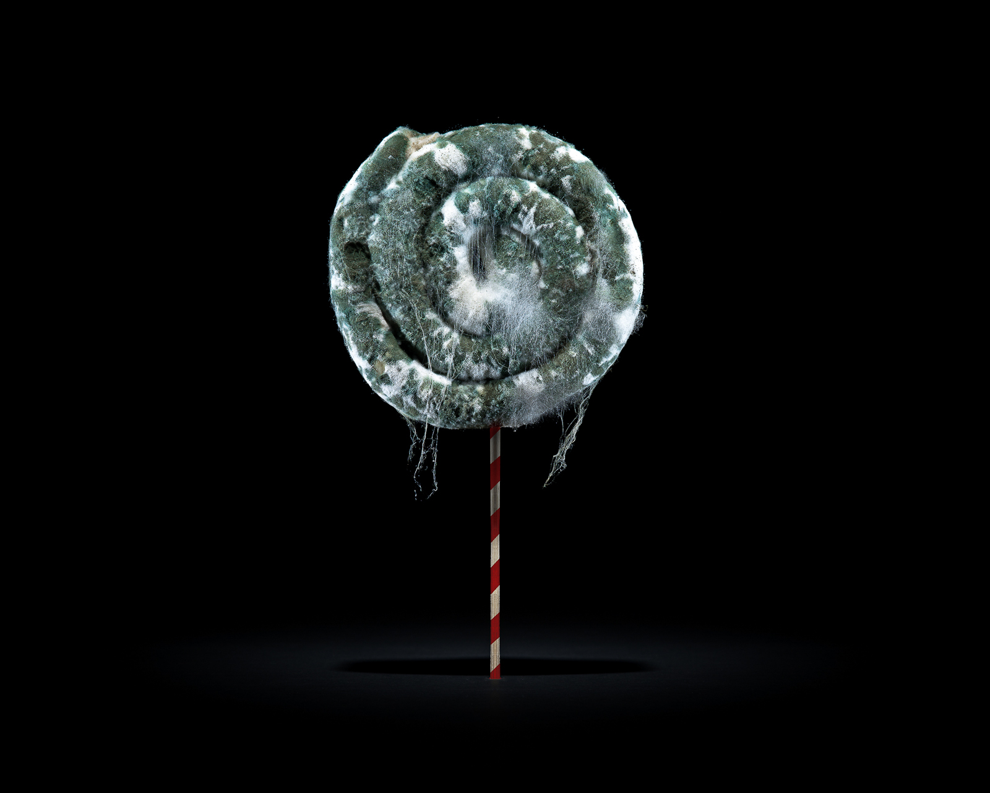
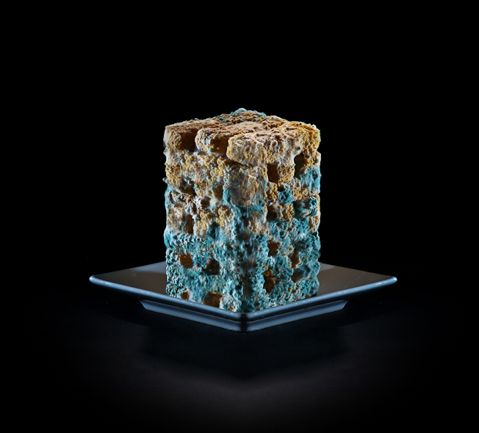
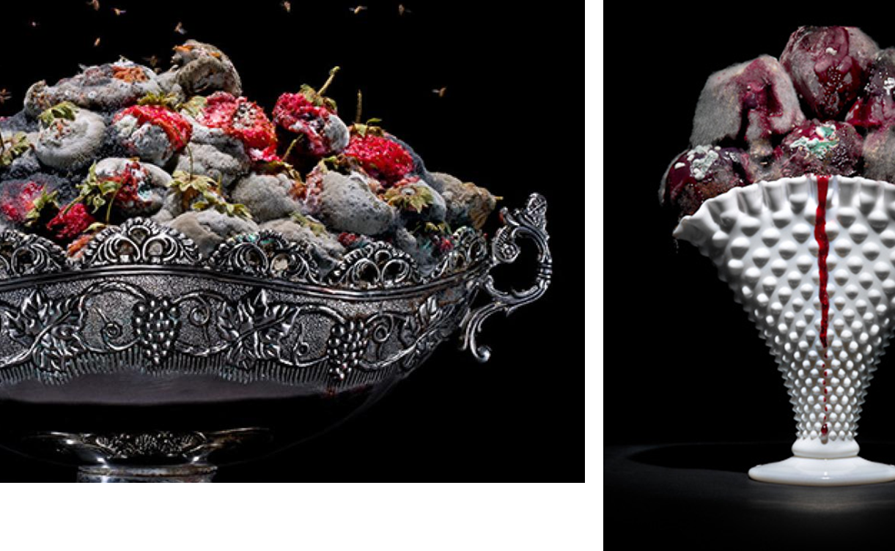
1: Texture
Klaus Pichler explored decaying food

Slide 22
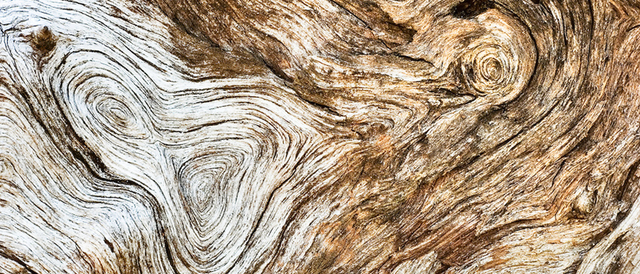
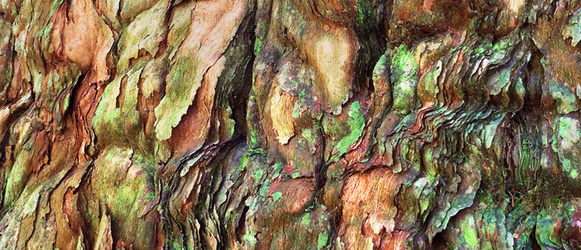
1: Texture
Many photographers have explored and emphasised the texture of surfaces.
Marc Anderson investigated texture in tree bark and wood grain.

Slide 23
2. Discarded items
Discarded items sometimes create hazardous pollution, as David Attenborough showed in Blue Planet, and they can sometimes be the source of creative ideas. Eian Kantorhas recorded discarded items in a series of photographs called ‘Found Sculptures’. In the project ‘Some cities and Mountains,’ Anthony Gerace produced photographs that record discarded items and aspects of neglect in the environment. Morgan Z Schultz created a short film with animation entitled ‘Discarded’ about the items people leave behind. Investigate relevant sources and produce your own response to Discarded items.

Slide 24
Some other suggested resources:
The photosculptures of Alina Szapocznikow. Keith Arnatt's Pictures From a Rubbish Tip. ​​Peter Fraser's Everyday Icons and Nazraeli Monograph. Stephen Gill's A Series of Disappointments. Gabriel Orozco's Asterisms and this great article about his practice. Peter Coles' Canivaux series. The Golden Sack by photographer Rut Blees Luxemburg and writer Michael Salu. Michael Wolf's Lost Laundry, and My Favourite Thing - Groups. ​Liam Frankland's Lost and Found photography project. Alan R. Jones' Orphaned Objects. Erik Burg's Found and The Party's Over. Kevin Newark's Protoplasm series. Danny Treacy's Those series. Matt Russell's Waste series. Barry Rosenthal's Found in Nature series. Hong Hao's My Things No. 5 - 5000 pieces of Rubbish

Slide 25
Some questions:
​Why might photographers be drawn to the things people leave behind?
Why do we create so much waste and what does this say about human life?
How does the act of making a photograph transform the found, mundane or discarded object into something remarkable or marvellous?

Slide 26
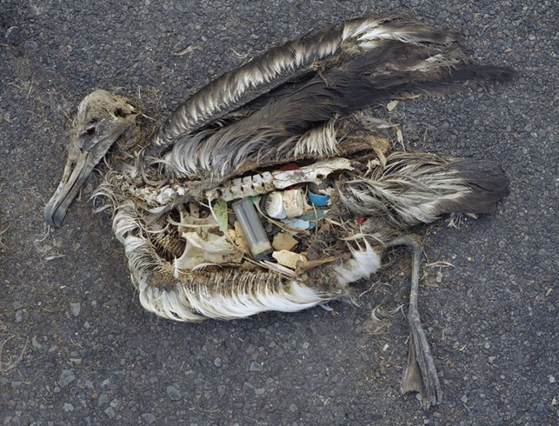
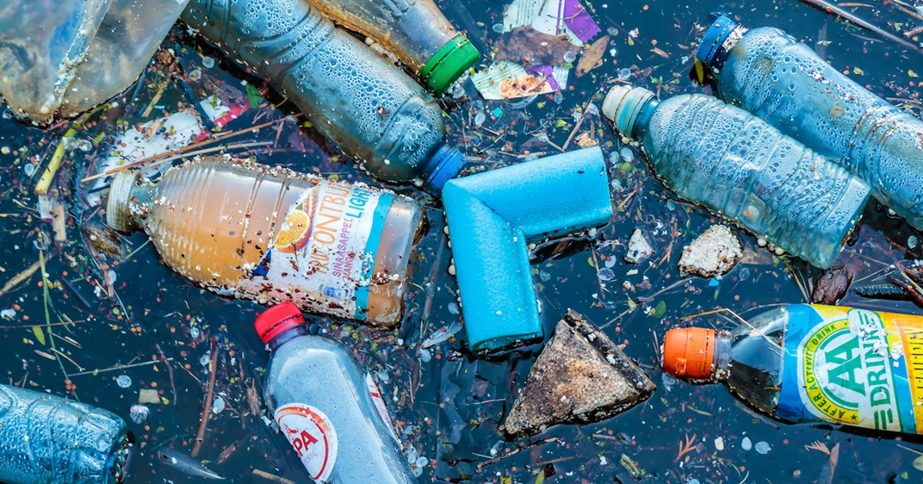
2: Discarded items
David Attenborough showed in Blue Planet, and they can sometimes be the source of creative ideas.
Discarded items sometimes create hazardous pollution

Slide 27
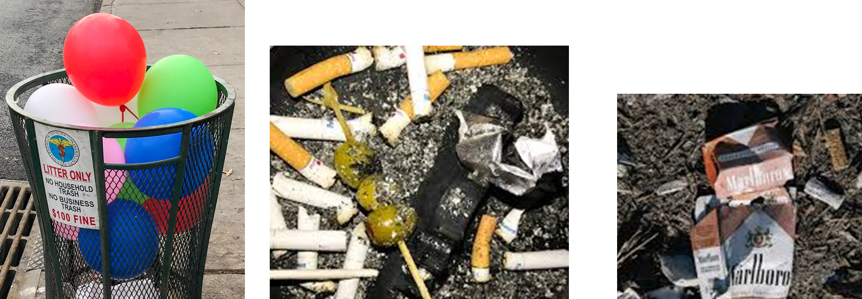
Eian Kantor has recorded discarded items in a series of photographs called ‘Found Sculptures’.

Slide 28
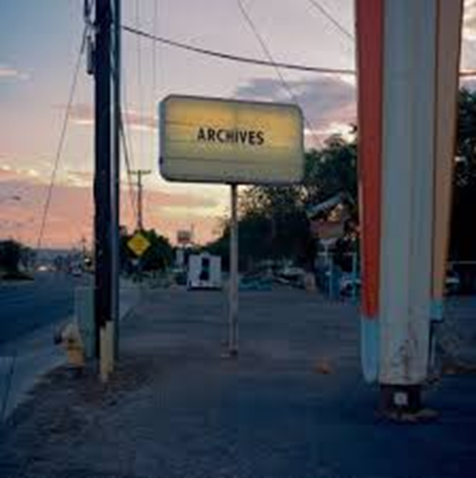
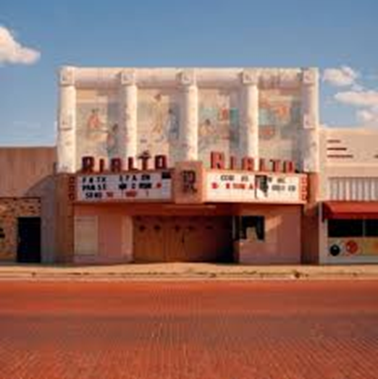
2: Discarded items
In the project ‘Some cities and Mountains,’ Anthony Gerace produced photographs that record discarded items and aspects of neglect in the environment.
Discarded items sometimes create hazardous pollution

Slide 29
2: Discarded items
https – Click Here
Morgan Z Schultz created a short film with animation entitled ‘Discarded’ about the items people leave behind.

Slide 30
3. messages
Barbara Kruger, Martha Rosler and Lorna Simpson combine words and phrases with their photographs to convey messages. In his animation ‘Awesome Stuff Week’, designer and illustrator Kyle Bean uses the stop frame process for a title sequence in a YouTube advertising campaign. Study appropriate sources and produce your own work that conveys a message by combining words with photographs.

Slide 31
Some other suggested resources:
Threshold Concept #7 ​Lee Friedlander's Letters From the People Duane Michals' Photographs with Text. Pencil Story by John Baldessari and other works by Baldessari. ​Hamish Fulton's Wind Through the Pines. ​A film about Sophie Calle's Take Care of Yourself. An interview with Taryn Simon about her work A Living Man Declared Dead and Other Chapters I-XVIII. Lou Reed on Robert Frank's Sick of Boodbys and his later photographs taken in New York and Nova Scotia. The painted photographs of François-Marie Banier Gillian Wearing's Signs that Say What You Want Them To Say and Not Signs that Say What Someone Else Wants You To Say. This strange video about a workshop run by the photographer Jason Fulford. Teju Cole's book Blind Spot. Jim Goldberg's use of text and image and a film about his famous book Raised by Wolves. Lindsay Bottos' Anonymous project. Stefan Sagmeister's Things I have Learned In My Life So Far. ​Olaf Breuning's Complaining Forest and Can Someone Tell Us Why We Are Here?

Slide 32
Some questions:
How can the meanings of photographs be altered by accompanying text?
How can texts be affected by accompanying photographs?
How might you experiment with additional titles and/or captions to manipulate the meanings of photographs?
What happens when text appears on the surface of or combined with photographs?
In what ways are words and photographs types of abstract sign?

Slide 33
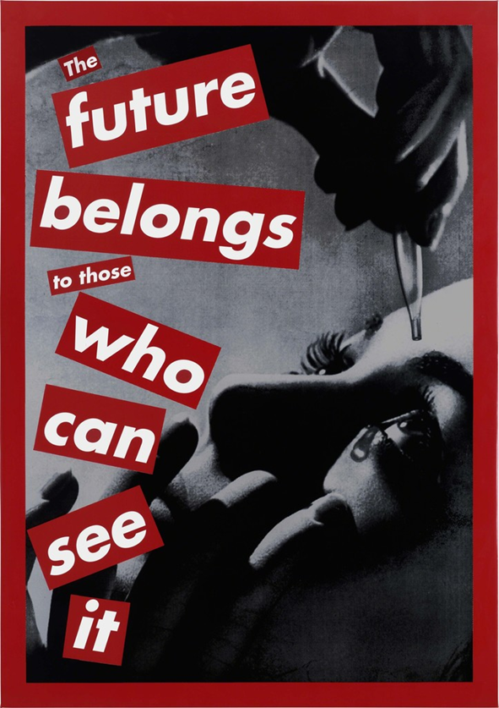
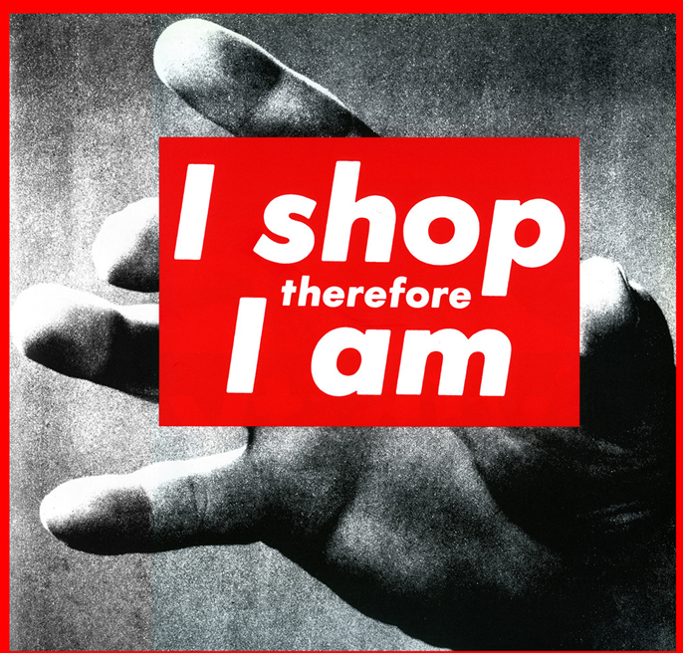
3:Messages
Barbara Kruger, combine words and phrases with her photographs to convey messages.

Slide 34
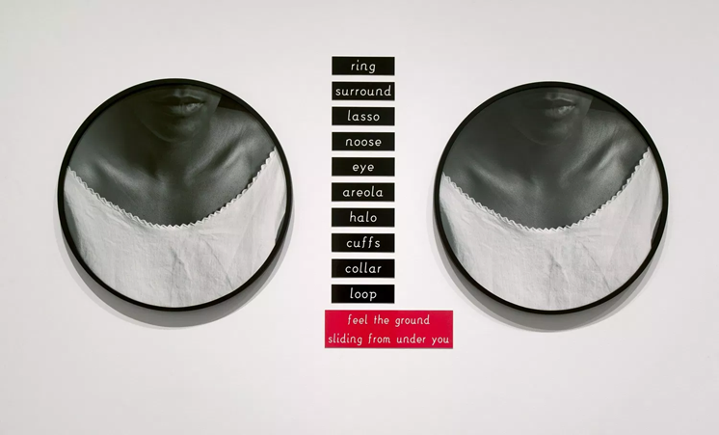
3:Messages
Lorna Simpson combine words and phrases with her
photographs to convey messages.

Slide 35
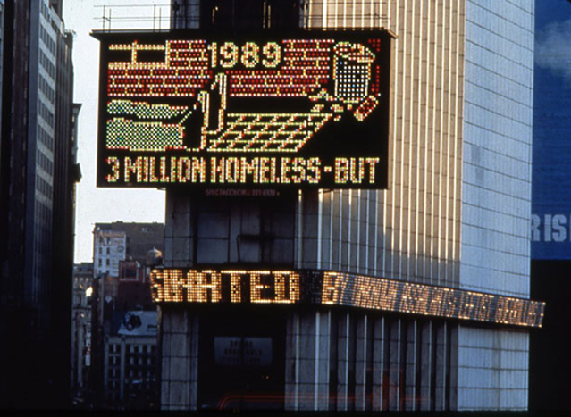
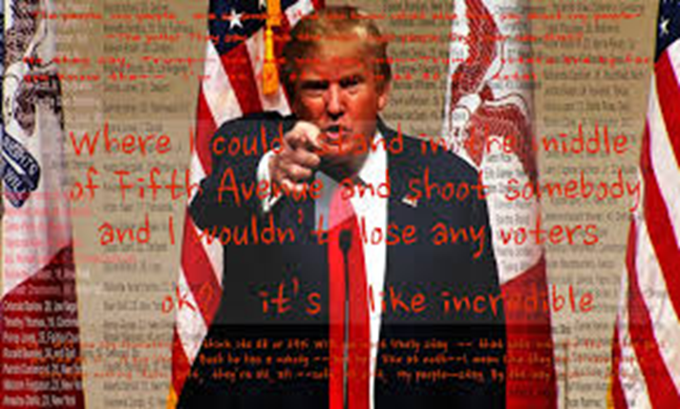
3:Messages
Martha Rosler combine words and phrases with her
photographs to convey messages.

Slide 36
https://kylebean.co.uk/portfolio/googlestuffweek
In his animation ‘Awesome Stuff Week’, designer and illustrator Kyle Bean uses the stop frame process for a title sequence in a YouTube advertising campaign.

Slide 37
4. Elements of the landscape in portraiture
In their joint project ‘What’s on your mind’, Anaïs Faubert and Geneviève Bellehumeur added fantasy digital landscapes to the hair of their portrait models. Antonio Mora, Christopher Rivera and Miki Takahashi use elements of the landscape to suggest facial features in digitally layered portraits. Research appropriate sources and produce portraits where elements of the landscape are included.
​N.B. You are strongly advised to avoid this starting point.

Slide 38
5. Working
Lewis Hine and Dorothea Lange were commissioned to produce photographs that documented the conditions under which people worked in fields and factories. More recently, Getty Images commissioned photographers such as Sean Gallup to produce images that portray the tasks of seasonal farm workers in Poland, and Luke Sharrett to photograph tobacco plantation workers in Kentucky. Study appropriate sources and produce your own response to the theme of Working.

Slide 39
Some other suggested resources:
A wonderful film interview with Dorothea Lange about her life and career. The Farm Security Administration's collection of photographs (featuring work by Lange and many others during the 1930's Depression. François Kollar's A Working Eye. ​Women War Workers of the North West. W. Eugene Smith's photographs of Pittsburgh. Lee Friedlander's At Work. Paul Graham's Beyond Caring. Anna Fox's Work Stations. Polly Braden's London's Square Mile. Alain Delorme's Totems. Glen McClure's Portraits of Shipyard Workers. Chris Crisman's Women's Work. Jamie Reid's Work and Play. Nigel Shafran's Supermarket Portraits.

Slide 40
Some questions:
Can photographs capture what it feels like to be a worker?
How can photographs help to improve people's lives by capturing their working conditions?
Can/do photographs present a positive view of work and workers?
What kind of work is involved in making photographs?

Slide 41
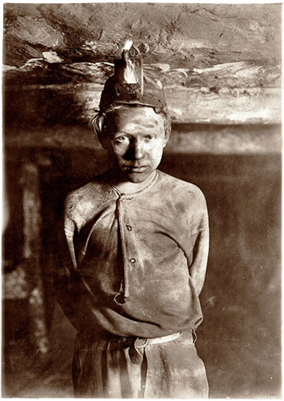
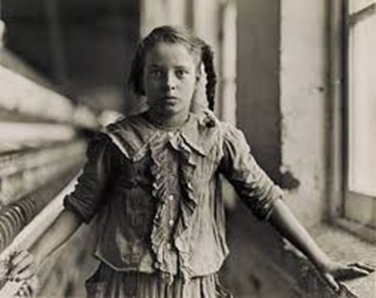
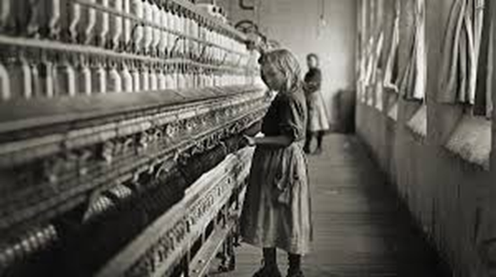
Lewis Hine was commissioned to produce photographs that documented the conditions under which people worked in fields and factories

Slide 42
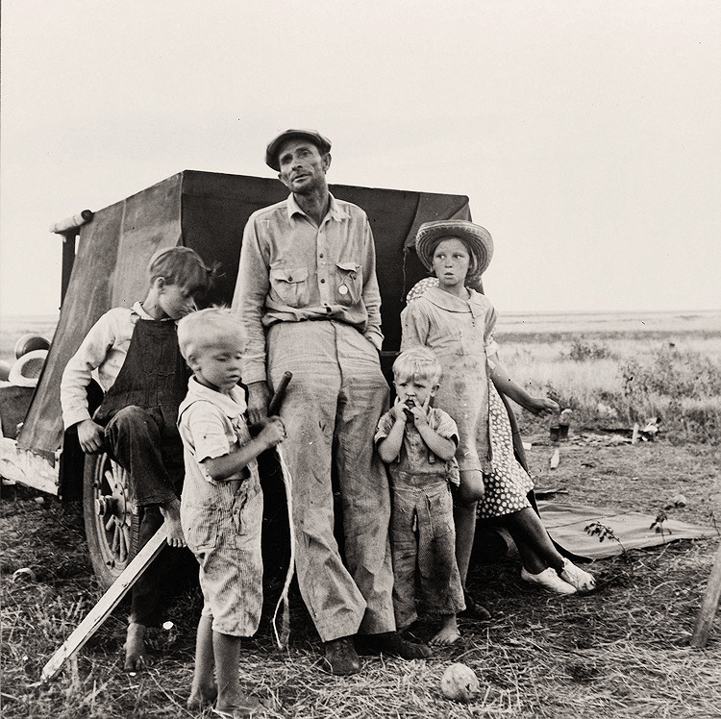
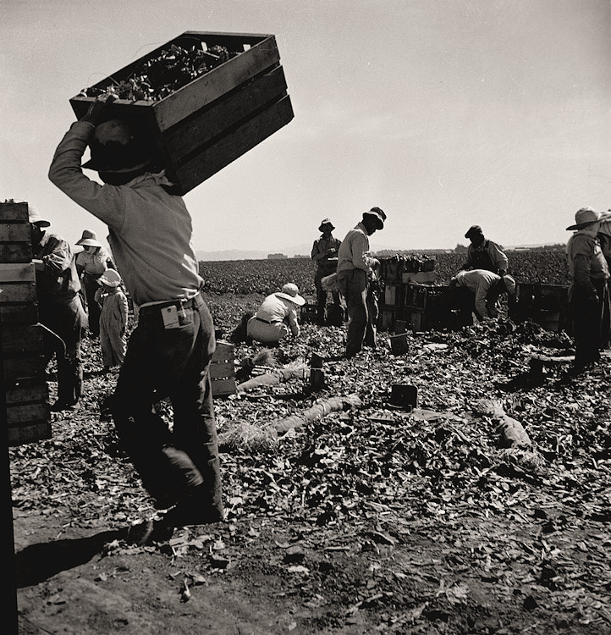
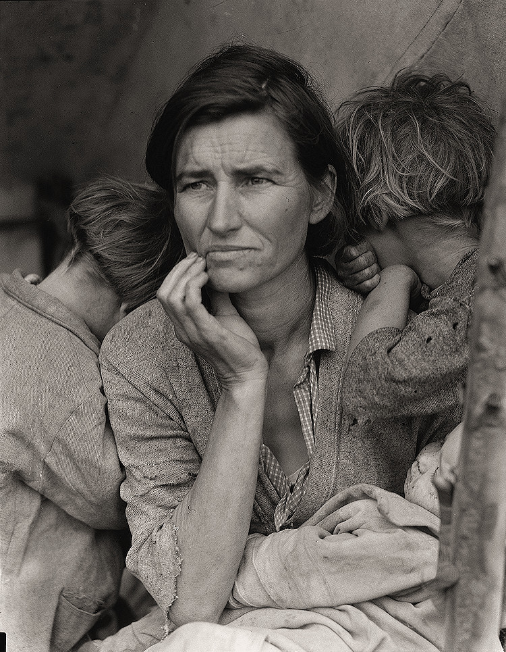
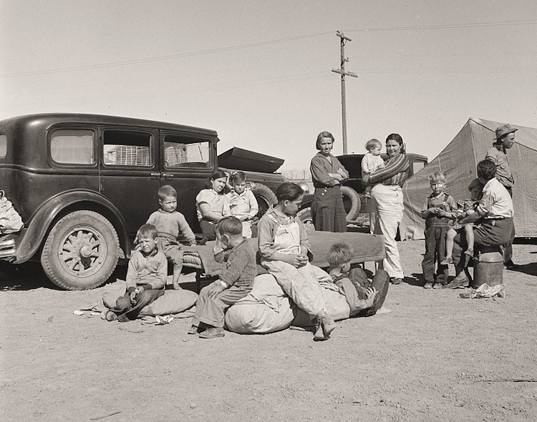
Working
Dorothea Lange was commissioned to produce photographs that documented the conditions under which people worked in fields and factories.

Slide 43
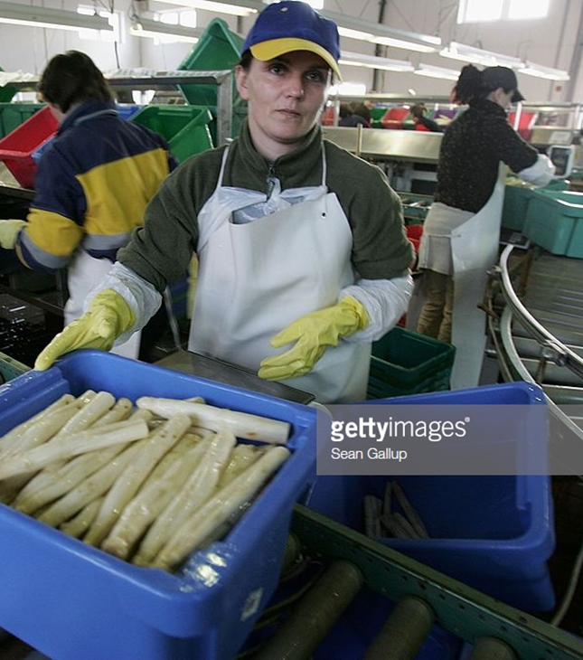
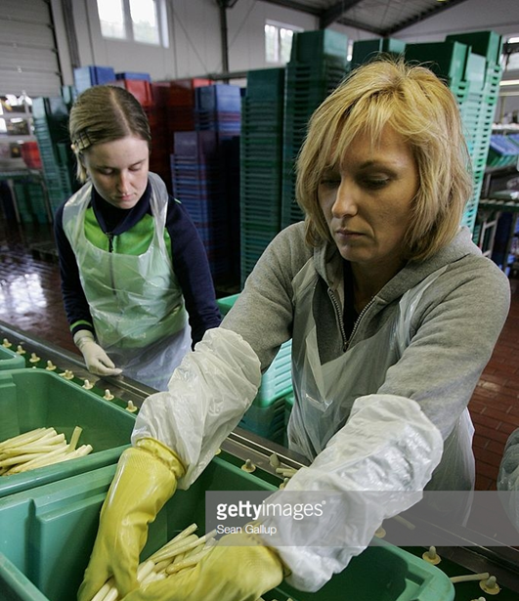
Working
Getty Images commissioned photographers such as Sean Gallup to produce images that portray the tasks of seasonal farm workers in Poland.

Slide 44
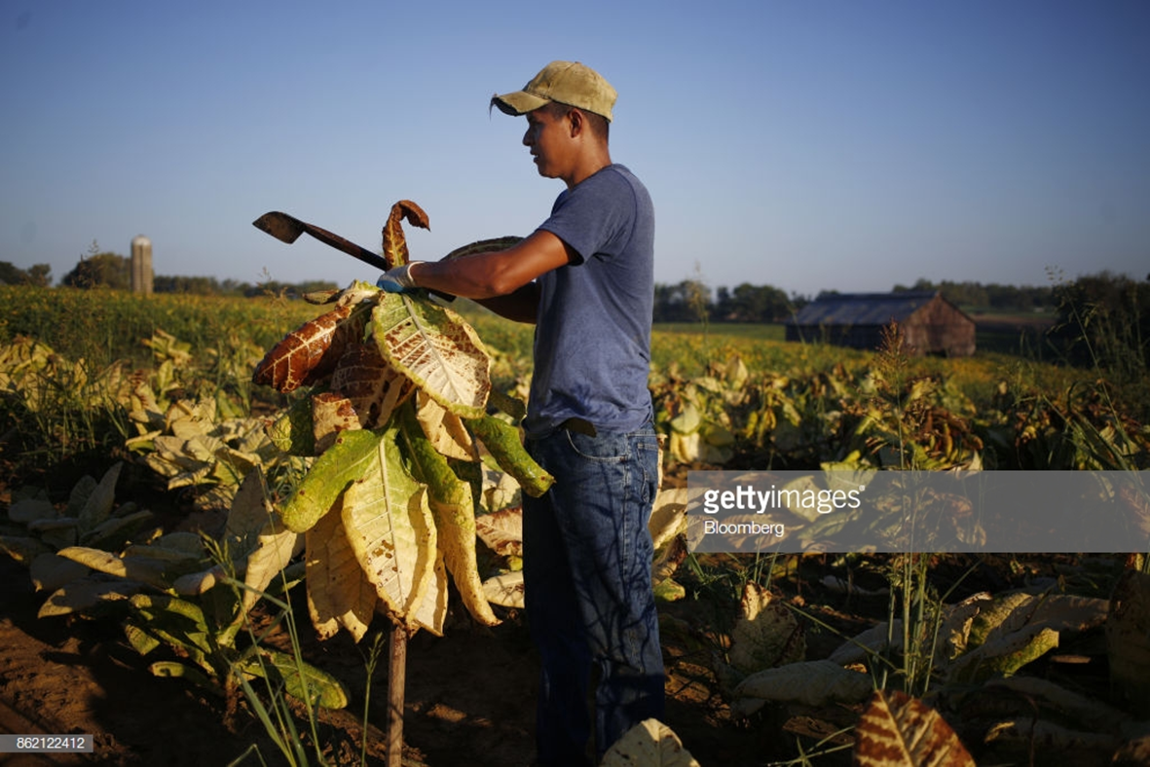
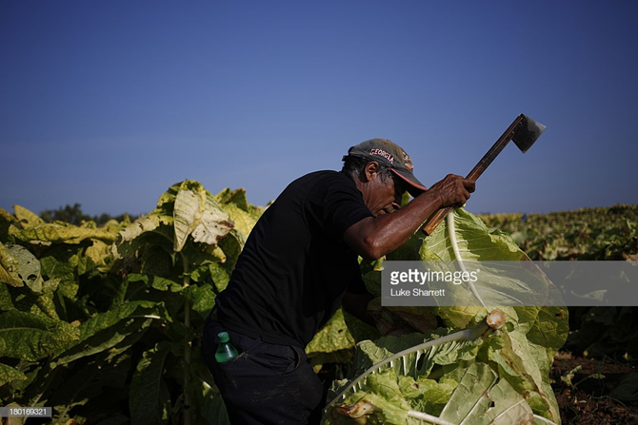
working
Luke Sharrett photographed tobacco plantation workers in Kentucky

Slide 45
6. The choice of colour
Daroo Photography, Jacob Reischel and Matt Russell produce still life photographs where choices about colour strength and contrast are very important. Martin Parr and Alec Soth carefully consider the colour of props, clothing and background in their documentary studies of people and places. ​Study appropriate sources and produce your own work where the choice of colour is important.

Slide 46
Some other suggested resources:
​Contemporary Still Life photography and Vanitas. Lorenzo Vitturi Dalston Anatomy. Erin O'Keefe Built Work. Scheltens and Abbenes The Sink. Barbara Kasten Collision. Contemporary documentary photographers article from the V&A. Mitch Epstein's The City. Paul Graham A New Europe. Julian Germain's For Every Minute You Are Angry You Lose Sixty Seconds Of Happiness. Stefanie Moshammer's Land of Black Milk. Peter Fraser Mathematics.

Slide 47
Some questions
Why is colour photography so successful in advertising? Why have (art) photographers been suspicious of colour in photography until quite recently?
How does colour affect our senses? How do colour combinations work?
How can photographers use colour theory to help them compose/construct their images?

Slide 48
The Choice Of Colour
Daroo Photography produces still life photographs where choices about colour strength and contrast are very important. Click the photo to get Daroo web link

Slide 49
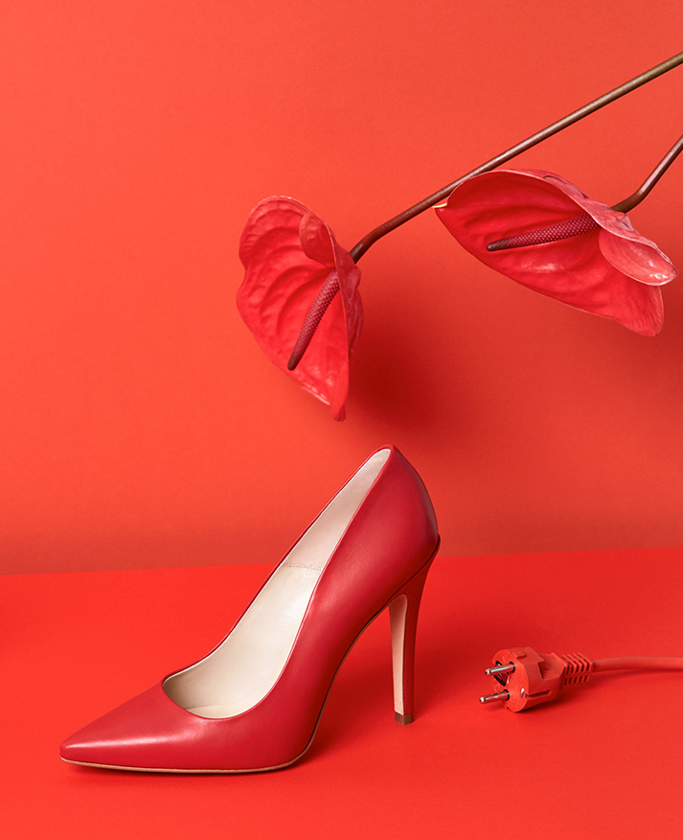
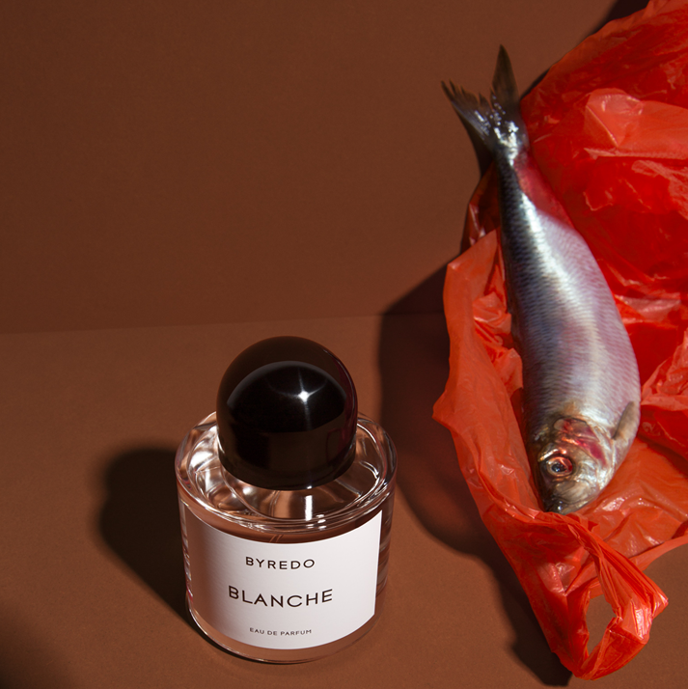
The Choice Of Colour
Jacob Reischel produces still life photographs
where choices about colour strength and contrast are very important.

Slide 50
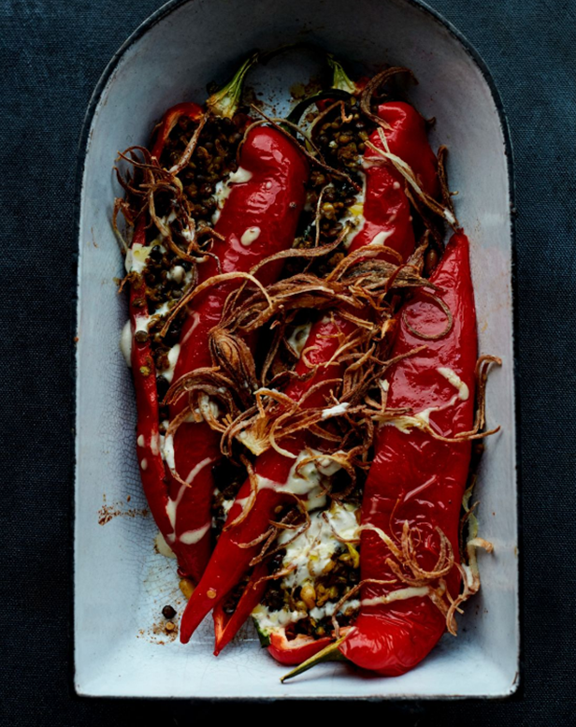
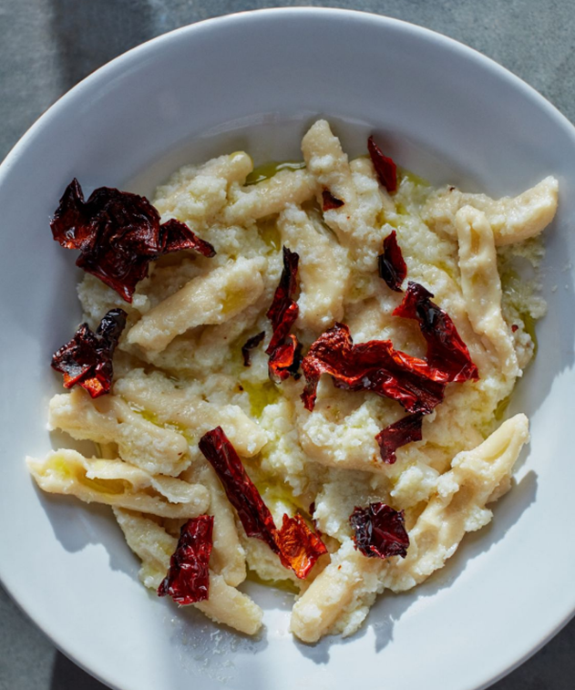
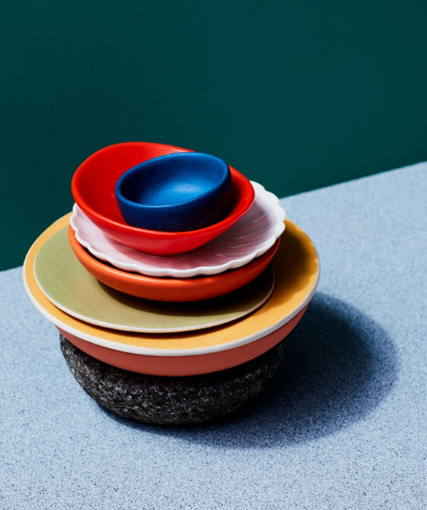
The Choice Of Colour
Matt Russell produces still life photographs
where choices about colour strength and contrast are very important.

Slide 51
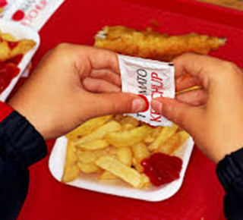
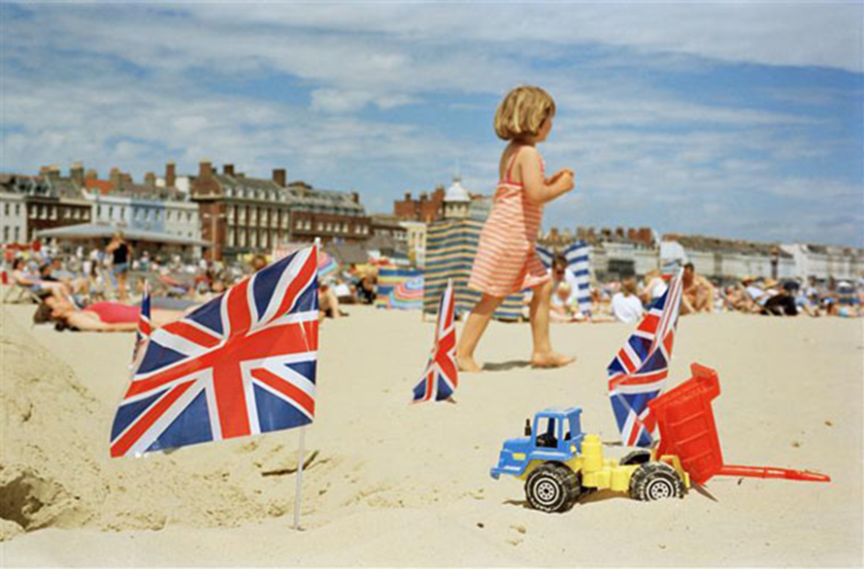
The Choice Of Colour
Martin Parr, carefully considers the colour of props, clothing and background in his documentary studies of people and places.

Slide 52
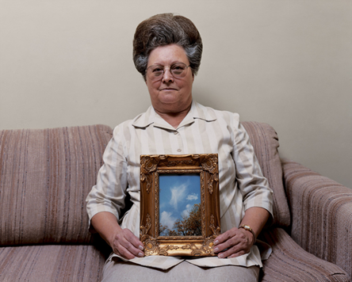
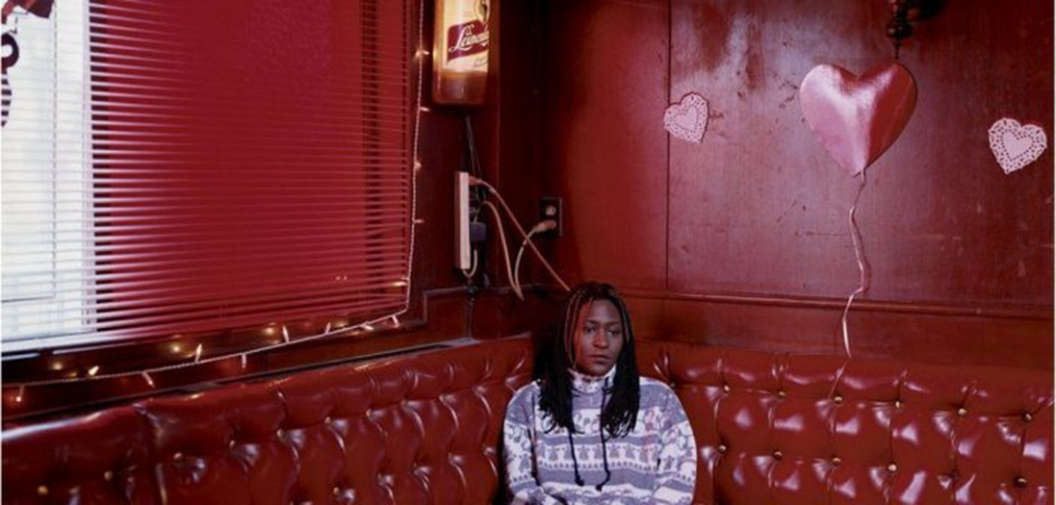
The Choice Of Colour
Alec Soth, carefully considers the colour of props, clothing and background in their
documentary studies of people and places.

Slide 53
7. Spaces
The theme Spaces can be interpreted in many ways. Refer to appropriate sources to develop your own interpretation of Spaces, or respond to one of the following:
(a) explore different types of spaces in the local environment
(b) explore negative space within a composition
(c) ‘Spaces’: an advertising company called ‘Spaces’ requires photographs for a brochure that will show how products are marketed in public places, such as on bus shelters and billboards.

Slide 54
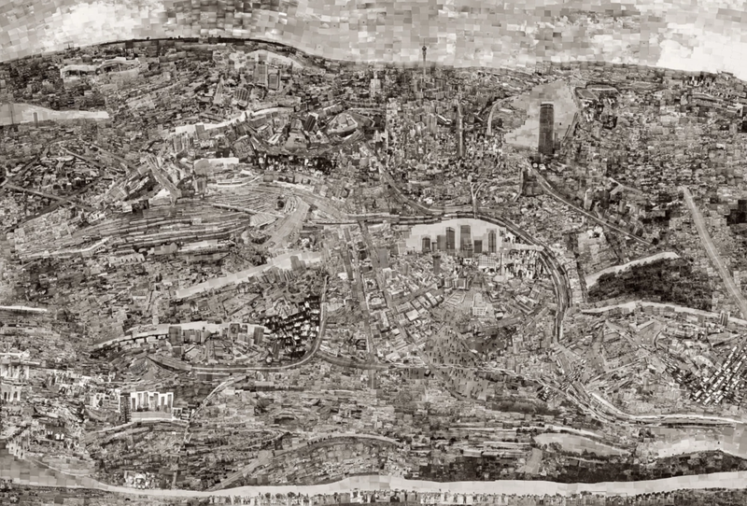
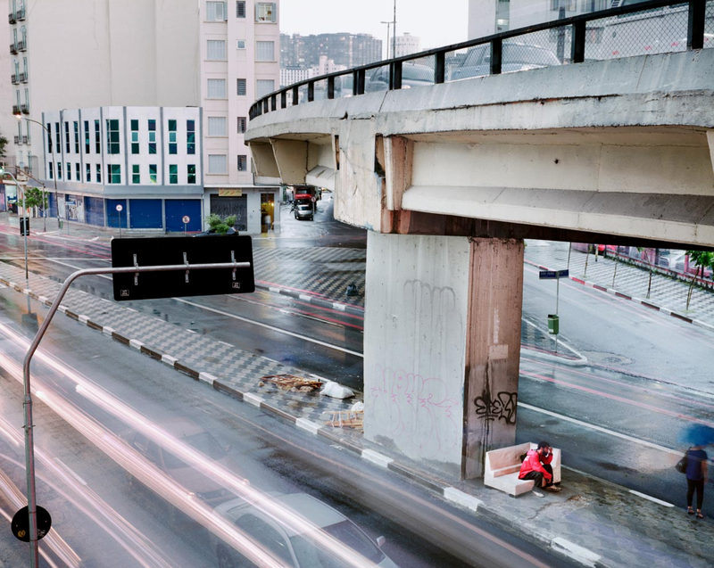
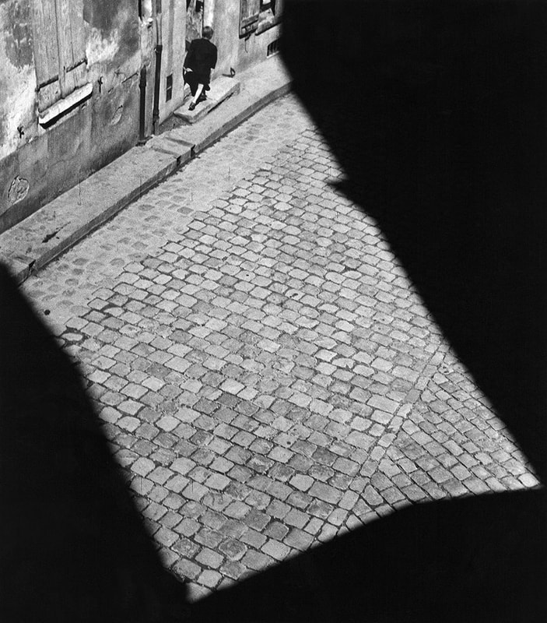
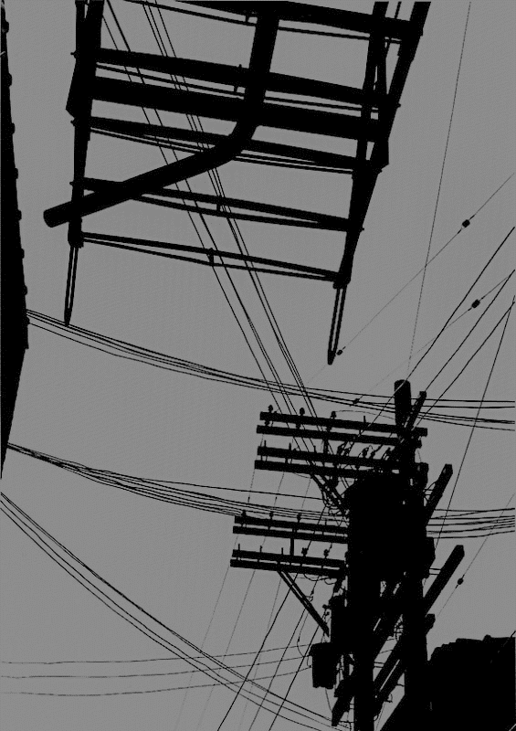
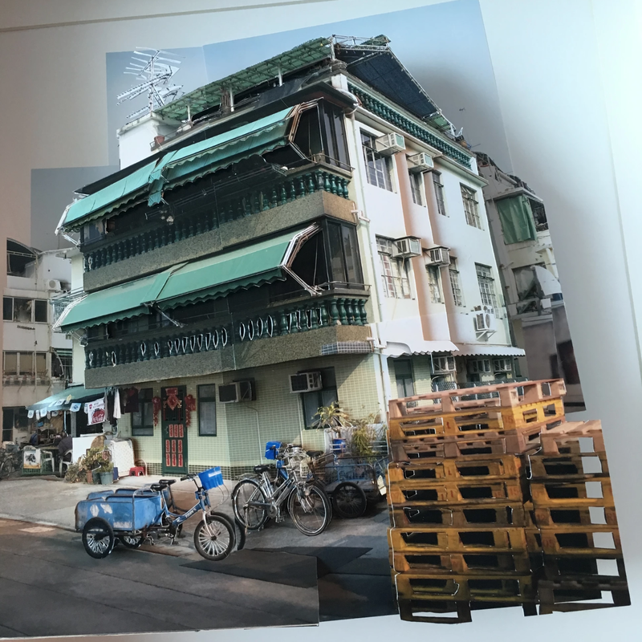
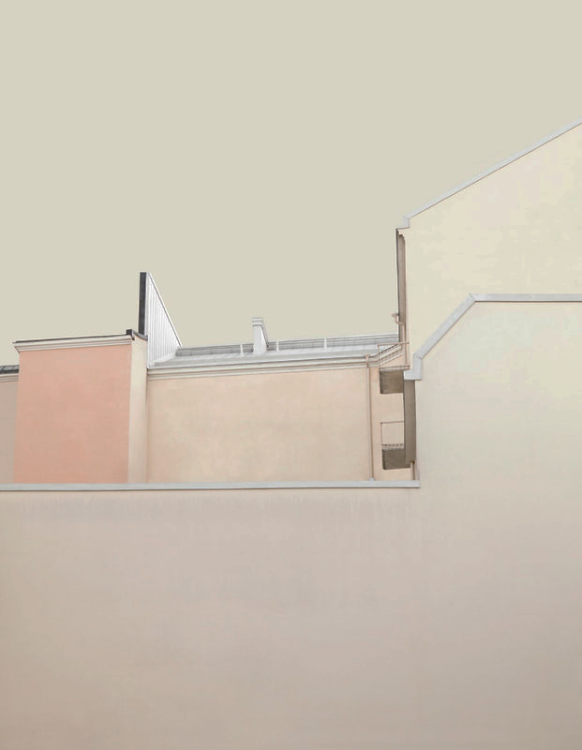
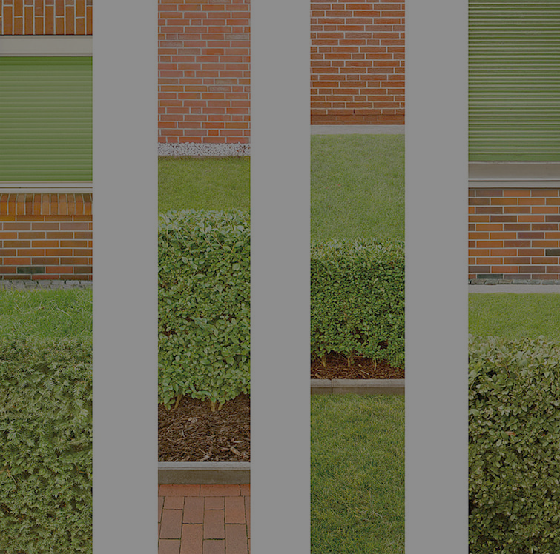
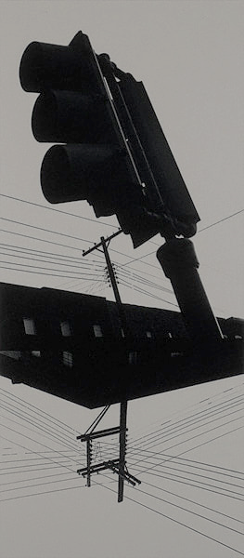
Some suggested resources
Martin Roemer’s
‘Metropolis’
series
Sohei Nishino’s Map Dioramas
Lucien Hervé’s architectural photographs
Harry Callahan ‘Chicago’
Keld Helmer-Petersen’s ‘Black Light’ and ‘Black Noise’’
Kimmo Metsäranta
‘Notes on a Place’
Menno Aden’s
‘Tracks and Fields’
Camille Levert’s 3D photo-
collages
Ray Metzker’s
Cityscapes
Christian
Rhum’s
‘Denial’
series
Wen Hang Lin
‘The Riff of Silence
Espen Dietrichson’s Collages
Nicky Hirst’s
#elemental63 on instagram
Wolfgang Tillmans’ ‘Book for Architects’
Matthias Heiderich’s Berlin
Takashi Homma’s book ‘The Narcissistic City
Franco Fontana’s ‘Asphalt’ series
Abigail Reynolds’ Cut and Folded Book Pages

