Slide 1
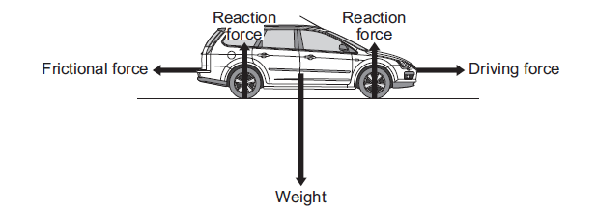
10 Minutes on ...
Acceleration and Motion
Use the equation, Acceleration = Change in Speed ÷ Time, to calculate the examples below:
Change in speed = 14 m/s; time taken = 2 seconds. Calculate the acceleration.
A car accelerates from rest (zero speed) up to a speed of 30 m/s in 12 seconds. Calculate the acceleration.
A cyclist in the Tour de France accelerates down a hill from 22 m/s to a speed of 37 m/s. This acceleration takes him 2 seconds. Calculate the acceleration.
Describe what is happening in each of the velocity-time graphs.
Exam question (use Bullet points):
Describe how the horizontal forces acting on the car change during the first two seconds of the acceleration. (3 Mark)
……………………………………………………………………………………………….
……………………………………………………………………………………………….
……………………………………………………………………………………………….
……………………………………………………………………………………………….
……………………………………………………………………………………………….
……………………………………………………………………………………………….

