Slide 1
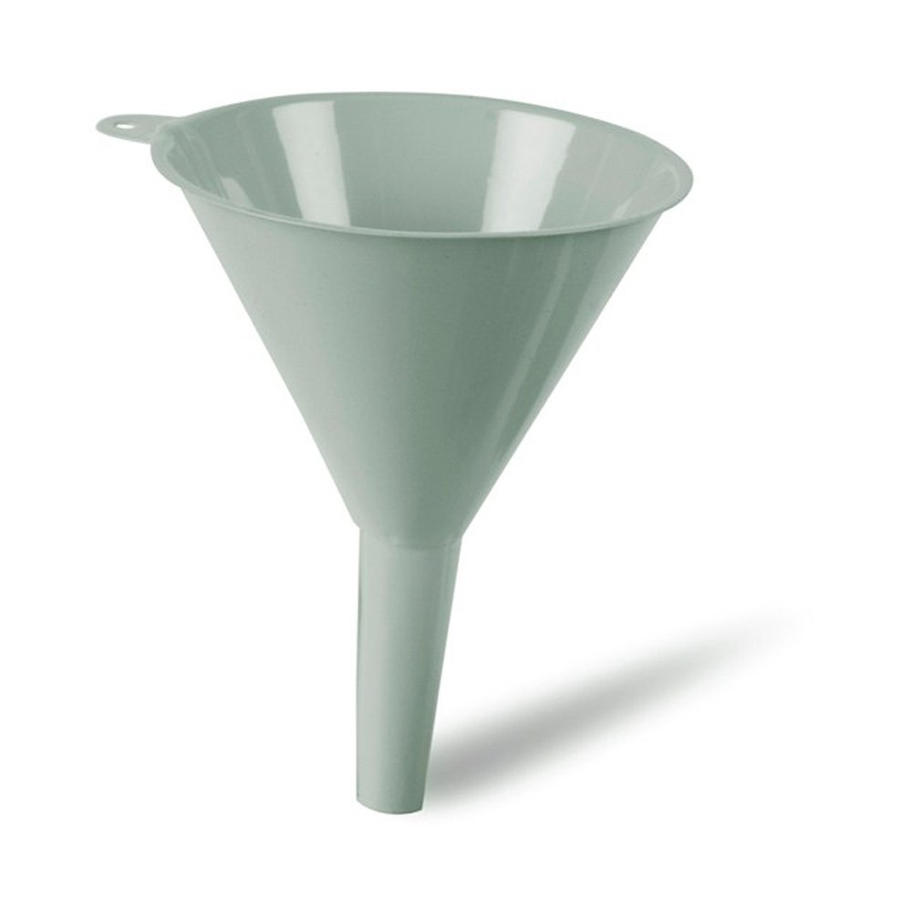
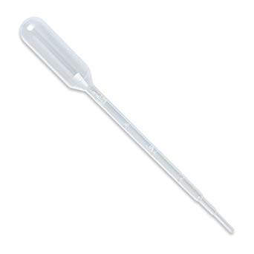
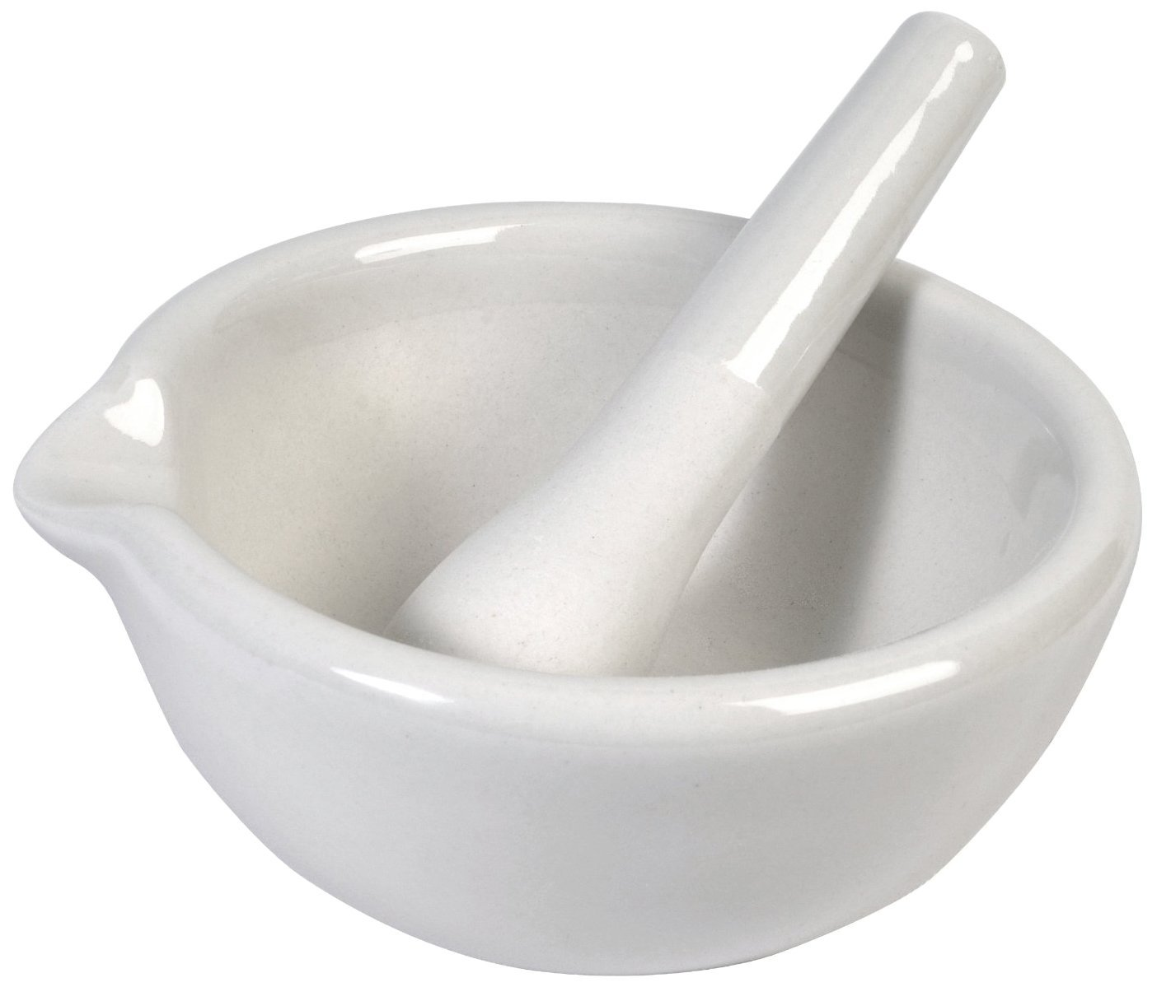
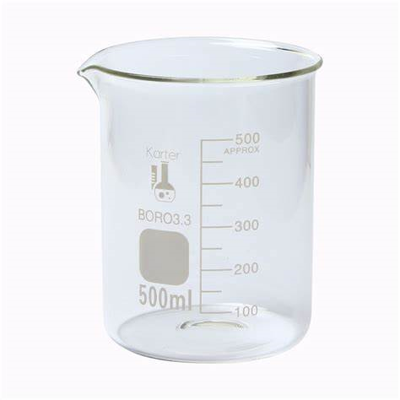
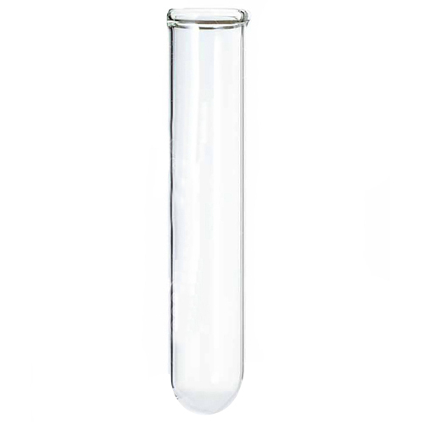
Food Tests RP
10 Minutes on ...
Identify the pieces of equipment.
Use the information to identify the nutrient present in the sample of food:
Sample 1 - Turns blue/black with iodine.
Sample 2 – Solution turns red/green with Benedict's solution.
Sample 3 – Red stained oil layer with Sudan (III)
Sample 4 – Biuret solution turns purple.
Exam question (use Bullet points):
Describe how you would test a sample of food to show it contains protein. (4 Marks) .………………………………………………………………………………………………
……………………………………………………………………………………………….
……………………………………………………………………………………………….
……………………………………………………………………………………………….
……………………………………………………………………………………………….
……………………………………………………………………………………………….

