Slide 1
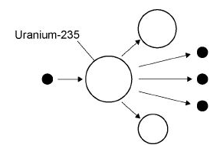
Nuclear Fission and Fusion
10 Minutes on ...
Describe what happens during a chain reaction using the diagram below:
Compare the processes of nuclear fusion and nuclear fission.
Nuclear Fusion | Nuclear Fission
Exam question (use Bullet points):
The control rods, made from boron, are used to control the chain reaction. Boron atoms absorb neutrons without undergoing nuclear fission.
Why does lowering the control rods reduce the amount of energy released each second from the nuclear fuel? (2 Marks) ..……………………………………………………………………………………………..
……………………………………………………………………………………………….
……………………………………………………………………………………………….
……………………………………………………………………………………………….
……………………………………………………………………………………………….
……………………………………………………………………………………………….
……………………………………………………………………………………………….
……………………………………………………………………………………………….
……………………………………………………………………………………………….

