Slide 1
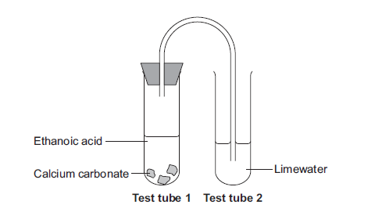
Gas Tests
10 Minutes on ...
Match the gas test to the outcome.
Chlorine
Squeaky Pop
Oxygen
Re-light a glowing splint
Hydrogen
Bleaches litmus paper.
Carbon Dioxide
Limewater turns cloudy
Describe a change that would be seen in each test tube.
Exam question (use Bullet points):
The chemist added hydrochloric acid to low sodium salt. Carbon dioxide gas was produced.
Describe the test for carbon dioxide and give the result of the test.
(2 Marks) ..……………………………………………………………………………………………...
……………………………………………………………………………………………….
……………………………………………………………………………………………….
……………………………………………………………………………………………….
……………………………………………………………………………………………….
……………………………………………………………………………………………….

