Slide 1
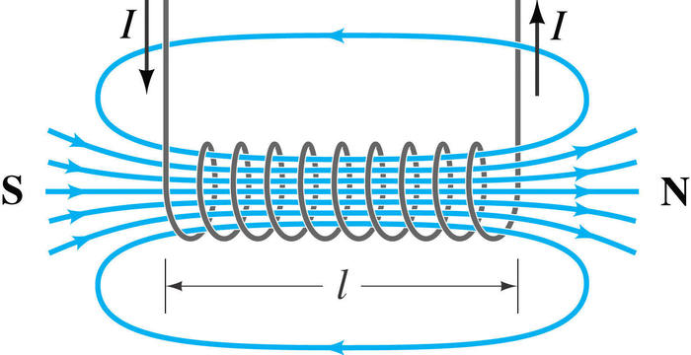
10 Minutes on ...
Magnetism
Describe the difference between a permanent magnet and an induced magnet.:
Sketch the magnetic field for a bar magnet and label the poles and direction of the magnetic field.
Describe the properties of the solenoid using the diagram below.
Exam question (use Bullet points):
Describe how to plot the magnetic field pattern of a bar magnet.. (3 Mark)
……………………………………………………………………………………………….
……………………………………………………………………………………………….
……………………………………………………………………………………………….
……………………………………………………………………………………………….
……………………………………………………………………………………………….
……………………………………………………………………………………………….
……………………………………………………………………………………………….
……………………………………………………………………………………………….

