Slide 1
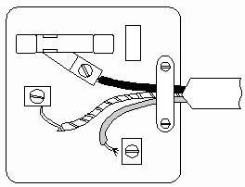
Mains Electricity
10 Minutes on ...
Label the structure of the plug with the following key terms: Earth, Live, Neutral, Fuse.
For each of the wires, state the colour of the wire.
Construct a flow diagram to show the structure of the National Grid.
Exam question (use Bullet points):
Some electrical appliances use electricity from the mains supply and some use electricity from a battery.
(a) Explain the differences between the current supplied by the mains supply and the current supplied by a battery. (2 Marks) ..……………………………………………………………………………………………..
……………………………………………………………………………………………….
……………………………………………………………………………………………….
……………………………………………………………………………………………….
……………………………………………………………………………………………….
……………………………………………………………………………………………….

