Slide 1
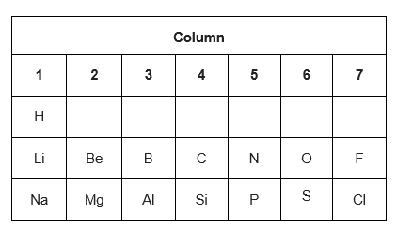
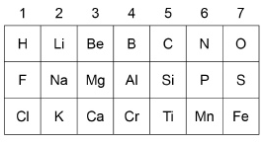
Periodic Table (History)
10 Minutes on ...
List 2 improvements that Mendeleev made to Newlands original Periodic table:
1.
2.
Compare Mendeleev and Newlands Periodic tables.
Mendeleev | Newlands
Exam question (use Bullet points):
When Mendeleev was developing his periodic table he changed the order of some of the elements. Explain why..(2 Marks) .………………………………………………………………………………………………
……………………………………………………………………………………………….
……………………………………………………………………………………………….
……………………………………………………………………………………………….
……………………………………………………………………………………………….
……………………………………………………………………………………………….
……………………………………………………………………………………………….

