Slide 1
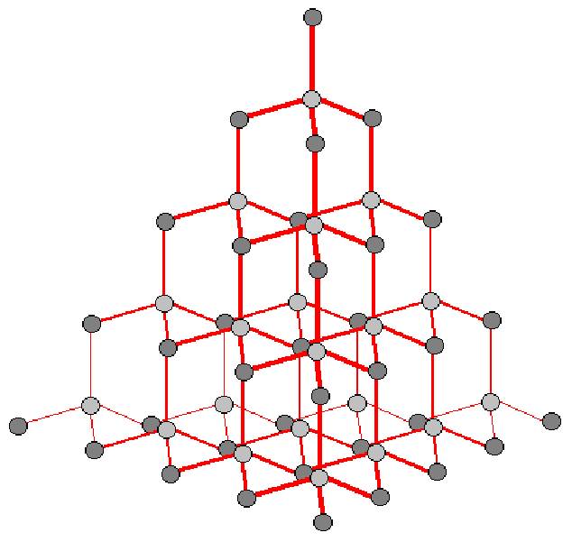
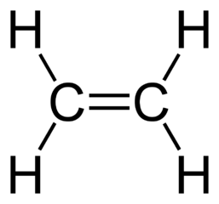
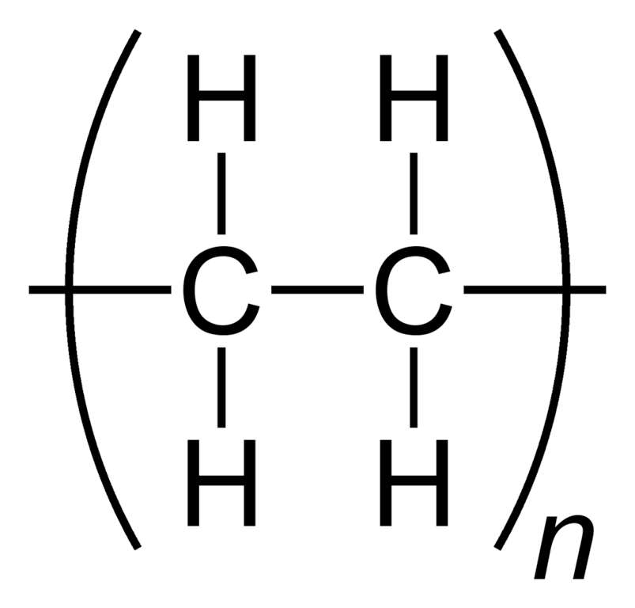
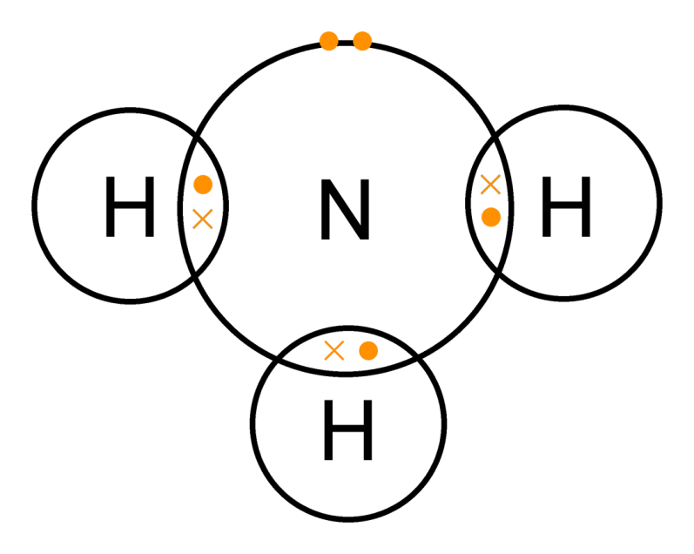
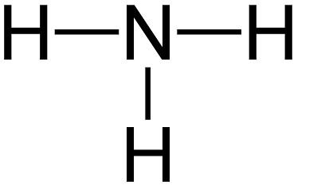
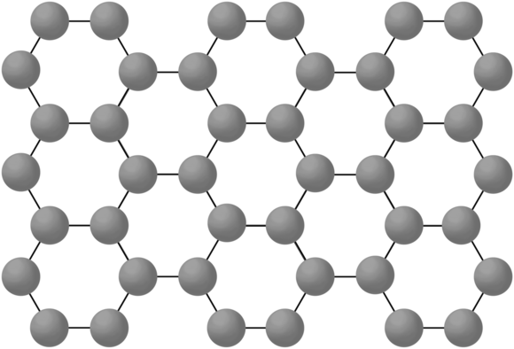
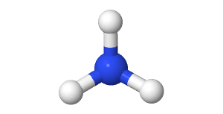
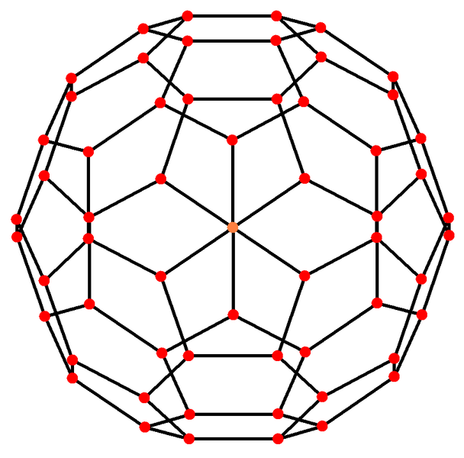
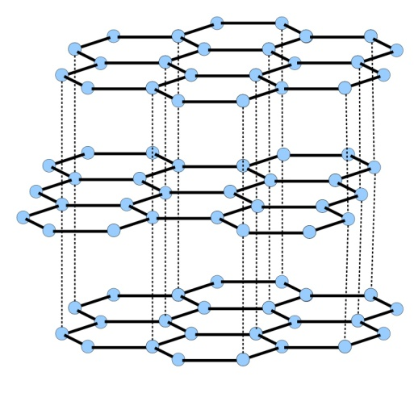
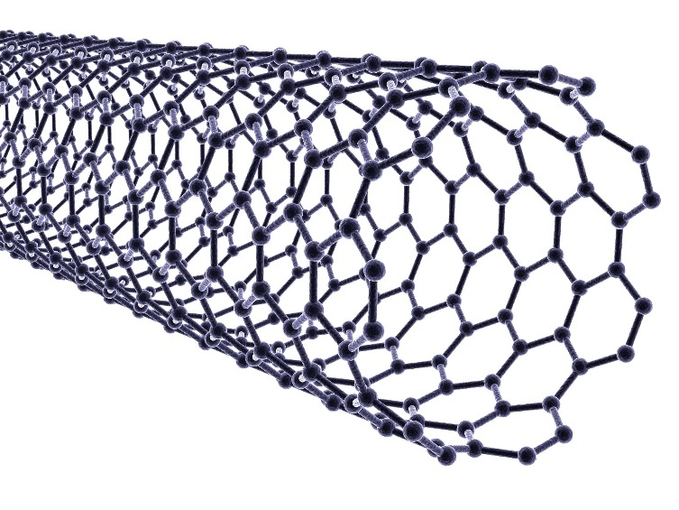
Each carbon atom is bonded to four others |  | Very hard. | Rigid structure.
 |  | Very high melting point. | Strong covalent bonds.
 |  | Does not conduct electricity. | No delocalised electrons.
Very large molecules | Solids at room temperature | Atoms are linked by strong covalent bonds.
Usually gases or liquids | Covalent bonds in the molecule are strong but forces between molecules (intermolecular) are weak | Low melting and boiling points. | Due to having weak intermolecular forces that easily broken.
 |  | Do not conduct electricity. | Due to them molecules not having an overall electrical charge.
 |  | Larger molecules have higher melting and boiling points. | Intermolecular forces increase with the size of the molecules.
Polymers
Diamond
Diamond, graphite, silicon dioxide | Very high melting points | Lots of energy needed to break strong, covalent bonds.
Giant covalent structures
AQA
BONDING, STRUCTURE AND THE PROPERTIES OF MATTER 2
Atoms share pairs of electrons | Can be small molecules e.g. ammonia
 | Can be giant covalent structures e.g. polymers
Properties of small molecules
Dot and cross :
+ Show which atom the
electrons in the bonds come
from
- All electrons are identical
Covalent bonding
Size of particles and their properties (Chemistry only)
2D with bonds:
+ Show which atoms are bonded together
- It shows the H-C-H bond
incorrectly at 90°
Graphene | Single layer of graphite one atom thick | Excellent conductor. | Contains delocalised electrons.
 |  | Very strong. | Contains strong covalent bonds.
Nanoparticles | Between 1 and 100 nanometres (nm) in size | 1 nanometre (1 nm) = 1 x 10⁻⁹ metres (0.000 000 001m or a billionth of a metre).
Graphene and fullerenes
3D ball and stick model:
+ Attempts to show the H-C-H bond angle is 109.5°
Use of nanoparticles
Healthcare, cosmetics, sun cream, catalysts, deodorants, electronics. | Nanoparticles may be toxic to people. They may be able to enter the brain from the bloodstream and cause harm.
Fullerenes |  | Buckminsterfullerene, C₆₀ First fullerene to be discovered. | Hexagonal rings of carbon atoms with hollow shapes. Can also have rings of five (pentagonal) or seven (heptagonal) carbon atoms.
Graphite
Each carbon atom is bonded to three others forming layers of hexagonal rings with no covalent bonds between the layers |  | Slippery. | Layers can slide over each other.
 |  | Very high melting point. | Strong covalent bonds.
 |  | Does conduct electricity. | Delocalised electrons between layers.
Carbon nanotubes |  | Very thin and long cylindrical fullerenes | Very conductive. | Used in electronics industry.
 |  |  | High tensile strength. | Reinforcing composite materials.
 |  |  | Large surface area to volume ratio. | Catalysts and lubricants.

Slide 2
 |  | Very hard. | Rigid structure.
 |  | Very high melting point. | Strong covalent bonds.
 |  | Does not conduct electricity. | No delocalised electrons.
 | Solids at room temperature | Atoms are linked by strong covalent bonds.
 | Covalent bonds in the molecule are strong but forces between molecules (intermolecular) are weak | Low melting and boiling points. | Due to having weak intermolecular forces that easily broken.
 |  | Do not conduct electricity. | Due to them molecules not having an overall electrical charge.
 |  | Larger molecules have higher melting and boiling points. | Intermolecular forces increase with the size of the molecules.
Polymers
Diamond
 | Very high melting points | Lots of energy needed to break strong, covalent bonds.
Giant covalent structures
AQA
BONDING, STRUCTURE AND THE PROPERTIES OF MATTER 2
 | Can be small molecules e.g. ammonia
 | Can be giant covalent structures e.g. polymers
Properties of small molecules
Dot and cross :
+ Show which atom the
electrons in the bonds come
from
- All electrons are identical
Covalent bonding
Size of particles and their properties (Chemistry only)
2D with bonds:
+ Show which atoms are bonded together
- It shows the H-C-H bond
incorrectly at 90°
 | Single layer of graphite one atom thick | Excellent conductor. | Contains delocalised electrons.
 |  | Very strong. | Contains strong covalent bonds.
Nanoparticles | Between 1 and 100 nanometres (nm) in size | 1 nanometre (1 nm) = 1 x 10⁻⁹ metres (0.000 000 001m or a billionth of a metre).
Graphene and fullerenes
3D ball and stick model:
+ Attempts to show the H-C-H bond angle is 109.5°
Use of nanoparticles
Healthcare, cosmetics, sun cream, catalysts, deodorants, electronics. | Nanoparticles may be toxic to people. They may be able to enter the brain from the bloodstream and cause harm.
 |  | Buckminsterfullerene, C₆₀ First fullerene to be discovered. | Hexagonal rings of carbon atoms with hollow shapes. Can also have rings of five (pentagonal) or seven (heptagonal) carbon atoms.
Graphite
Each carbon atom is bonded to three others forming layers of hexagonal rings with no covalent bonds between the layers |  |  | Layers can slide over each other.
 |  |  | Strong covalent bonds.
 |  |  | Delocalised electrons between layers.
 |  | Very thin and long cylindrical fullerenes | Very conductive. | Used in electronics industry.
 |  |  | High tensile strength. | Reinforcing composite materials.
 |  |  | Large surface area to volume ratio. | Catalysts and lubricants.

Slide 3
 |  | Very hard. | Rigid structure.
 |  | Very high melting point. | Strong covalent bonds.
 |  | Does not conduct electricity. | No delocalised electrons.
 | Solids at room temperature
 |  | Low melting and boiling points. | Due to having weak intermolecular forces that easily broken.
 |  | Do not conduct electricity. | Due to them molecules not having an overall electrical charge.
 |  | Larger molecules have higher melting and boiling points. | Intermolecular forces increase with the size of the molecules.
Polymers
Diamond
 |  | Lots of energy needed to break strong, covalent bonds.
Giant covalent structures
AQA
BONDING, STRUCTURE AND THE PROPERTIES OF MATTER 2
Properties of small molecules
Dot and cross :
+ Show which atom the
electrons in the bonds come
from
- All electrons are identical
Covalent bonding
Size of particles and their properties (Chemistry only)
2D with bonds:
+ Show which atoms are bonded together
- It shows the H-C-H bond
incorrectly at 90°
 |  | Excellent conductor. | Contains delocalised electrons.
 |  | Very strong. | Contains strong covalent bonds.
Nanoparticles |  | 1 nanometre (1 nm) = 1 x 10⁻⁹ metres (0.000 000 001m or a billionth of a metre).
Graphene and fullerenes
3D ball and stick model:
+ Attempts to show the H-C-H bond angle is 109.5°
Use of nanoparticles
 | Nanoparticles may be toxic to people. They may be able to enter the brain from the bloodstream and cause harm.
 |  |  | Hexagonal rings of carbon atoms with hollow shapes. Can also have rings of five (pentagonal) or seven (heptagonal) carbon atoms.
Graphite
 |  |  | Layers can slide over each other.
 |  |  | Strong covalent bonds.
 |  |  | Delocalised electrons between layers.
 |  |  | Very conductive. | Used in electronics industry.
 |  |  | High tensile strength. | Reinforcing composite materials.
 |  |  | Large surface area to volume ratio. | Catalysts and lubricants.

Slide 4
Polymers
Diamond
Giant covalent structures
AQA
BONDING, STRUCTURE AND THE PROPERTIES OF MATTER 2
Properties of small molecules
Covalent bonding
Size of particles and their properties (Chemistry only)
Nanoparticles
Graphene and fullerenes
Use of nanoparticles
 | .
Graphite

