Slide 1
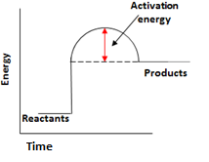
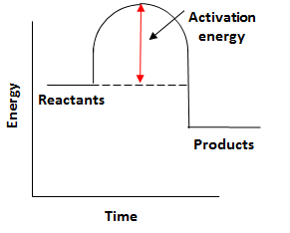
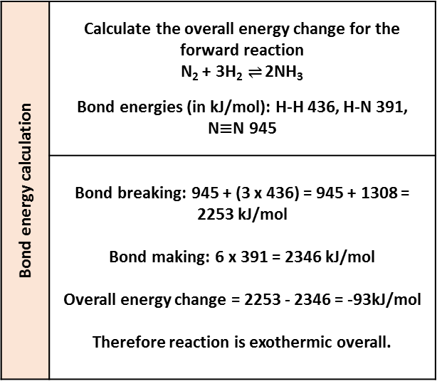
Endothermic | Energy is taken in from the surroundings so the temperature of the surroundings decreases | Thermal decomposition Sports injury packs
Exothermic | Energy is transferred to the surroundings so the temperature of the surroundings increases | Combustion Hand warmers Neutralisation
Ionic half equations | Negative electrode: 2H₂ (g) + 4OH⁻ (aq) → 4H₂O (l) + 4e⁻ | Positive electrode: O₂ (g) + 2H₂O (l) + 4e⁻ → 4OH⁻ (aq)
Hydrogen fuel cells | Word equation: hydrogen + oxygen → water | Symbol equation: 2H₂ + O₂ → 2H₂O
 | Advantages: No pollutants produced Can be a range of sizes | Disadvantages: Hydrogen is highly flammable Hydrogen is difficult to store
Reaction profiles | Show the overall energy change of a reaction
Types of reaction
Fuel cells (Chemistry only)
Breaking bonds in reactants | Endothermic process
Making bonds in products | Exothermic process
The energy change of reactions
(HT only)
AQA GCSE
Energy changes
Activation energy | Chemical reactions only happen when particles collide with sufficient energy | The minimum amount of energy that colliding particles must have in order to react is called the activation energy.
Reaction profiles
Overall energy change of a reaction | Exothermic | Energy released making new bonds is greater than the energy taken in breaking existing bonds.
 | Endothermic | Energy needed to break existing bonds is greater than the energy released making new bonds.
Cells and batteries
(Chemistry only)
Simple cell | Make a simple cell by connecting two different metals in contact with an electrolyte | Increase the voltage by increasing the reactivity difference between the two metals.
Batteries | Consist of two or more cells connected together in series to provide a greater voltage.
Endothermic |  | Products are at a higher energy level than the reactants. As the reactants form products, energy is transferred from the surroundings to the reaction mixture. The temperature of the surroundings decreases because energy is taken in during the reaction.
Exothermic |  | Products are at a lower energy level than the reactants. When the reactants form products, energy is transferred to the surroundings. The temperature of the surroundings increases because energy is released during the reaction.
Bond energy calculation | Calculate the overall energy change for the forward reaction N₂ + 3H₂ $⇌$ 2NH₃ Bond energies (in kJ/mol): H-H 436, H-N 391, N$≡$N 945
 | Bond breaking: 945 + (3 x 436) = 945 + 1308 = 2253 kJ/mol Bond making: 6 x 391 = 2346 kJ/mol Overall energy change = 2253 - 2346 = -93kJ/mol Therefore reaction is exothermic overall.
Non-rechargeable cells | Stop when one of the reactants has been used up | Alkaline batteries
Rechargeable cells | Can be recharged because the chemical reactions are reversed when an external electrical current is supplied | Rechargeable batteries

Slide 2
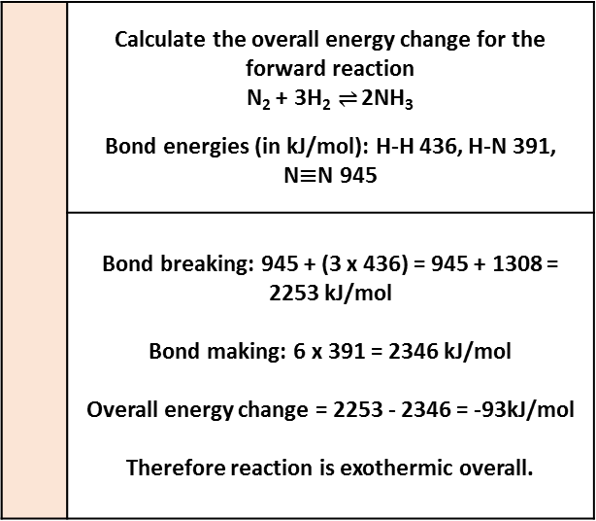
 | Energy is taken in from the surroundings so the temperature of the surroundings decreases | Thermal decomposition Sports injury packs
 | Energy is transferred to the surroundings so the temperature of the surroundings increases | Combustion Hand warmers Neutralisation
 | Negative electrode: 2H₂ (g) + 4OH⁻ (aq) → 4H₂O (l) + 4e⁻ | Positive electrode: O₂ (g) + 2H₂O (l) + 4e⁻ → 4OH⁻ (aq)
 | Word equation: hydrogen + oxygen → water | Symbol equation: 2H₂ + O₂ → 2H₂O
 | Advantages: No pollutants produced Can be a range of sizes | Disadvantages: Hydrogen is highly flammable Hydrogen is difficult to store
 | Show the overall energy change of a reaction
Types of reaction
Fuel cells (Chemistry only)
 | Endothermic process
 | Exothermic process
The energy change of reactions
(HT only)
AQA GCSE
Energy changes
 | Chemical reactions only happen when particles collide with sufficient energy | The minimum amount of energy that colliding particles must have in order to react is called the activation energy.
Reaction profiles
 | Exothermic | Energy released making new bonds is greater than the energy taken in breaking existing bonds.
 | Endothermic | Energy needed to break existing bonds is greater than the energy released making new bonds.
Cells and batteries
(Chemistry only)
 | Make a simple cell by connecting two different metals in contact with an electrolyte | Increase the voltage by increasing the reactivity difference between the two metals.
 | Consist of two or more cells connected together in series to provide a greater voltage.
 |  | Products are at a higher energy level than the reactants. As the reactants form products, energy is transferred from the surroundings to the reaction mixture. The temperature of the surroundings decreases because energy is taken in during the reaction.
 |  | Products are at a lower energy level than the reactants. When the reactants form products, energy is transferred to the surroundings. The temperature of the surroundings increases because energy is released during the reaction.
 | Calculate the overall energy change for the forward reaction N₂ + 3H₂ $⇌$ 2NH₃ Bond energies (in kJ/mol): H-H 436, H-N 391, N$≡$N 945
 | Bond breaking: 945 + (3 x 436) = 945 + 1308 = 2253 kJ/mol Bond making: 6 x 391 = 2346 kJ/mol Overall energy change = 2253 - 2346 = -93kJ/mol Therefore reaction is exothermic overall.
 | Stop when one of the reactants has been used up | Alkaline batteries
 | Can be recharged because the chemical reactions are reversed when an external electrical current is supplied | Rechargeable batteries

Slide 3
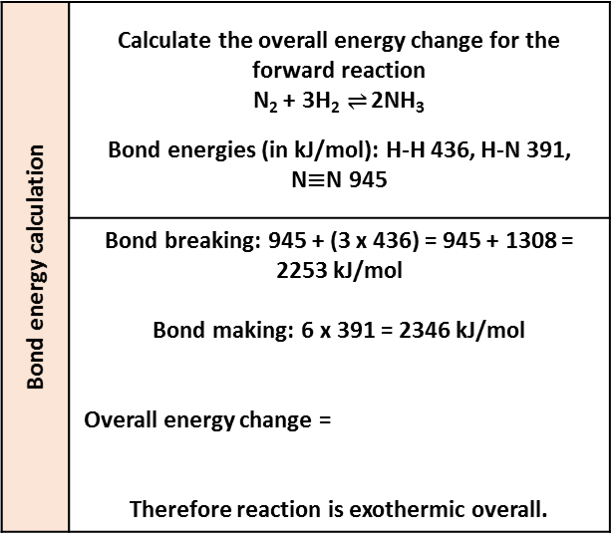
Endothermic |  | Thermal decomposition Sports injury packs
Exothermic |  | Combustion Hand warmers Neutralisation
 | Negative electrode: 2H₂ (g) + 4OH⁻ (aq) → 4H₂O (l) + 4e⁻ | Positive electrode: O₂ (g) + 2H₂O (l) + 4e⁻ → 4OH⁻ (aq)
 | Word equation: | Symbol equation:
 | Advantages: | Disadvantages:
Reaction profiles
Types of reaction
Fuel cells (Chemistry only)
Breaking bonds in reactants
Making bonds in products
The energy change of reactions
(HT only)
AQA GCSE
Energy changes
Activation energy |  | The minimum amount of energy that colliding particles must have in order to react is called the activation energy.
Reaction profiles
Overall energy change of a reaction |  | Energy released making new bonds is greater than the energy taken in breaking existing bonds.
 |  | Energy needed to break existing bonds is greater than the energy released making new bonds.
Cells and batteries
(Chemistry only)
Simple cell |  | Increase the voltage by increasing the reactivity difference between the two metals.
Batteries
 |  | Products are at a higher energy level than the reactants. As the reactants form products, energy is transferred from the surroundings to the reaction mixture. The temperature of the surroundings decreases because energy is taken in during the reaction.
Bond energy calculation | Calculate the overall energy change for the forward reaction N₂ + 3H₂ $⇌$ 2NH₃ Bond energies (in kJ/mol): H-H 436, H-N 391, N$≡$N 945
 | Bond breaking: 945 + (3 x 436) = 945 + 1308 = 2253 kJ/mol Bond making: 6 x 391 = 2346 kJ/mol Overall energy change = Therefore reaction is exothermic overall.
Non-rechargeable cells |  | Alkaline batteries
Rechargeable cells |  | Rechargeable batteries

Slide 4
Endothermic |  | Examples:
Exothermic |  | Examples:
Ionic half equations | Negative electrode: | Positive electrode:
Hydrogen fuel cells | Word equation: | Symbol equation:
 | Advantages: | Disadvantages:
Reaction profiles
Types of reaction
Fuel cells (Chemistry only)
Breaking bonds in reactants
Making bonds in products
The energy change of reactions
(HT only)
AQA GCSE
Energy changes
Activation energy
Reaction profiles
Overall energy change of a reaction
Cells and batteries
(Chemistry only)
Simple cell
Batteries
Bond energy calculation | Calculate the overall energy change for the forward reaction N₂ + 3H₂ $⇌$ 2NH₃ Bond energies (in kJ/mol): H-H 436, H-N 391, N$≡$N 945
Non-rechargeable cells |  | Example:
Rechargeable cells |  | Example:

