Slide 1
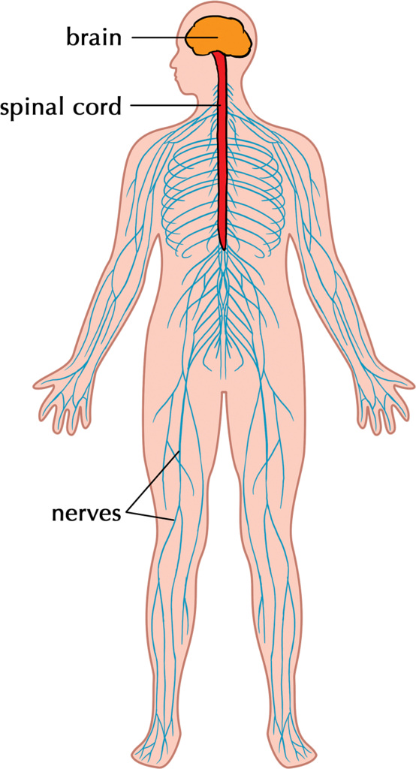
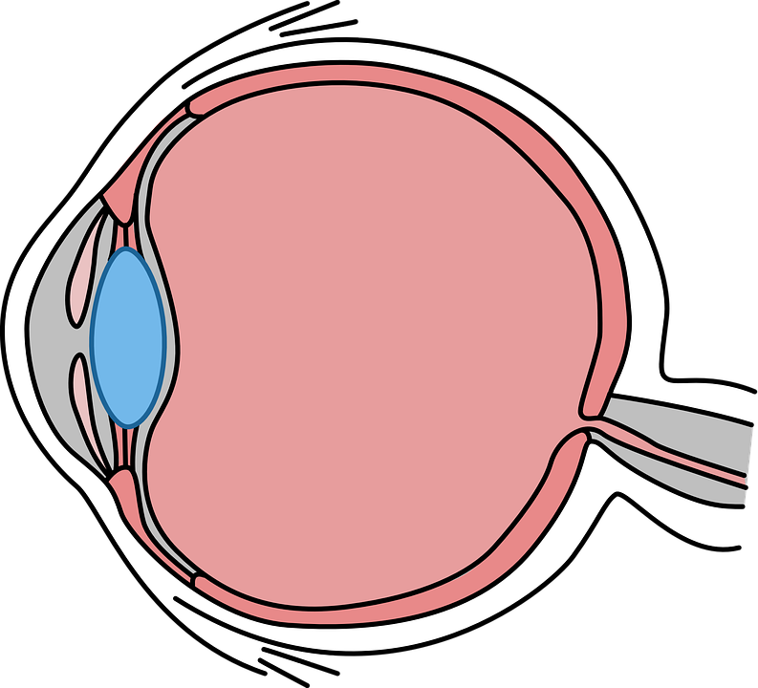
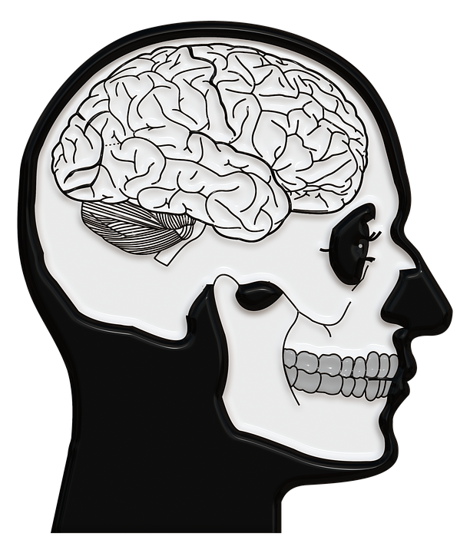
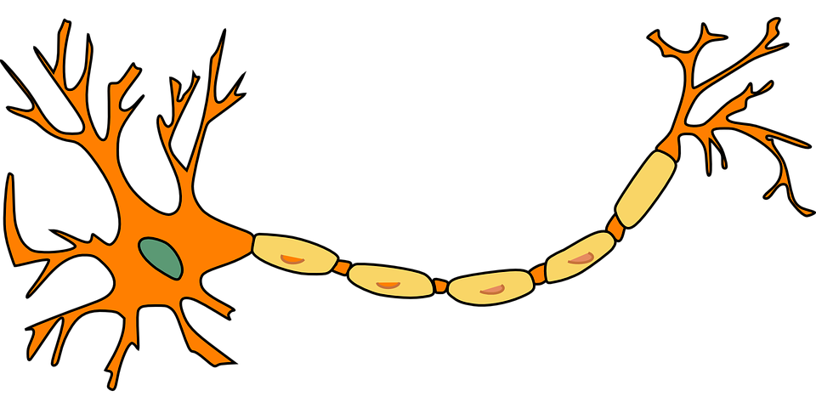
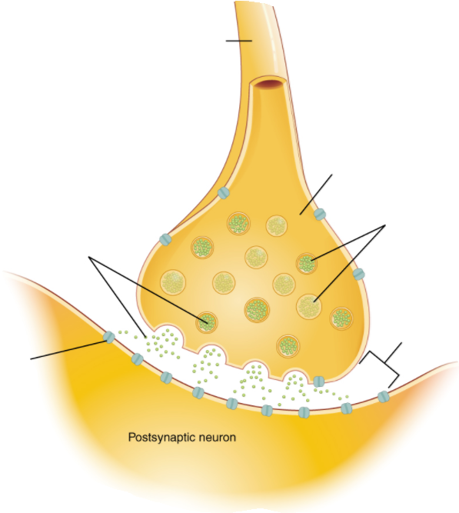
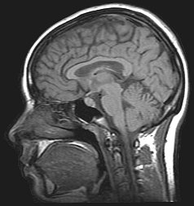
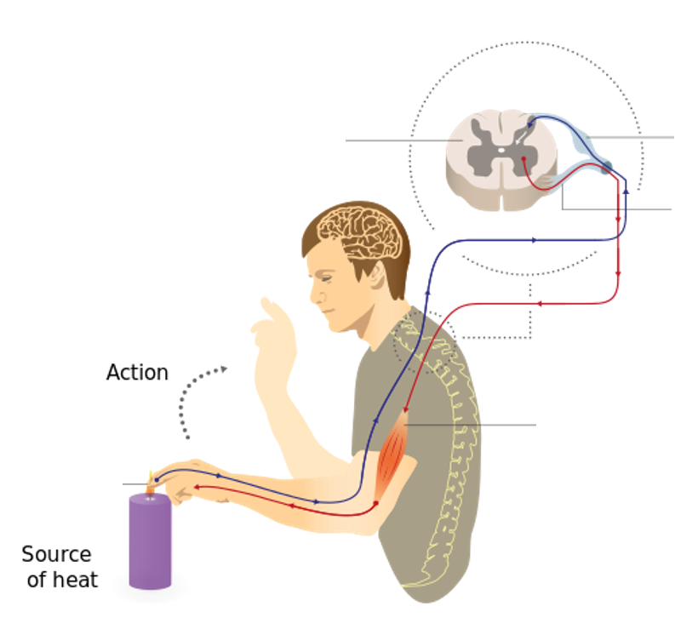
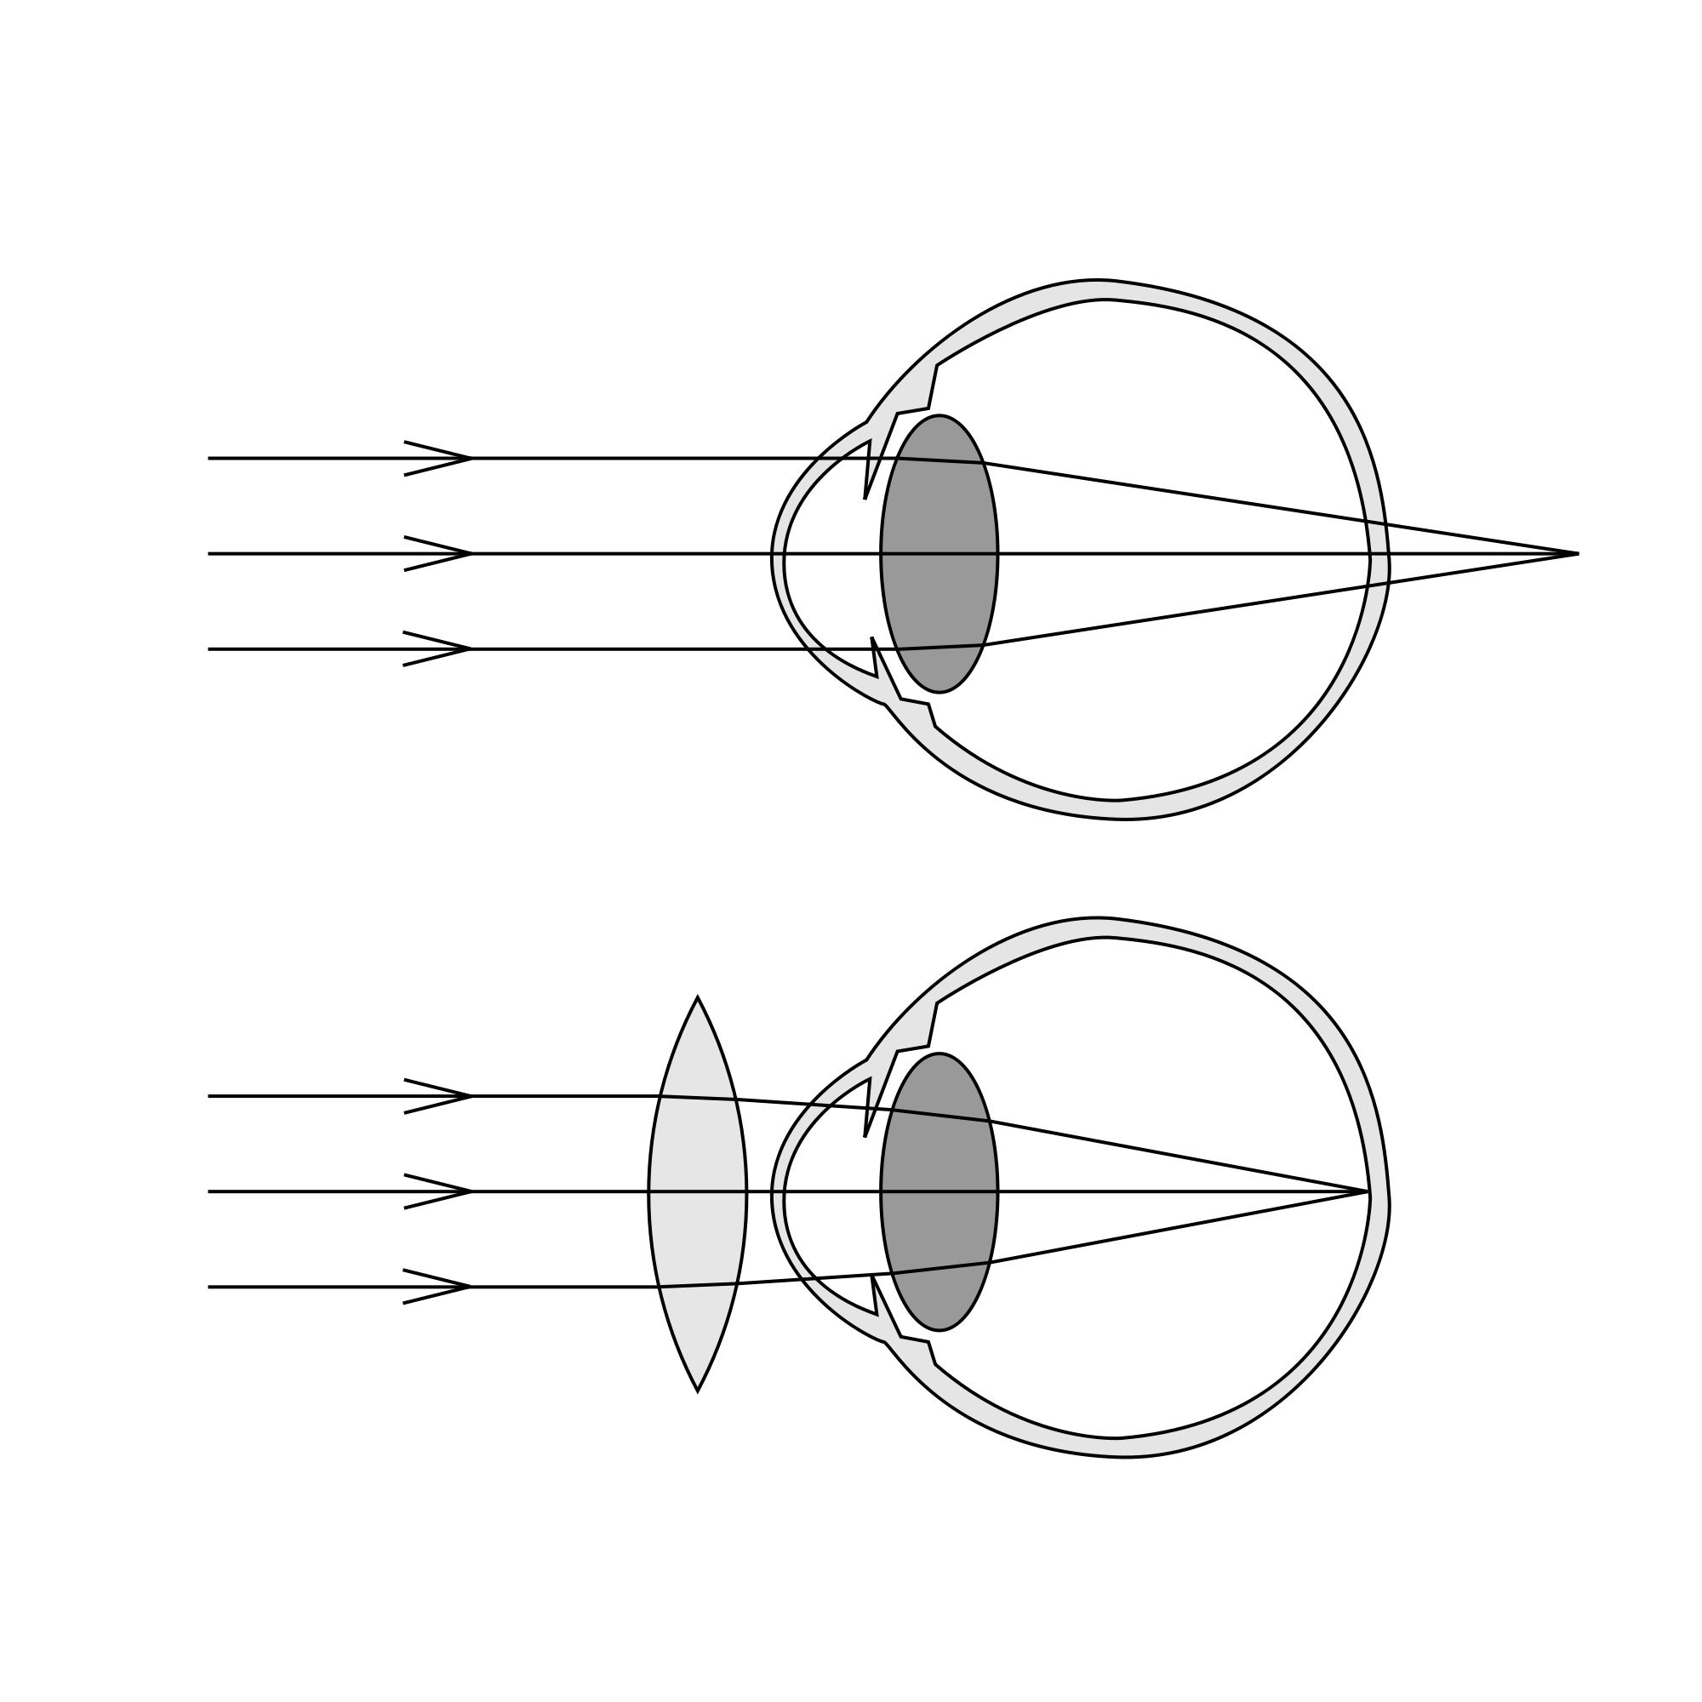
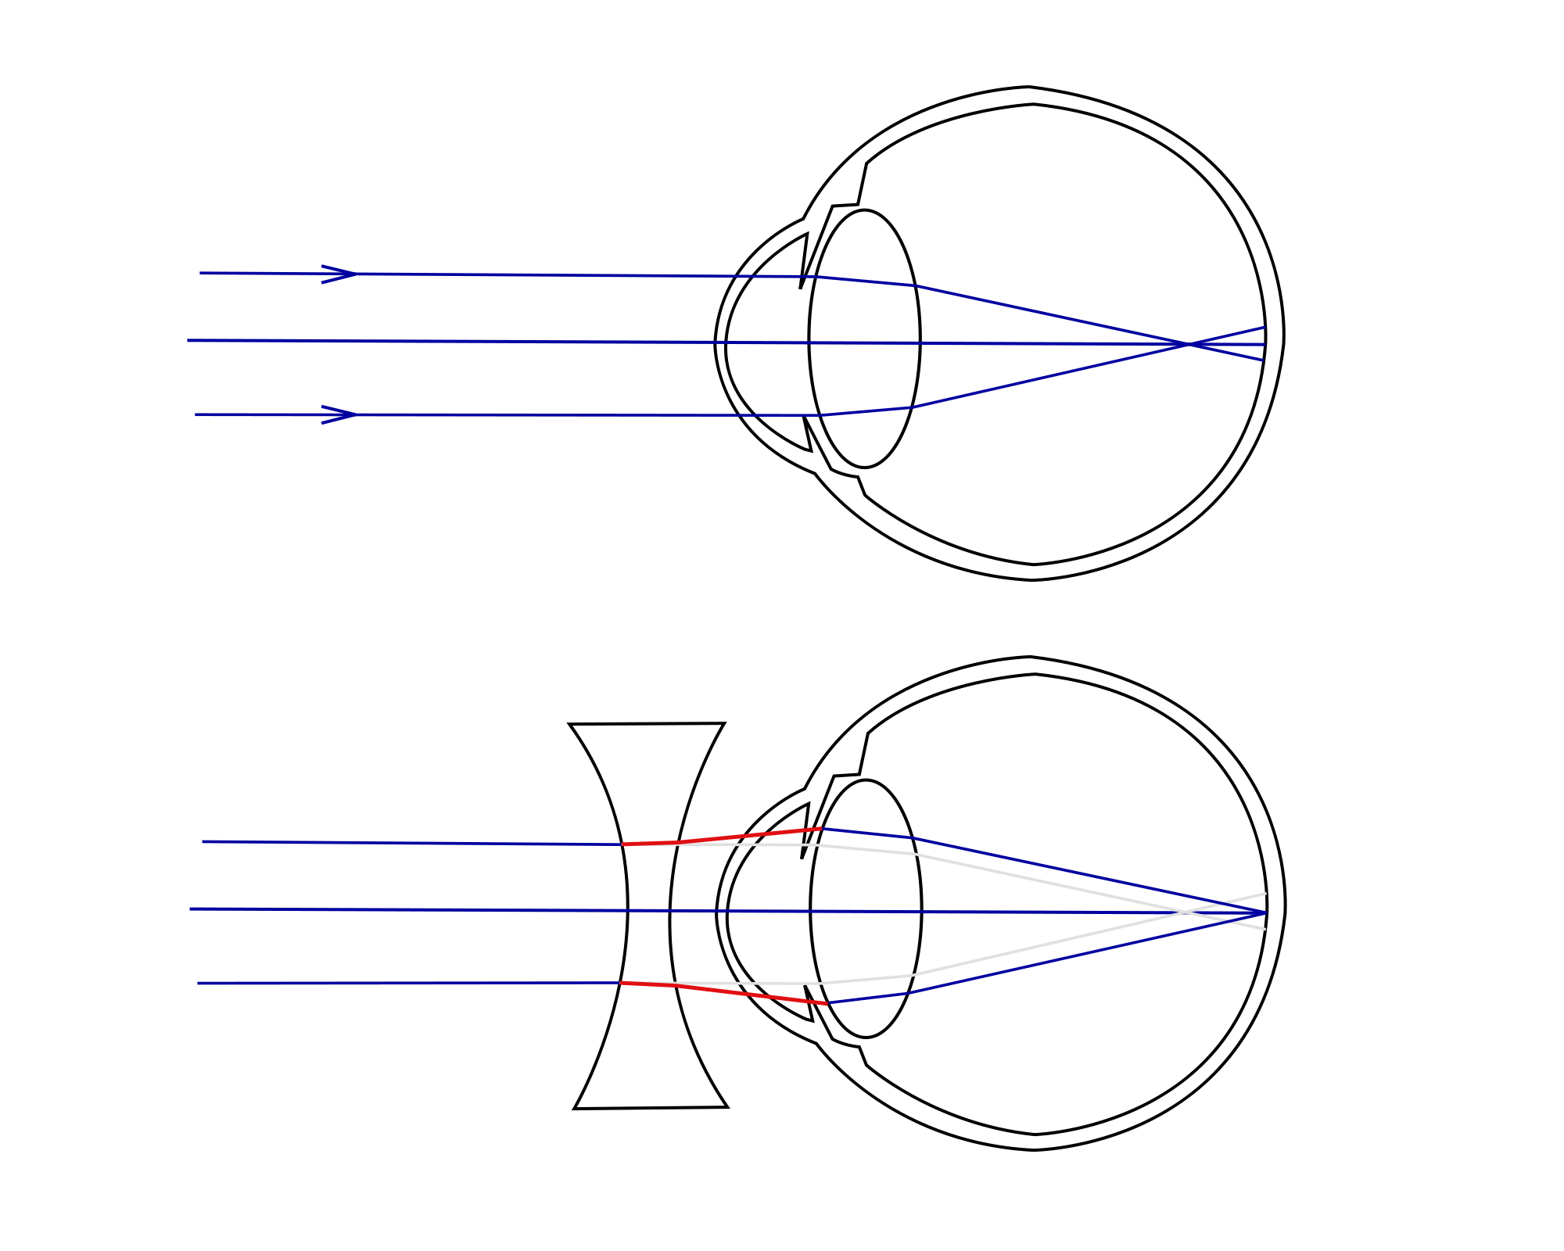
The iris can dilate the pupil (aperture) to let in more light in dim conditions
Sense organ containing receptors sensitive to light intensity and colour
Human control systems include | Cells called receptors | Detect stimuli (changes in environment).
 | Coordination centres | e.g. brain, spinal cord and pancreas that receive information from receptors.
 | Effectors | Muscles or glands, which bring about responses to restore optimum levels.
Enables humans to react to their surroundings and to co-ordinate their behaviour
Structures of the eye | Retina | Light sensitive cell layer.
 | Optic nerve | Carries impulse to brain.
 | Sclera | Protects the eye.
 | Cornea | Transparent layer that covers the pupil and iris.
 | Iris | Pigmented layer, controls size of pupil.
 | Ciliary muscles | Controls thickness of lens.
 | Suspensory ligaments | Connects lens to ciliary muscles.
Information from receptors passes along cells (neurones) as electrical impulses to the central nervous system (CNS)
The CNS is the brain and the spinal cord.
Coordinates the response of effectors; muscles contracting or glands secreting hormones
Stimulus | Lights switch on
Receptor | Cells in retina
Coordinator | CNS
Effector | Muscles connected to iris
Response | Pupils get smaller
The Eye (Bio only)
AQA GCSE HOMEOSTASIS AND RESPONSE part 1
The human nervous system
suspensory ligament
sclera
cornea
retina
optic nerve
cerebral cortex
The Brain
(Bio only)
iris
dendrites
ciliary muscles
cerebellum
The brain controls complex behaviour. It is made of billions of interconnected neurones.
cell body
Accommodation is the process of changing the shape of the lens to focus
Near object | Far object
Ciliary muscles contract, suspensory ligaments loosed, lens get thicker, light is more refracted. | Ciliary muscles relax, suspensory ligaments pulled tight, lens pulled thin, light is only slightly refracted.
Neuroscientists have been able to map regions of the brain by studying patients with brain damage, electrical stimulation and MRI.
axon terminal
medulla
nucleus
axon with insulating sheath
The brain has different regions that carry out different functions. | Cerebral cortex | Largest part of the human brain. Higher thinking skills e.g. speech, decision making.
 | Cerebellum | Balance and voluntary muscle function e.g. walking, lifting.
 | Medulla | Involuntary (automatic) body functions e.g. breathing, heart rate.
Typical motor neurone
Synapse (gap where two neurones meet).
(HT) The complexity and delicacy of the brain makes investigating and treating brain disorders very difficult
axon
direction of impulse
axon terminal
neurotransmitter
vesicles
Hyperopia (long sightedness) | Myopia (short sightedness)
Treated using a convex lens so the light is focused on the retina. | Treated using a concave lens so light is focused on the retina.
Synaptic cleft
neurotransmitter
receptors
spinal cord
sensory neurone
Treating brain damage and disease | e.g. Lobotomy – cutting part of the cerebral cortex | Benefit: thought to alleviate the symptoms of some mental illnesses.
 |  | Risks: bleeding in the brain, seizures, loss of brain function. Procedure was abandoned in the 1950s due to risk.
Reflex arc | Receptor | Detect stimuli.
 | Sensory neurone | Long axon carries impulse from receptor to spinal cord.
 | Synapse | Gap where neurones meet. Chemical message using neurotransmitter.
 | Relay neurone | Allows impulses to travel between sensory and motor neurones in the spinal cord.
 | Motor neurone | Long axon carries impulse from receptor to effector.
 | Effector | Muscle or gland that carries out response.
motor neurone
pain receptors
muscle (effector)
New technologies now include hard/soft contact lens, laser surgery to change the shape of the cornea and a replacement lens in the eye.
Reflex actions are automatic and rapid; they do not involve the conscious part of the brain and can protect humans from harm.

Slide 2
The iris can dilate the pupil (aperture) to let in more light in dim conditions
Sense organ containing receptors sensitive to light intensity and colour
 | Cells called receptors | Detect stimuli (changes in environment).
 | Coordination centres | e.g. brain, spinal cord and pancreas that receive information from receptors.
 | Effectors | Muscles or glands, which bring about responses to restore optimum levels.
Enables humans to react to their surroundings and to co-ordinate their behaviour
 | Retina | Light sensitive cell layer.
 | Optic nerve | Carries impulse to brain.
 | Sclera | Protects the eye.
 | Cornea | Transparent layer that covers the pupil and iris.
 | Iris | Pigmented layer, controls size of pupil.
 | Ciliary muscles | Controls thickness of lens.
 | Suspensory ligaments | Connects lens to ciliary muscles.
The CNS is the brain and the spinal cord.
Coordinates the response of effectors; muscles contracting or glands secreting hormones
Stimulus | Lights switch on
Receptor | Cells in retina
Coordinator | CNS
Effector | Muscles connected to iris
Response | Pupils get smaller
The Eye (Bio only)
AQA GCSE HOMEOSTASIS AND RESPONSE part 1
The human nervous system
suspensory ligament
sclera
cornea
retina
optic nerve
cerebral cortex
The Brain
(Bio only)
iris
dendrites
ciliary muscles
cerebellum
The brain controls complex behaviour. It is made of billions of interconnected neurones.
cell body
Near object | Far object
Ciliary muscles contract, suspensory ligaments loosed, lens get thicker, light is more refracted. | Ciliary muscles relax, suspensory ligaments pulled tight, lens pulled thin, light is only slightly refracted.
Neuroscientists have been able to map regions of the brain by studying patients with brain damage, electrical stimulation and MRI.
axon terminal
medulla
nucleus
axon with insulating sheath
 | Cerebral cortex | Largest part of the human brain. Higher thinking skills e.g. speech, decision making.
 | Cerebellum | Balance and voluntary muscle function e.g. walking, lifting.
 | Medulla | Involuntary (automatic) body functions e.g. breathing, heart rate.
Typical motor neurone
Synapse (gap where two neurones meet).
(HT) The complexity and delicacy of the brain makes investigating and treating brain disorders very difficult
axon
direction of impulse
axon terminal
neurotransmitter
vesicles
Hyperopia (long sightedness) | Myopia (short sightedness)
Treated using a convex lens so the light is focused on the retina. | Treated using a concave lens so light is focused on the retina.
Synaptic cleft
neurotransmitter
receptors
spinal cord
sensory neurone
 | e.g. Lobotomy – cutting part of the cerebral cortex | Benefit: thought to alleviate the symptoms of some mental illnesses.
 |  | Risks: bleeding in the brain, seizures, loss of brain function. Procedure was abandoned in the 1950s due to risk.
 | Receptor | Detect stimuli.
 | Sensory neurone | Long axon carries impulse from receptor to spinal cord.
 | Synapse | Gap where neurones meet. Chemical message using neurotransmitter.
 | Relay neurone | Allows impulses to travel between sensory and motor neurones in the spinal cord.
 | Motor neurone | Long axon carries impulse from receptor to effector.
 | Effector | Muscle or gland that carries out response.
motor neurone
pain receptors
muscle (effector)
New technologies now include hard/soft contact lens, laser surgery to change the shape of the cornea and a replacement lens in the eye.
Reflex actions are automatic and rapid; they do not involve the conscious part of the brain and can protect humans from harm.

Slide 3
The iris can dilate the pupil (aperture) to let in more light in dim conditions
Sense organ containing receptors sensitive to light intensity and colour
 |  | Detect stimuli (changes in environment).
 |  | e.g. brain, spinal cord and pancreas that receive information from receptors.
 |  | Muscles or glands, which bring about responses to restore optimum levels.
Enables humans to react to their surroundings and to co-ordinate their behaviour
 |  | Light sensitive cell layer.
 |  | Carries impulse to brain.
 |  | Protects the eye.
 |  | Transparent layer that covers the pupil and iris.
 |  | Pigmented layer, controls size of pupil.
 |  | Controls thickness of lens.
 |  | Connects lens to ciliary muscles.
Coordinates the response of effectors; muscles contracting or glands secreting hormones
Stimulus | Lights switch on
Receptor | Cells in retina
Coordinator | CNS
Effector | Muscles connected to iris
Response | Pupils get smaller
The Eye (Bio only)
AQA GCSE HOMEOSTASIS AND RESPONSE part 1
The human nervous system
suspensory ligament
sclera
cornea
retina
optic nerve
cerebral cortex
The Brain
(Bio only)
iris
dendrites
ciliary muscles
cerebellum
The brain controls complex behaviour. It is made of billions of interconnected neurones.
cell body
Ciliary muscles contract, suspensory ligaments loosed, lens get thicker, light is more refracted. | Ciliary muscles relax, suspensory ligaments pulled tight, lens pulled thin, light is only slightly refracted.
Neuroscientists have been able to map regions of the brain by studying patients with brain damage, electrical stimulation and MRI.
axon terminal
medulla
nucleus
axon with insulating sheath
 |  | Largest part of the human brain. Higher thinking skills e.g. speech, decision making.
 |  | Balance and voluntary muscle function e.g. walking, lifting.
 |  | Involuntary (automatic) body functions e.g. breathing, heart rate.
Typical motor neurone
Synapse (gap where two neurones meet).
(HT) The complexity and delicacy of the brain makes investigating and treating brain disorders very difficult
axon
direction of impulse
axon terminal
neurotransmitter
vesicles
Treated using a convex lens so the light is focused on the retina. | Treated using a concave lens so light is focused on the retina.
Synaptic cleft
neurotransmitter
receptors
spinal cord
sensory neurone
 |  | Benefit: thought to alleviate the symptoms of some mental illnesses.
 |  | Risks: bleeding in the brain, seizures, loss of brain function. Procedure was abandoned in the 1950s due to risk.
 |  | Detect stimuli.
 |  | Long axon carries impulse from receptor to spinal cord.
 |  | Gap where neurones meet. Chemical message using neurotransmitter.
 |  | Allows impulses to travel between sensory and motor neurones in the spinal cord.
 |  | Long axon carries impulse from receptor to effector.
 |  | Muscle or gland that carries out response.
motor neurone
pain receptors
muscle (effector)
New technologies now include hard/soft contact lens, laser surgery to change the shape of the cornea and a replacement lens in the eye.
Reflex actions are automatic and rapid; they do not involve the conscious part of the brain and can protect humans from harm.

Slide 4
The iris can dilate the pupil (aperture) to let in more light in dim conditions
Sense organ containing receptors sensitive to light intensity and colour
Enables humans to react to their surroundings and to co-ordinate their behaviour
The Eye (Bio only)
AQA GCSE HOMEOSTASIS AND RESPONSE part 1
The human nervous system
suspensory ligament
sclera
cornea
retina
optic nerve
cerebral cortex
The Brain
(Bio only)
iris
dendrites
ciliary muscles
cerebellum
The brain controls complex behaviour. It is made of billions of interconnected neurones.
cell body
Neuroscientists have been able to map regions of the brain by studying patients with brain damage, electrical stimulation and MRI.
axon terminal
medulla
nucleus
axon with insulating sheath
Typical motor neurone
Synapse (gap where two neurones meet).
(HT) The complexity and delicacy of the brain makes investigating and treating brain disorders very difficult
axon
direction of impulse
axon terminal
neurotransmitter
vesicles
neurotransmitter
receptors
Synaptic cleft
spinal cord
sensory neurone
motor neurone
pain receptors
muscle (effector)
New technologies now include hard/soft contact lens, laser surgery to change the shape of the cornea and a replacement lens in the eye.
Reflex actions are automatic and rapid; they do not involve the conscious part of the brain and can protect humans from harm.

