Slide 1
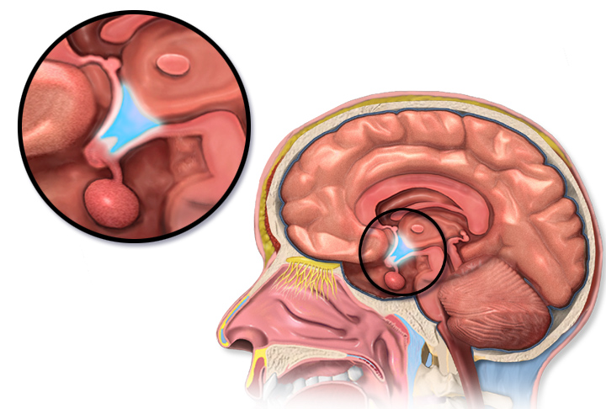
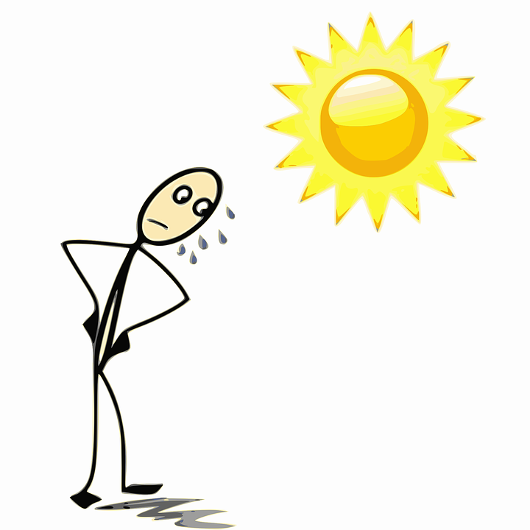
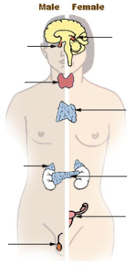
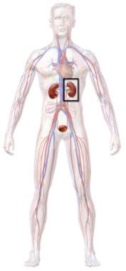
Monitoring body temperature | Thermoregulatory centre | Contains receptors sensitive to the temperature of the blood.
 | Skin | Contains temperature receptors, sends nervous impulses to the thermoregulatory centre.
Controls in the human body | Blood glucose concentration | These automatic control systems may involve nervous responses or chemical responses.
 | Body temperature
 | Water levels
Body temperature | Too high | Blood vessels dilate (vasodilation), sweat produced from sweat glands.
 | Too low | Blood vessels constrict (vasoconstriction), sweating stops, muscles contract (shivering).
Thermoregulatory centre (hypothalamus)
(HT) Thermal energy is lost from blood near the surface of the skin, sweat evaporates transferring thermal energy.
Response to internal and external change
The regulation of internal conditions of a cell or organism to maintain optimum conditions for function.
Control of body temperature
(Biology only)
(HT) Thermal energy loss at the surface of the skin is reduced, respiring muscles cells transfer chemical to thermal energy.
Homeostasis maintains optimal conditions for enzyme action and all cell functions.
Human endocrine system
Endocrine system | Composed of glands which secrete chemicals called hormones directly into the bloodstream. | The blood carries the hormone to a target organ where is produces an effect. Compared to the nervous system effects are slower but act for longer.
AQA GCSE HOMEOSTASIS AND RESPONSE PART 2
Pituitary
gland
Pineal
gland
Homeostasis
Thyroid
Water and nitrogen balance
(Biology only)
Thymus
Adrenal
gland
Pituitary gland | ‘Master gland’; secretes several hormones into the blood | Stimulates other glands to produce hormones to bring about effects.
If body cells lose or gain too much water by osmosis they do no function efficiently. | Uncontrolled water/ion urea loss | Water exhaled in lungs, water, ions and urea in sweat.
 | Controlled water/ion/urea loss | Via the kidneys in urine.
Control of blood glucose concentration
Pancreas
Ovaries
Testes
Blood glucose concentration
Monitored and controlled by the pancreas
Too high | (HT only) Too low
Pancreas produces the hormone insulin, glucose moves from the blood into the cells. In liver and muscle cells excess glucose is converted to glycogen for storage. | Pancreas produces the hormone glucagon that causes glycogen to be converted into glucose and released into the blood.
Negative feedback (HT only) | Adrenaline | Produced in adrenal glands, increases breathing/heart rate, blood flow to muscles, conversion glycogen to glucose. Prepares body for ‘fight or flight’.
 | Thyroxine | Produced in the thyroid gland, stimulates the basal metabolic rate. Important in growth and development.
Kidney failure is treated by organ transplant or dialysis.
(HT only) digestion of proteins results in excess amino acids. In the liver they are de-aminated to form toxic ammonia which is converted to urea
Kidney function | Maintain water balance of the body. | Produce urine by filtration of the blood and selective reabsorption of glucose, ions and water.
A dialysis machine removes urea from the blood by diffusion while maintaining ion and glucose levels.
(HT) Rising glucose levels inhibit the release of glucagon in a negative feedback system. Insulin is released to reduce glucose levels and which cause the pancreas to release glucagon
Increasing thyroxine levels prevent the release of thyroid stimulating hormone which stops the release of thyroxine.
Diabetes
Type 1 | Type 2
Pancreas fails to produce sufficient insulin leading to uncontrolled blood glucose levels. Normally treated by insulin injection. | Obesity is a risk factor. Body cells no longer respond to insulin. Common treatments include changing by diet and increasing exercise.
(HT only) ADH | Acts on kidney tubules to control water levels. | Released by pituitary gland when blood is too concentrated. Water is reabsorbed back into the blood from the kidney tubules (NEGATIVE FEEDBACK).

Slide 2
 | Thermoregulatory centre | Contains receptors sensitive to the temperature of the blood.
 | Skin | Contains temperature receptors, sends nervous impulses to the thermoregulatory centre.
 | Blood glucose concentration | These automatic control systems may involve nervous responses or chemical responses.
 | Body temperature
 | Water levels
 | Too high | Blood vessels dilate (vasodilation), sweat produced from sweat glands.
 | Too low | Blood vessels constrict (vasoconstriction), sweating stops, muscles contract (shivering).
Thermoregulatory centre (hypothalamus)
(HT) Thermal energy is lost from blood near the surface of the skin, sweat evaporates transferring thermal energy.
Response to internal and external change
The regulation of internal conditions of a cell or organism to maintain optimum conditions for function.
Control of body temperature
(Biology only)
(HT) Thermal energy loss at the surface of the skin is reduced, respiring muscles cells transfer chemical to thermal energy.
Homeostasis maintains optimal conditions for enzyme action and all cell functions.
Human endocrine system
 | Composed of glands which secrete chemicals called hormones directly into the bloodstream. | The blood carries the hormone to a target organ where is produces an effect. Compared to the nervous system effects are slower but act for longer.
AQA GCSE HOMEOSTASIS AND RESPONSE PART 2
Pituitary
gland
Pineal
gland
Homeostasis
Thyroid
Water and nitrogen balance
(Biology only)
Thymus
Adrenal
gland
 | ‘Master gland’; secretes several hormones into the blood | Stimulates other glands to produce hormones to bring about effects.
 | Uncontrolled water/ion urea loss | Water exhaled in lungs, water, ions and urea in sweat.
 | Controlled water/ion/urea loss | Via the kidneys in urine.
Control of blood glucose concentration
Pancreas
Ovaries
Testes
Monitored and controlled by the pancreas
Too high | (HT only) Too low
Pancreas produces the hormone insulin, glucose moves from the blood into the cells. In liver and muscle cells excess glucose is converted to glycogen for storage. | Pancreas produces the hormone glucagon that causes glycogen to be converted into glucose and released into the blood.
 | Adrenaline | Produced in adrenal glands, increases breathing/heart rate, blood flow to muscles, conversion glycogen to glucose. Prepares body for ‘fight or flight’.
 | Thyroxine | Produced in the thyroid gland, stimulates the basal metabolic rate. Important in growth and development.
Kidney failure is treated by organ transplant or dialysis.
(HT only) digestion of proteins results in excess amino acids. In the liver they are de-aminated to form toxic ammonia which is converted to urea
 | Maintain water balance of the body. | Produce urine by filtration of the blood and selective reabsorption of glucose, ions and water.
A dialysis machine removes urea from the blood by diffusion while maintaining ion and glucose levels.
(HT) Rising glucose levels inhibit the release of glucagon in a negative feedback system. Insulin is released to reduce glucose levels and which cause the pancreas to release glucagon
Increasing thyroxine levels prevent the release of thyroid stimulating hormone which stops the release of thyroxine.
Type 1 | Type 2
Pancreas fails to produce sufficient insulin leading to uncontrolled blood glucose levels. Normally treated by insulin injection. | Obesity is a risk factor. Body cells no longer respond to insulin. Common treatments include changing by diet and increasing exercise.
 | Acts on kidney tubules to control water levels. | Released by pituitary gland when blood is too concentrated. Water is reabsorbed back into the blood from the kidney tubules (NEGATIVE FEEDBACK).

Slide 3
 |  | Contains receptors sensitive to the temperature of the blood.
 |  | Contains temperature receptors, sends nervous impulses to the thermoregulatory centre.
 |  | These automatic control systems may involve nervous responses or chemical responses.
 |  | Blood vessels dilate (vasodilation), sweat produced from sweat glands.
 |  | Blood vessels constrict (vasoconstriction), sweating stops, muscles contract (shivering).
Thermoregulatory centre (hypothalamus)
(HT) Thermal energy is lost from blood near the surface of the skin, sweat evaporates transferring thermal energy.
Response to internal and external change
The regulation of internal conditions of a cell or organism to maintain optimum conditions for function.
Control of body temperature
(Biology only)
(HT) Thermal energy loss at the surface of the skin is reduced, respiring muscles cells transfer chemical to thermal energy.
Homeostasis maintains optimal conditions for enzyme action and all cell functions.
Human endocrine system
 |  | The blood carries the hormone to a target organ where is produces an effect. Compared to the nervous system effects are slower but act for longer.
AQA GCSE HOMEOSTASIS AND RESPONSE PART 2
Pituitary
gland
Pineal
gland
Homeostasis
Thyroid
Water and nitrogen balance
(Biology only)
Thymus
Adrenal
gland
 |  | Stimulates other glands to produce hormones to bring about effects.
 |  | Water exhaled in lungs, water, ions and urea in sweat.
 |  | Via the kidneys in urine.
Control of blood glucose concentration
Pancreas
Ovaries
Testes
Too high | (HT only) Too low
Pancreas produces the hormone insulin, glucose moves from the blood into the cells. In liver and muscle cells excess glucose is converted to glycogen for storage. | Pancreas produces the hormone glucagon that causes glycogen to be converted into glucose and released into the blood.
 |  | Produced in adrenal glands, increases breathing/heart rate, blood flow to muscles, conversion glycogen to glucose. Prepares body for ‘fight or flight’.
 |  | Produced in the thyroid gland, stimulates the basal metabolic rate. Important in growth and development.
Kidney failure is treated by organ transplant or dialysis.
(HT only) digestion of proteins results in excess amino acids. In the liver they are de-aminated to form toxic ammonia which is converted to urea
 |  | Produce urine by filtration of the blood and selective reabsorption of glucose, ions and water.
A dialysis machine removes urea from the blood by diffusion while maintaining ion and glucose levels.
(HT) Rising glucose levels inhibit the release of glucagon in a negative feedback system. Insulin is released to reduce glucose levels and which cause the pancreas to release glucagon
Increasing thyroxine levels prevent the release of thyroid stimulating hormone which stops the release of thyroxine.
Pancreas fails to produce sufficient insulin leading to uncontrolled blood glucose levels. Normally treated by insulin injection. | Obesity is a risk factor. Body cells no longer respond to insulin. Common treatments include changing by diet and increasing exercise.
 |  | Released by pituitary gland when blood is too concentrated. Water is reabsorbed back into the blood from the kidney tubules (NEGATIVE FEEDBACK).

Slide 4
 |  | .
Thermoregulatory centre (hypothalamus)
(HT) Thermal energy is lost from blood near the surface of the skin, sweat evaporates transferring thermal energy.
Response to internal and external change
The regulation of internal conditions of a cell or organism to maintain optimum conditions for function.
Control of body temperature
(Biology only)
(HT) Thermal energy loss at the surface of the skin is reduced, respiring muscles cells transfer chemical to thermal energy.
Homeostasis maintains optimal conditions for enzyme action and all cell functions.
Human endocrine system
AQA GCSE HOMEOSTASIS AND RESPONSE PART 2
Pituitary
gland
Pineal
gland
Homeostasis
Thyroid
Water and nitrogen balance
(Biology only)
Thymus
Adrenal
gland
Control of blood glucose concentration
Pancreas
Ovaries
Testes
Too high | (HT only) Too low
Kidney failure is treated by organ transplant or dialysis.
(HT only) digestion of proteins results in excess amino acids. In the liver they are de-aminated to form toxic ammonia which is converted to urea
A dialysis machine removes urea from the blood by diffusion while maintaining ion and glucose levels.
(HT) Rising glucose levels inhibit the release of glucagon in a negative feedback system. Insulin is released to reduce glucose levels and which cause the pancreas to release glucagon
Increasing thyroxine levels prevent the release of thyroid stimulating hormone which stops the release of thyroxine.

