Slide 1
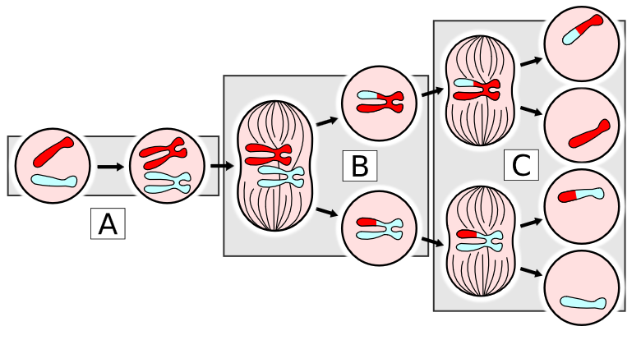
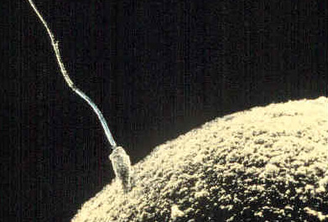
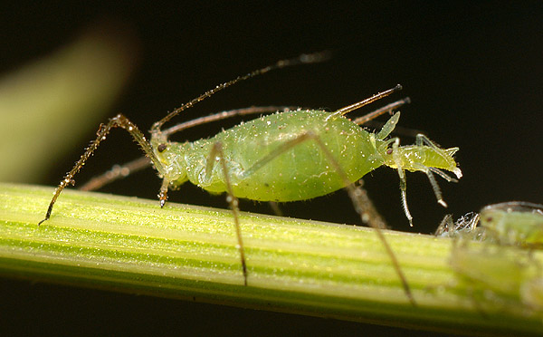
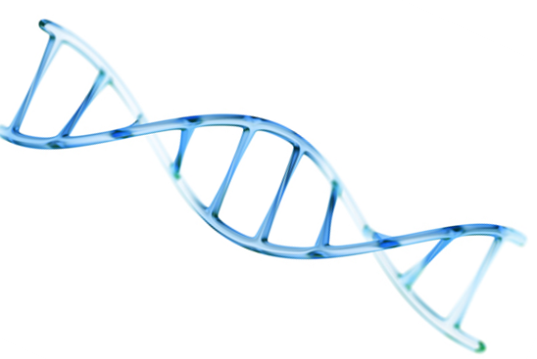
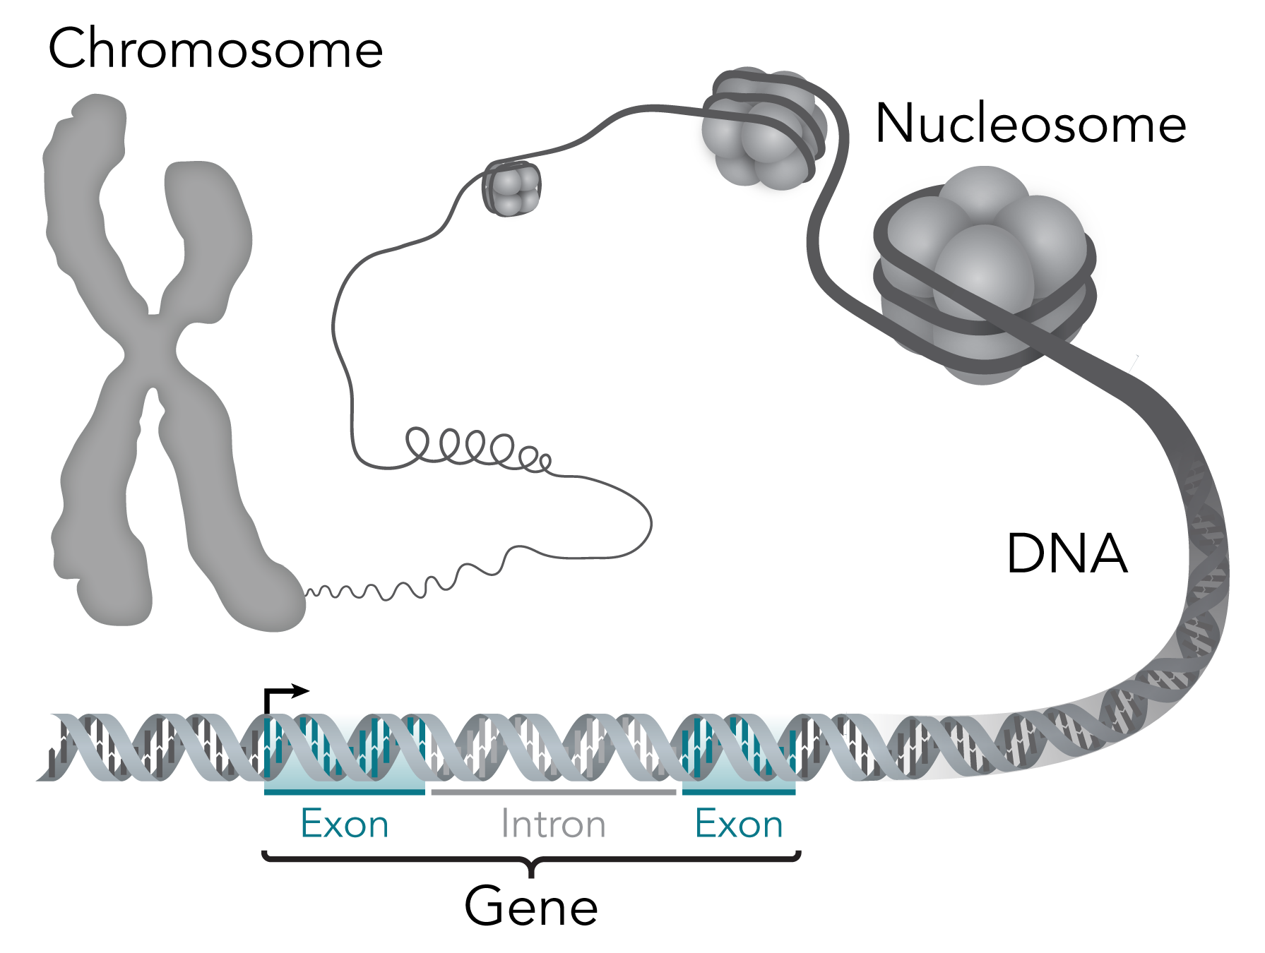
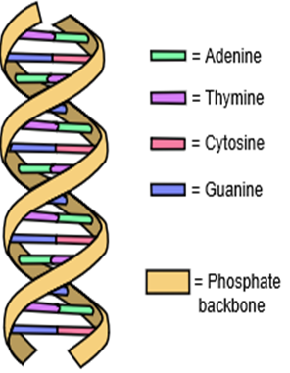
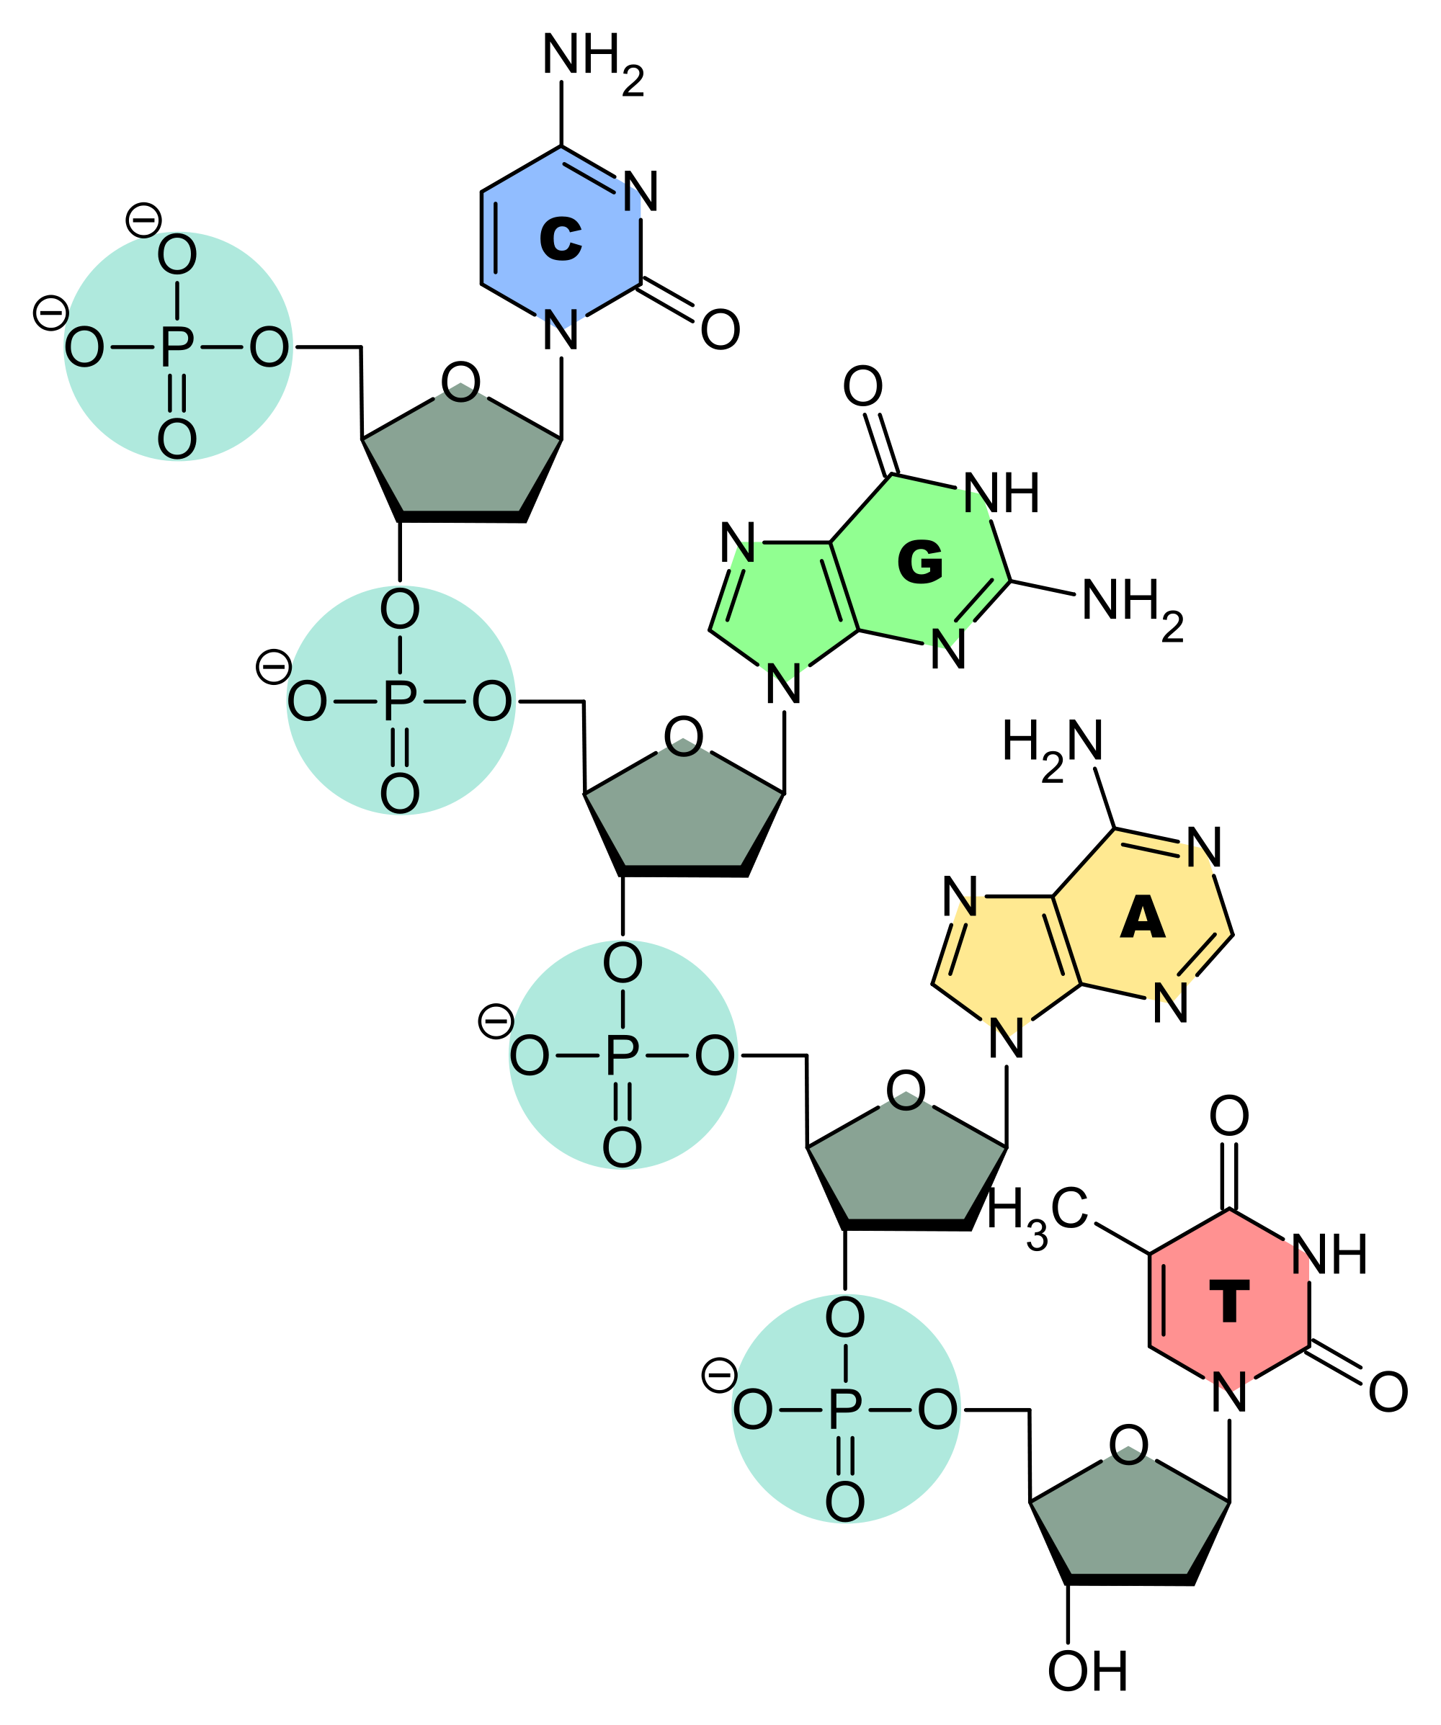
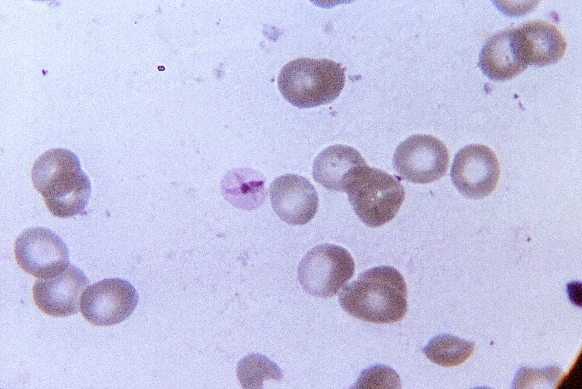
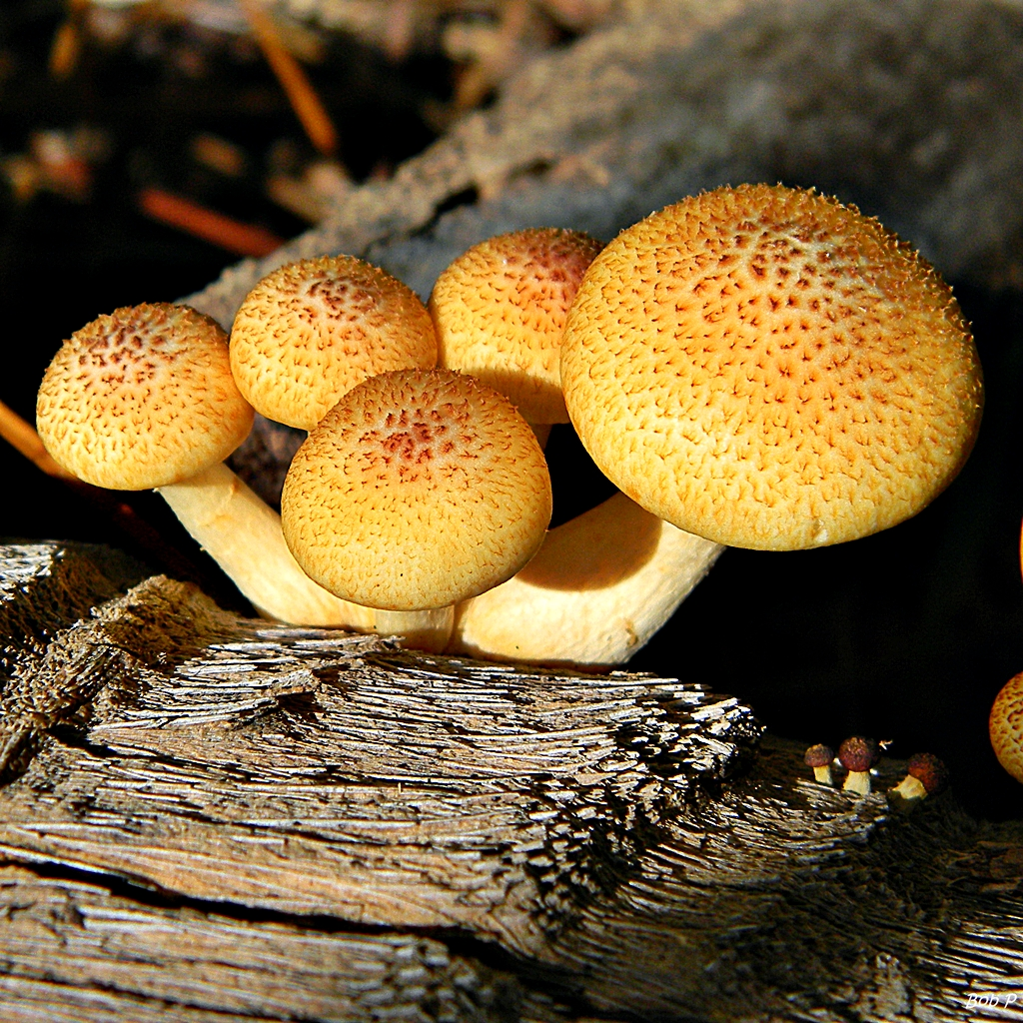
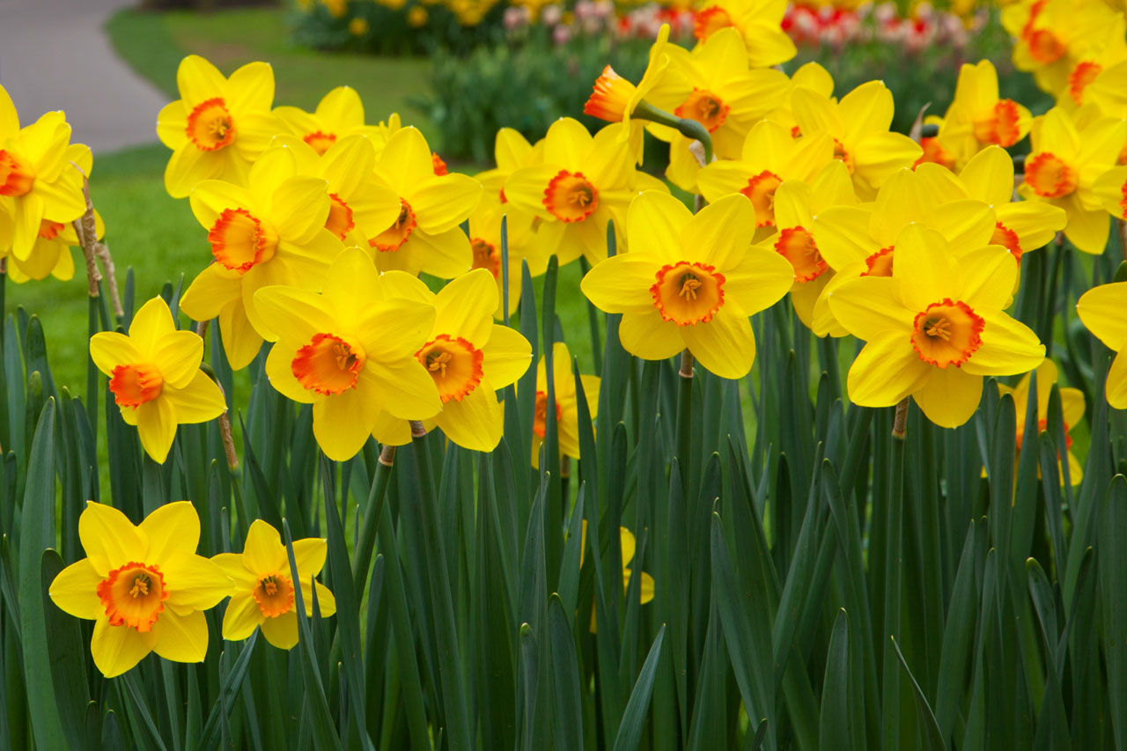
Gametes are made in reproductive organs (in animals ovaries and testes) | Cells divide by meiosis to form gametes | Copies of the genetic information are made.
 |  | The cell divides twice to form four gametes each with single set of chromosomes.
 |  | All gametes are genetically different from each other.
Sexual reproduction involves the fusion of male and female gametes. | Sperm and egg in animals. | Produced by meiosis. There is mixing of genetic information which leads to a variety in the offspring.
 | Pollen and egg cells in flowering plants.
Asexual reproduction involves only one parent and no fusion of gametes. | e.g. cloning of females only in an aphid population. | Only mitosis is involved. There is no mixing of genetic information. This leads to genetically identical clones.
Meiosis halves the number of chromosomes
Gametes join at fertilisation to restore the number of chromosomes
Advantages and disadvantages of sexual and asexual reproduction (Biology only)
The new cell divides by mitosis. The number of cells increase. As the embryo develops cells differentiate.
When the protein chain is complete it folds to form a unique shape. This allows proteins to do their job as enzymes, hormones or new structures such as collagen.
Meiosis leads to non-identical cells being formed while mitosis leads to identical cells being formed
Some change the shape and affect the function of proteins e.g. and enzyme active site will change or a structural protein loses its strength
Most do not alter the protein so that its appearance or function is not changed.
(HT) Making new proteins (protein synthesis)
Composed of chains of amino acids. A sequence of 3 bases codes for a particular amino acid.
DNA in the nucleus unravels.
Enzymes make a copy of the DNA strand called mRNA.
mRNA moves from the nucleus to ribosome in the cytoplasm.
Ribosomes translate each 3 bases into amino acids according to mRNA template
Ribosomes link amino acids brought by carrier proteins.
A long chain of amino acids form. Their specific order forms a specific protein.
Meiosis
Reproduction advantages/disadvantages
Sexual | Asexual
Needs two parents. | Only one parent needed (quicker).
Produces variation in the offspring. | Identical offspring (no variation).
If the environment changes variation gives a survival advantage by natural selection. | Vulnerable to rapidly changing conditions due to lack of variation.
Negative mutations are not always inherited. | Negative mutation can affect all offspring.
Natural selection can by speeded up using selective breeding to increase food production. | Food/medicine production can be extremely quick.
DNA and the genome
Sexual and asexual reproduction
AQA GCSE INHERITANCE, VARIATION AND EVOLUTION Part 1
Mutations occur continuously (HT only)
Genetic material in the nucleus is composed of a chemical called DNA.
Protein synthesis (HT only)
In DNA the complementary strands C, A, T, G always link in the same way. C always linked to G on the opposite strand and A to T.
DNA structure
Polymer made up of two strands forming a double helix.
Contained in structures called chromosomes. A gene is a small section of DNA on a chromosome. Each gene codes for a sequence of amino acids to make a specific protein.
DNA structure (Biology only)
DNA is polymer made from four different nucleotides. Each nucleotide consists of a common sugar, phosphate group and one of 4 different bases A, C, G & T
The genome is the entire genetic material of an organism.
Phosphate and sugar back bone
Repeating nucleotide units.
(HT only) Not all parts code for proteins. Non-coding parts can switch genes on and off. Mutations may affect how genes are expressed.
ribose
sugar
phosphate
group
base
Some organisms use both methods depending on the circumstances | Malarial parasites |  | Asexually in the human host but sexually in a mosquito.
 | Fungi |  | Asexually by spores, sexually to give variation.
 | Plants |  | Produce seeds sexually, asexually by runners in strawberry plants, bulbs division in daffodils.
The whole human genome has now been studied. | It is of great importance for future medical developments | Searching for genes linked to different types of disease.
 |  | Understanding and treatment of inherited disorders.
 |  | Tracing migration patterns from the past.
A sequence of 3 bases is the code for a particular amino acid. The order of bases controls the order in which each amino acid is assemble to produce a specific protein.
nucleotide

Slide 2
 | Cells divide by meiosis to form gametes | Copies of the genetic information are made.
 |  | The cell divides twice to form four gametes each with single set of chromosomes.
 |  | All gametes are genetically different from each other.
 | Sperm and egg in animals. | Produced by meiosis. There is mixing of genetic information which leads to a variety in the offspring.
 | Pollen and egg cells in flowering plants.
 | e.g. cloning of females only in an aphid population. | Only mitosis is involved. There is no mixing of genetic information. This leads to genetically identical clones.
Meiosis halves the number of chromosomes
Gametes join at fertilisation to restore the number of chromosomes
Advantages and disadvantages of sexual and asexual reproduction (Biology only)
The new cell divides by mitosis. The number of cells increase. As the embryo develops cells differentiate.
When the protein chain is complete it folds to form a unique shape. This allows proteins to do their job as enzymes, hormones or new structures such as collagen.
Meiosis leads to non-identical cells being formed while mitosis leads to identical cells being formed
Some change the shape and affect the function of proteins e.g. and enzyme active site will change or a structural protein loses its strength
Most do not alter the protein so that its appearance or function is not changed.
Composed of chains of amino acids. A sequence of 3 bases codes for a particular amino acid.
DNA in the nucleus unravels.
Enzymes make a copy of the DNA strand called mRNA.
mRNA moves from the nucleus to ribosome in the cytoplasm.
Ribosomes translate each 3 bases into amino acids according to mRNA template
Ribosomes link amino acids brought by carrier proteins.
A long chain of amino acids form. Their specific order forms a specific protein.
Meiosis
Sexual | Asexual
Needs two parents. | Only one parent needed (quicker).
Produces variation in the offspring. | Identical offspring (no variation).
If the environment changes variation gives a survival advantage by natural selection. | Vulnerable to rapidly changing conditions due to lack of variation.
Negative mutations are not always inherited. | Negative mutation can affect all offspring.
Natural selection can by speeded up using selective breeding to increase food production. | Food/medicine production can be extremely quick.
DNA and the genome
Sexual and asexual reproduction
AQA GCSE INHERITANCE, VARIATION AND EVOLUTION Part 1
Mutations occur continuously (HT only)
Genetic material in the nucleus is composed of a chemical called DNA.
Protein synthesis (HT only)
In DNA the complementary strands C, A, T, G always link in the same way. C always linked to G on the opposite strand and A to T.
DNA structure
Polymer made up of two strands forming a double helix.
Contained in structures called chromosomes. A gene is a small section of DNA on a chromosome. Each gene codes for a sequence of amino acids to make a specific protein.
DNA structure (Biology only)
DNA is polymer made from four different nucleotides. Each nucleotide consists of a common sugar, phosphate group and one of 4 different bases A, C, G & T
The genome is the entire genetic material of an organism.
Phosphate and sugar back bone
Repeating nucleotide units.
(HT only) Not all parts code for proteins. Non-coding parts can switch genes on and off. Mutations may affect how genes are expressed.
ribose
sugar
phosphate
group
base
 | Malarial parasites |  | Asexually in the human host but sexually in a mosquito.
 | Fungi |  | Asexually by spores, sexually to give variation.
 | Plants |  | Produce seeds sexually, asexually by runners in strawberry plants, bulbs division in daffodils.
 | It is of great importance for future medical developments | Searching for genes linked to different types of disease.
 |  | Understanding and treatment of inherited disorders.
 |  | Tracing migration patterns from the past.
A sequence of 3 bases is the code for a particular amino acid. The order of bases controls the order in which each amino acid is assemble to produce a specific protein.
nucleotide

Slide 3
 |  | Copies of the genetic information are made.
 |  | The cell divides twice to form four gametes each with single set of chromosomes.
 |  | All gametes are genetically different from each other.
 |  | Produced by meiosis. There is mixing of genetic information which leads to a variety in the offspring.
 |  | Only mitosis is involved. There is no mixing of genetic information. This leads to genetically identical clones.
Meiosis halves the number of chromosomes
Gametes join at fertilisation to restore the number of chromosomes
Advantages and disadvantages of sexual and asexual reproduction (Biology only)
The new cell divides by mitosis. The number of cells increase. As the embryo develops cells differentiate.
When the protein chain is complete it folds to form a unique shape. This allows proteins to do their job as enzymes, hormones or new structures such as collagen.
Meiosis leads to non-identical cells being formed while mitosis leads to identical cells being formed
Some change the shape and affect the function of proteins e.g. and enzyme active site will change or a structural protein loses its strength
Most do not alter the protein so that its appearance or function is not changed.
DNA in the nucleus unravels.
Enzymes make a copy of the DNA strand called mRNA.
mRNA moves from the nucleus to ribosome in the cytoplasm.
Ribosomes translate each 3 bases into amino acids according to mRNA template
Ribosomes link amino acids brought by carrier proteins.
A long chain of amino acids form. Their specific order forms a specific protein.
Meiosis
Needs two parents. | Only one parent needed (quicker).
Produces variation in the offspring. | Identical offspring (no variation).
If the environment changes variation gives a survival advantage by natural selection. | Vulnerable to rapidly changing conditions due to lack of variation.
Negative mutations are not always inherited. | Negative mutation can affect all offspring.
Natural selection can by speeded up using selective breeding to increase food production. | Food/medicine production can be extremely quick.
DNA and the genome
Sexual and asexual reproduction
AQA GCSE INHERITANCE, VARIATION AND EVOLUTION Part 1
Mutations occur continuously (HT only)
Genetic material in the nucleus is composed of a chemical called DNA.
Protein synthesis (HT only)
In DNA the complementary strands C, A, T, G always link in the same way. C always linked to G on the opposite strand and A to T.
DNA structure
Contained in structures called chromosomes. A gene is a small section of DNA on a chromosome. Each gene codes for a sequence of amino acids to make a specific protein.
DNA structure (Biology only)
DNA is polymer made from four different nucleotides. Each nucleotide consists of a common sugar, phosphate group and one of 4 different bases A, C, G & T
The genome is the entire genetic material of an organism.
Phosphate and sugar back bone
Repeating nucleotide units.
(HT only) Not all parts code for proteins. Non-coding parts can switch genes on and off. Mutations may affect how genes are expressed.
ribose
sugar
phosphate
group
base
 |  |  | Asexually in the human host but sexually in a mosquito.
 |  |  | Asexually by spores, sexually to give variation.
 |  |  | Produce seeds sexually, asexually by runners in strawberry plants, bulbs division in daffodils.
 |  | Searching for genes linked to different types of disease.
 |  | Understanding and treatment of inherited disorders.
 |  | Tracing migration patterns from the past.
A sequence of 3 bases is the code for a particular amino acid. The order of bases controls the order in which each amino acid is assemble to produce a specific protein.
nucleotide

Slide 4
Meiosis halves the number of chromosomes
Gametes join at fertilisation to restore the number of chromosomes
Advantages and disadvantages of sexual and asexual reproduction (Biology only)
The new cell divides by mitosis. The number of cells increase. As the embryo develops cells differentiate.
When the protein chain is complete it folds to form a unique shape. This allows proteins to do their job as enzymes, hormones or new structures such as collagen.
Meiosis leads to non-identical cells being formed while mitosis leads to identical cells being formed
Some change the shape and affect the function of proteins e.g. and enzyme active site will change or a structural protein loses its strength
Meiosis
DNA and the genome
Sexual and asexual reproduction
AQA GCSE INHERITANCE, VARIATION AND EVOLUTION Part 1
Mutations occur continuously (HT only)
Genetic material in the nucleus is composed of a chemical called DNA.
Protein synthesis (HT only)
DNA structure
DNA structure (Biology only)
DNA is polymer made from four different nucleotides. Each nucleotide consists of a common sugar, phosphate group and one of 4 different bases A, C, G & T
The genome is the entire genetic material of an organism.
Phosphate and sugar back bone
Repeating nucleotide units.
(HT only) Not all parts code for proteins. Non-coding parts can switch genes on and off. Mutations may affect how genes are expressed.
ribose
sugar
phosphate
group
base
A sequence of 3 bases is the code for a particular amino acid. The order of bases controls the order in which each amino acid is assemble to produce a specific protein.
nucleotide

