Slide 1
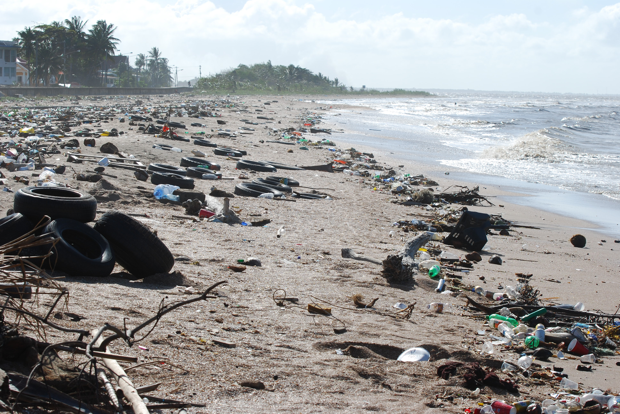
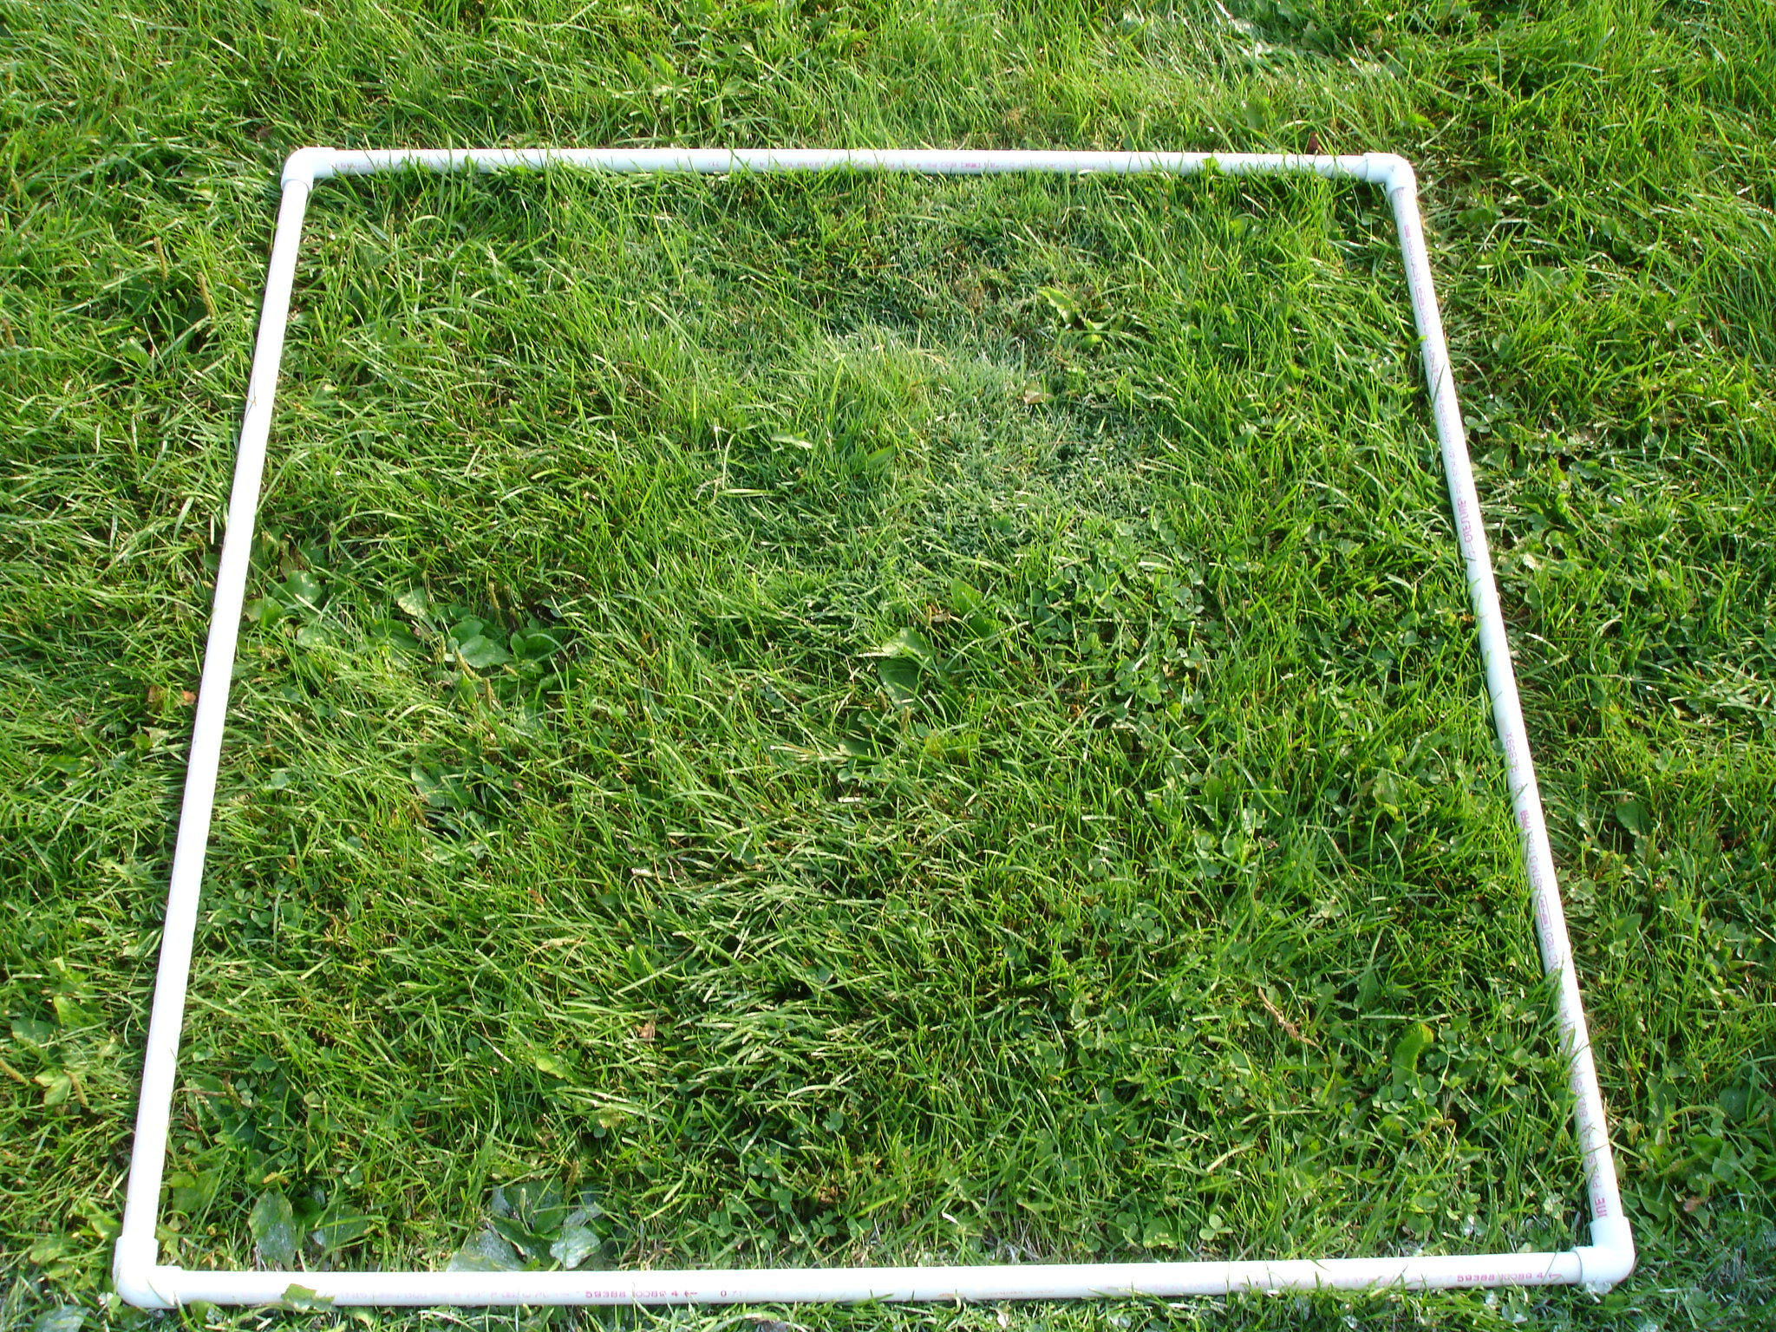
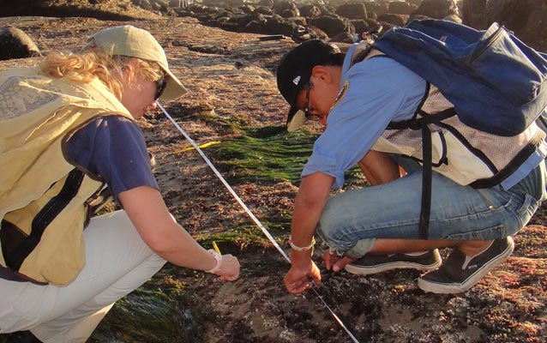
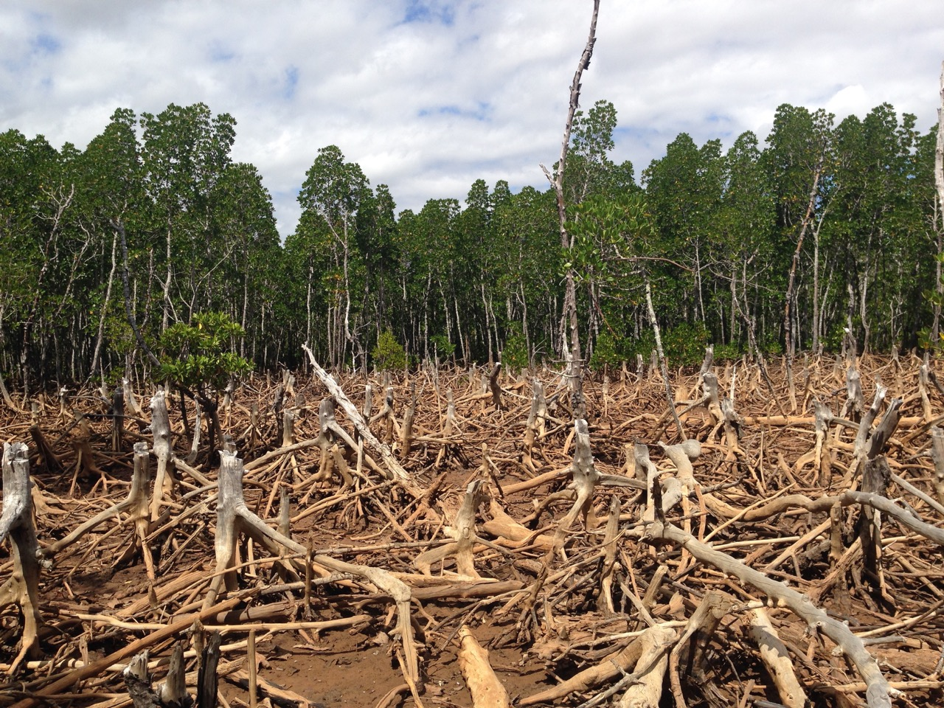
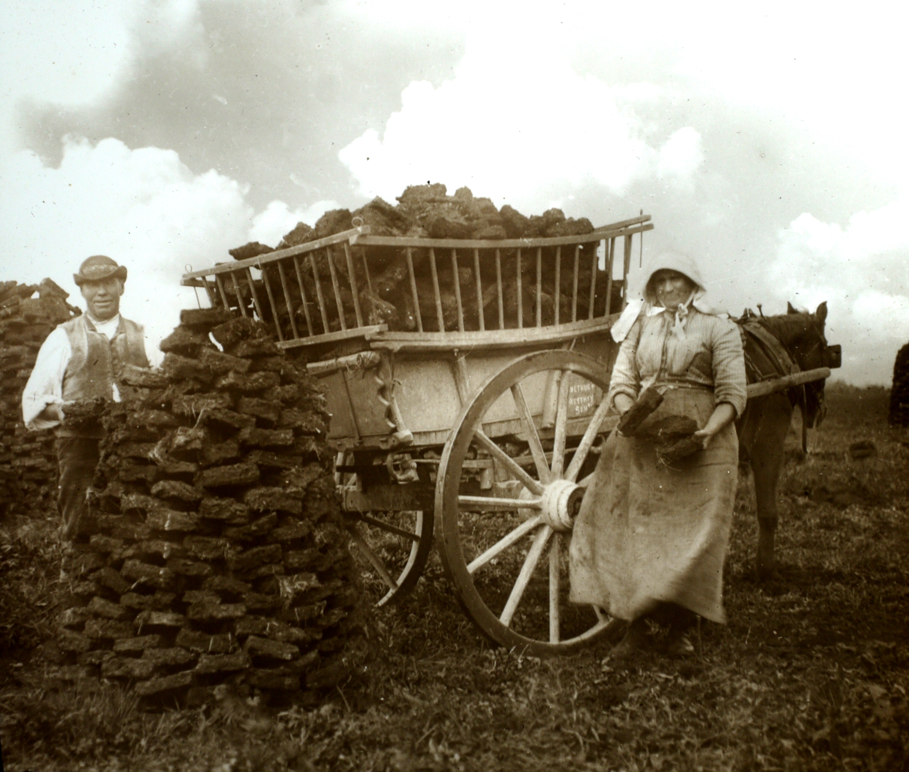
Maintain a great biodiversity | Ensures the stability of ecosystems | By reducing the dependence on one species on another for food, shelter, maintenance of the physical environment.
 | Future of human species | Many human activities are reduction biodiversity and only recently measures have been taken to stop it.
Human activity can have a negative impact on biodiversity
Pollution kills plants and animals which can reduce biodiversity.
Waste management | Rapid growth in human population and higher standard of living | More resources used and more waste produced.
 |  | Pollution in water; sewage, fertiliser or toxic chemicals.
 |  | Pollution in air; smoke or acidic gases.
 |  | Pollution on land; landfill and toxic chemicals.
Biodiversity is the variety of all different species of organisms on Earth, or within an ecosystem
Biodiversity and the effect of human interaction on the ecosystem
Biodiversity
Experimental methods are used to determine the distribution and abundance of a species.
AQA GCSE ECOLOGY PART 3
Land use
Humans reduce the amount of land and habitats available for other plants, animals and microorganisms.
Building and quarrying.
Farming for animals and food crops.
Dumping waste.
Destruction of peat bogs to produce cheap compost for gardeners/farmers to increase food production.
Sampling techniques | Quadrats | Organisms are counted within a randomly placed square
 | Transects | Organisms are counted along a belt (transect) of the ecosystem.
Waste, land use and deforestation
Processing data
Median | Middle value in a sample.
Mode | Most occurring value in a sample.
Mean | The sum of all the value in a sample divided by the sample number.
Impact of environmental change (Biology HT only)
Large scale deforestation
In tropical areas (e.g. rain forest) has occurred to:
Provide land for cattle and rice fields, grow crops for biofuels.
The decay or burning of peat release CO₂ into the atmosphere.
Environmental changes affect the distribution of species | Temperature | These changes might be seasonal, geographic or caused by human interaction.
 | Availability of water
 | Composition of atmospheric gases
This conflicts with conserving peat bogs and peatlands as habitats for biodiversity and reduce CO₂ emissions.
Example: Several species of bird migrate from cold winter conditions to warmer conditions closer to the equator.
Deforestation reduces biodiversity and removes a sink for increasing the amount CO₂ in the atmosphere.

Slide 2
 | Ensures the stability of ecosystems | By reducing the dependence on one species on another for food, shelter, maintenance of the physical environment.
 | Future of human species | Many human activities are reduction biodiversity and only recently measures have been taken to stop it.
Human activity can have a negative impact on biodiversity
Pollution kills plants and animals which can reduce biodiversity.
 | Rapid growth in human population and higher standard of living | More resources used and more waste produced.
 |  | Pollution in water; sewage, fertiliser or toxic chemicals.
 |  | Pollution in air; smoke or acidic gases.
 |  | Pollution on land; landfill and toxic chemicals.
Biodiversity is the variety of all different species of organisms on Earth, or within an ecosystem
Biodiversity and the effect of human interaction on the ecosystem
Biodiversity
Experimental methods are used to determine the distribution and abundance of a species.
AQA GCSE ECOLOGY PART 3
Humans reduce the amount of land and habitats available for other plants, animals and microorganisms.
Building and quarrying.
Farming for animals and food crops.
Dumping waste.
Destruction of peat bogs to produce cheap compost for gardeners/farmers to increase food production.
 | Quadrats | Organisms are counted within a randomly placed square
 | Transects | Organisms are counted along a belt (transect) of the ecosystem.
Waste, land use and deforestation
Median | Middle value in a sample.
Mode | Most occurring value in a sample.
Mean | The sum of all the value in a sample divided by the sample number.
Impact of environmental change (Biology HT only)
In tropical areas (e.g. rain forest) has occurred to:
Provide land for cattle and rice fields, grow crops for biofuels.
The decay or burning of peat release CO₂ into the atmosphere.
 | Temperature | These changes might be seasonal, geographic or caused by human interaction.
 | Availability of water
 | Composition of atmospheric gases
This conflicts with conserving peat bogs and peatlands as habitats for biodiversity and reduce CO₂ emissions.
Example: Several species of bird migrate from cold winter conditions to warmer conditions closer to the equator.
Deforestation reduces biodiversity and removes a sink for increasing the amount CO₂ in the atmosphere.

Slide 3
 |  | By reducing the dependence on one species on another for food, shelter, maintenance of the physical environment.
 |  | Many human activities are reduction biodiversity and only recently measures have been taken to stop it.
Human activity can have a negative impact on biodiversity
Pollution kills plants and animals which can reduce biodiversity.
 |  | More resources used and more waste produced.
 |  | Pollution in water; sewage, fertiliser or toxic chemicals.
 |  | Pollution in air; smoke or acidic gases.
 |  | Pollution on land; landfill and toxic chemicals.
Biodiversity is the variety of all different species of organisms on Earth, or within an ecosystem
Biodiversity and the effect of human interaction on the ecosystem
Biodiversity
Experimental methods are used to determine the distribution and abundance of a species.
AQA GCSE ECOLOGY PART 3
Building and quarrying.
Farming for animals and food crops.
Dumping waste.
Destruction of peat bogs to produce cheap compost for gardeners/farmers to increase food production.
 |  | Organisms are counted within a randomly placed square
 |  | Organisms are counted along a belt (transect) of the ecosystem.
Waste, land use and deforestation
 | Middle value in a sample.
 | Most occurring value in a sample.
 | The sum of all the value in a sample divided by the sample number.
Impact of environmental change (Biology HT only)
Provide land for cattle and rice fields, grow crops for biofuels.
The decay or burning of peat release CO₂ into the atmosphere.
 |  | These changes might be seasonal, geographic or caused by human interaction.
This conflicts with conserving peat bogs and peatlands as habitats for biodiversity and reduce CO₂ emissions.
Example: Several species of bird migrate from cold winter conditions to warmer conditions closer to the equator.
Deforestation reduces biodiversity and removes a sink for increasing the amount CO₂ in the atmosphere.

Slide 4
Human activity can have a negative impact on biodiversity
Pollution kills plants and animals which can reduce biodiversity.
Biodiversity is the variety of all different species of organisms on Earth, or within an ecosystem
Biodiversity and the effect of human interaction on the ecosystem
Biodiversity
Experimental methods are used to determine the distribution and abundance of a species.
AQA GCSE ECOLOGY PART 3
Waste, land use and deforestation
Impact of environmental change (Biology HT only)
The decay or burning of peat release CO₂ into the atmosphere.
This conflicts with conserving peat bogs and peatlands as habitats for biodiversity and reduce CO₂ emissions.
Example: Several species of bird migrate from cold winter conditions to warmer conditions closer to the equator.
Deforestation reduces biodiversity and removes a sink for increasing the amount CO₂ in the atmosphere.

