Slide 1
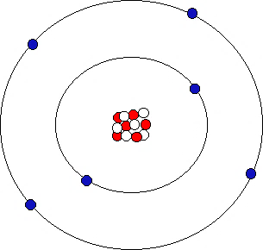
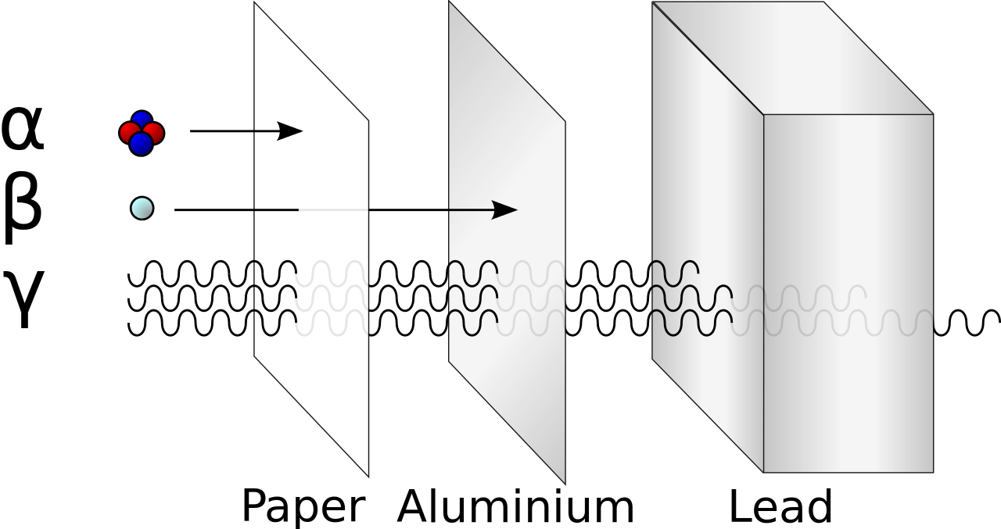
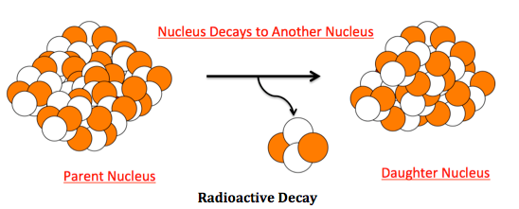
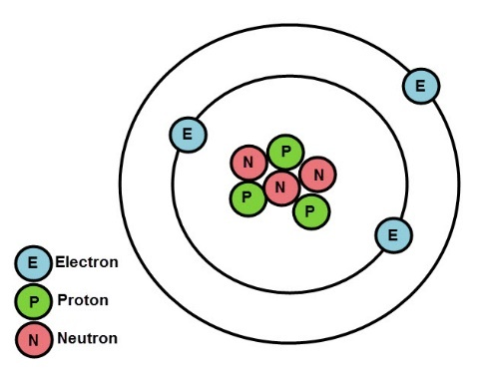
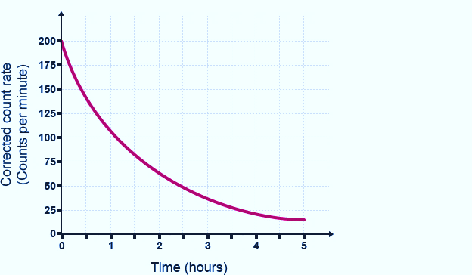
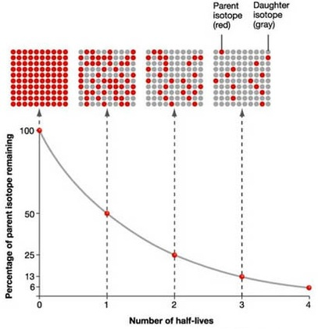
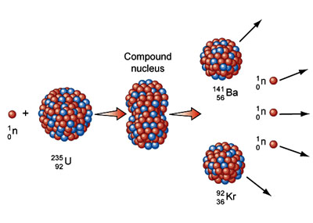
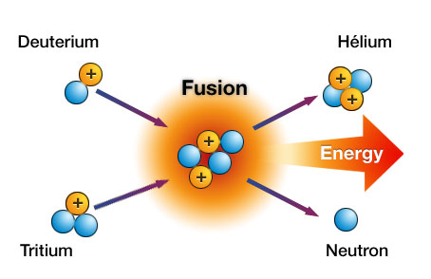
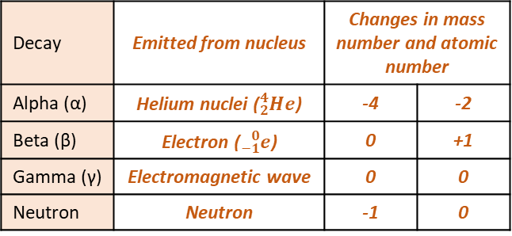
Radius of an atom 1 X 10⁻¹⁰m
Electrons gained
Electrons lost
Decay | Range in air | Ionising power | Penetration power
Alpha | Few cm | Very strong | Stopped by paper
Beta | Few m | Medium | Stopped by Aluminium
Gamma | Great distances | Weak | Stopped by thick lead
Negative ion
Positive ion
Atom | Same number of protons and electrons
Ion | Unequal number of electrons to protons
Mass number | Number of protons and neutrons
Atomic number | Number of protons
Radioactive decay | Unstable atoms randomly emit radiation to become stable
Detecting | Use Geiger Muller tube
Unit | Becquerel
Ionisation | All radiation ionises
Decay | Emitted from nucleus | Changes in mass number and atomic number
Alpha (α) | Helium nuclei (${}_{2}^{4}{He}$) | -4 | -2
Beta (β) | Electron (${}_{−1}^{0}e$) | 0 | +1
Gamma (γ) | Electromagnetic wave | 0 | 0
Neutron | Neutron | -1 | 0
Particle | Charge | Size | Found
Neutron | None | 1 | In the nucleus
Proton | + | 1
Electron | - | Tiny | Orbits the nucleus
Atom structure
$${}_{92}^{238}U→ {}_{90}^{234}{Th+ {}_{2}^{4}{He}}$$
$${}_{6}^{14}C→ {}_{7}^{14}{N+ {}_{−1}^{0}e}$$
Atoms and Nuclear Radiation
$${}_{43}^{99}{Tc}→ {}_{43}^{99}{Tc+ γ}$$
Isotope
Different forms of an element with the same number of protons but different number of neutrons
Atoms and Isotopes
Contamination | Unwanted presence of radioactive atoms
Irradiation | Person is in exposed to radioactive source
AQA
ATOMIC STRUCTURE
PHYSICS ONLY: Hazards and uses of Radioactive emissions and of background radiation
Half life | The time taken to lose half of its initial radioactivity
Discovery of the nucleus
Democritus | Suggested idea of atoms as small spheres that cannot be cut.
J J Thomson (1897) | Discovered electrons– emitted from surface of hot metal. Showed electrons are negatively charged and that they are much less massive than atoms.
Thomson (1904) | Proposed ‘plum pudding’ model – atoms are a ball of positive charge with negative electrons embedded in it.
Geiger and Marsden (1909) | Directed beam of alpha particles (He²⁺)at a thin sheet of gold foil. Found some travelled through, some were deflected, some bounced back.
Rutherford (1911) | Used above evidence to suggest alpha particles deflected due to electrostatic interaction between the very small charged nucleus, nucleus was massive. Proposed mass and positive charge contained in nucleus while electrons found outside the nucleus which cancel the positive charge exactly.
Bohr (1913) | Suggested modern model of atom – electrons in circular orbits around nucleus, electrons can change orbits by emitting or absorbing electromagnetic radiation. His research led to the idea of some particles within the nucleus having positive charge; these were named protons.
Chadwick (1932) | Discovered neutrons in nucleus – enabling other scientists to account for mass of atom.
Sievert | Unit measuring dose of radiation
Background | Constant low level environmental radiation, e.g. from nuclear testing, nuclear power, waste
Nuclear fission and fusion
Uses | Different isotopes have different half lives | Short half-lives used in high doses, long half lives used in low doses.
Tracers | Used within body | Isotope with short half life injected, allowed to circulate and collect in damaged areas. PET scanner used to detect emitting radiation. Must be beta or gamma as alpha does not penetrate the body.
Radiation therapy | Used to treat illnesses e.g. cancer | Cancer cells killed by gamma rays. High dose used to kill cells. Damage to healthy cells prevented by focussed gamma ray gun.
Fuel rods | Made of U-238, ‘enriched’ with U-235 (3%). Long and thin to allow neutrons to escape, hitting nuclei.
Control rods | Made of Boron. Controls the rate of reaction. Boron absorbs excess neutrons.
Concrete | Neutrons hazardous to humans – thick concreate shield protects workers.
PHYSICS ONLY: Nuclear energy
Nuclear fission | One large unstable nucleus splits to make two smaller nuclei | Neutron hits U-235 nucleus, nucleus absorbs neutron, splits emitting two or three neutrons and two smaller nuclei. Process also releases energy. | Process repeats, chain reaction formed
 |  |  | Used in nuclear power stations
Nuclear fusion | Two small nuclei join to make one larger nucleus | Difficult to do on Earth – huge amounts of pressure and temperature needed. | Occurs in stars

Slide 2
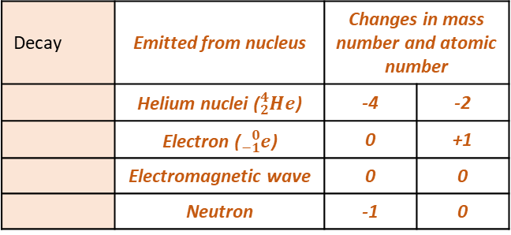
Radius of an atom 1 X 10⁻¹⁰m
Electrons gained
Electrons lost
 | Range in air | Ionising power | Penetration power
 | Few cm | Very strong | Stopped by paper
 | Few m | Medium | Stopped by Aluminium
 | Great distances | Weak | Stopped by thick lead
Negative ion
Positive ion
 | Same number of protons and electrons
 | Unequal number of electrons to protons
 | Number of protons and neutrons
 | Number of protons
 | Unstable atoms randomly emit radiation to become stable
 | Use Geiger Muller tube
 | Becquerel
 | All radiation ionises
Decay | Emitted from nucleus | Changes in mass number and atomic number
 | Helium nuclei (${}_{2}^{4}{He}$) | -4 | -2
 | Electron (${}_{−1}^{0}e$) | 0 | +1
 | Electromagnetic wave | 0 | 0
 | Neutron | -1 | 0
Particle | Charge | Size | Found
 | None | 1 | In the nucleus
 | + | 1
 | - | Tiny | Orbits the nucleus
Atom structure
$${}_{92}^{238}U→ {}_{90}^{234}{Th+ {}_{2}^{4}{He}}$$
$${}_{6}^{14}C→ {}_{7}^{14}{N+ {}_{−1}^{0}e}$$
Atoms and Nuclear Radiation
$${}_{43}^{99}{Tc}→ {}_{43}^{99}{Tc+ γ}$$
Different forms of an element with the same number of protons but different number of neutrons
Atoms and Isotopes
 | Unwanted presence of radioactive atoms
 | Person is in exposed to radioactive source
AQA
ATOMIC STRUCTURE
PHYSICS ONLY: Hazards and uses of Radioactive emissions and of background radiation
 | The time taken to lose half of its initial radioactivity
Discovery of the nucleus
 | Suggested idea of atoms as small spheres that cannot be cut.
 | Discovered electrons– emitted from surface of hot metal. Showed electrons are negatively charged and that they are much less massive than atoms.
 | Proposed ‘plum pudding’ model – atoms are a ball of positive charge with negative electrons embedded in it.
 | Directed beam of alpha particles (He²⁺)at a thin sheet of gold foil. Found some travelled through, some were deflected, some bounced back.
 | Used above evidence to suggest alpha particles deflected due to electrostatic interaction between the very small charged nucleus, nucleus was massive. Proposed mass and positive charge contained in nucleus while electrons found outside the nucleus which cancel the positive charge exactly.
 | Suggested modern model of atom – electrons in circular orbits around nucleus, electrons can change orbits by emitting or absorbing electromagnetic radiation. His research led to the idea of some particles within the nucleus having positive charge; these were named protons.
 | Discovered neutrons in nucleus – enabling other scientists to account for mass of atom.
 | Unit measuring dose of radiation
 | Constant low level environmental radiation, e.g. from nuclear testing, nuclear power, waste
Nuclear fission and fusion
 | Different isotopes have different half lives | Short half-lives used in high doses, long half lives used in low doses.
 | Used within body | Isotope with short half life injected, allowed to circulate and collect in damaged areas. PET scanner used to detect emitting radiation. Must be beta or gamma as alpha does not penetrate the body.
 | Used to treat illnesses e.g. cancer | Cancer cells killed by gamma rays. High dose used to kill cells. Damage to healthy cells prevented by focussed gamma ray gun.
 | Made of U-238, ‘enriched’ with U-235 (3%). Long and thin to allow neutrons to escape, hitting nuclei.
 | Made of Boron. Controls the rate of reaction. Boron absorbs excess neutrons.
 | Neutrons hazardous to humans – thick concreate shield protects workers.
PHYSICS ONLY: Nuclear energy
 | One large unstable nucleus splits to make two smaller nuclei | Neutron hits U-235 nucleus, nucleus absorbs neutron, splits emitting two or three neutrons and two smaller nuclei. Process also releases energy. | Process repeats, chain reaction formed
 |  |  | Used in nuclear power stations
 | Two small nuclei join to make one larger nucleus | Difficult to do on Earth – huge amounts of pressure and temperature needed. | Occurs in stars

Slide 3
Radius of an atom
Decay
Alpha
Beta
Gamma
Negative ion
Positive ion
Atom
Ion
Mass number
Atomic number
Radioactive decay
Detecting
Unit
Ionisation
Decay
Alpha (α)
Beta (β)
Gamma (γ)
Neutron
Particle |  | Size
Neutron |  | 1
Proton |  | 1
Electron |  | Tiny
Atom structure
$${}_{92}^{238}U→ {}_{90}^{234}{Th+ {}_{2}^{4}{He}}$$
$${}_{6}^{14}C→ {}_{7}^{14}{N+ {}_{−1}^{0}e}$$
Atoms and Nuclear Radiation
$${}_{43}^{99}{Tc}→ {}_{43}^{99}{Tc+ γ}$$
Isotope
Atoms and Isotopes
Contamination | Unwanted presence of radioactive atoms
Irradiation | Person is in exposed to radioactive source
AQA
ATOMIC STRUCTURE
PHYSICS ONLY: Hazards and uses of Radioactive emissions and of background radiation
Half life
Discovery of the nucleus
Democritus
J J Thomson (1897)
Thomson (1904)
Geiger and Marsden (1909)
Rutherford (1911)
Bohr (1913)
Chadwick (1932)
Sievert
Background
Nuclear fission and fusion
Uses
Tracers
Radiation therapy
Fuel rods
Control rods
Concrete
PHYSICS ONLY: Nuclear energy
Nuclear fission
Nuclear fusion

Slide 4
Atom structure
Atoms and Nuclear Radiation
Atoms and Isotopes
AQA
ATOMIC STRUCTURE
PHYSICS ONLY: Hazards and uses of Radioactive emissions and of background radiation
Discovery of the nucleus
Nuclear fission and fusion
PHYSICS ONLY: Nuclear energy

