Slide 1
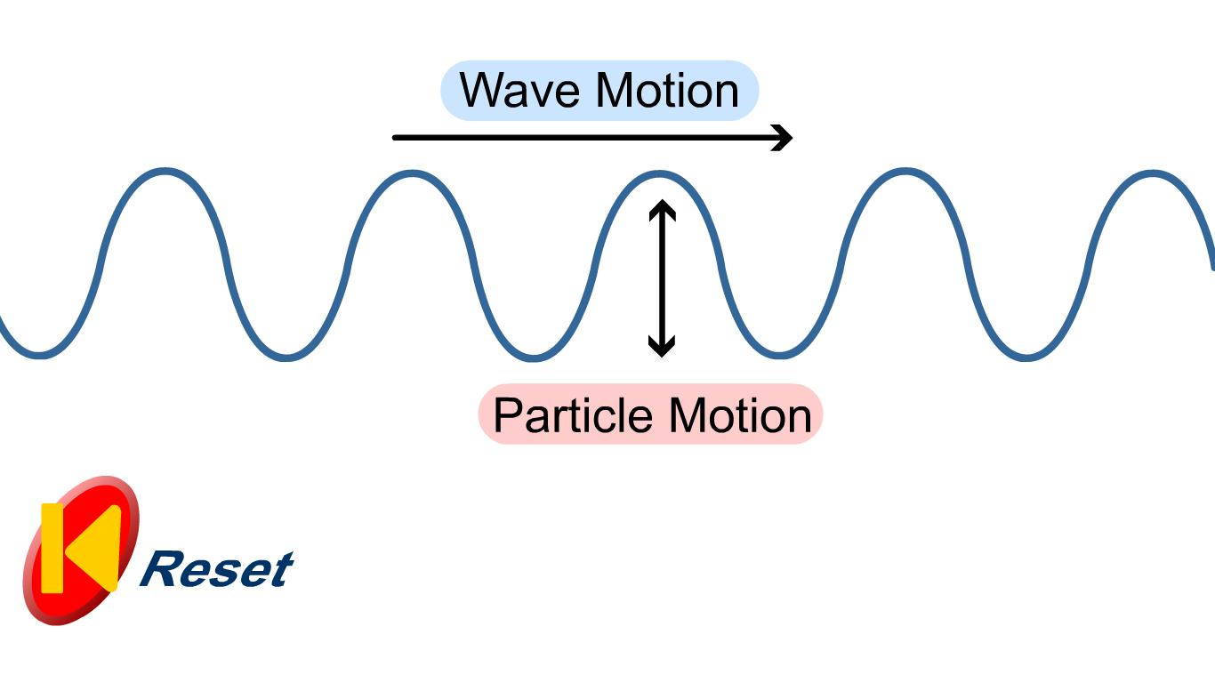
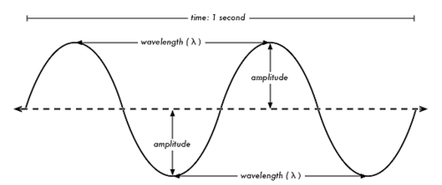
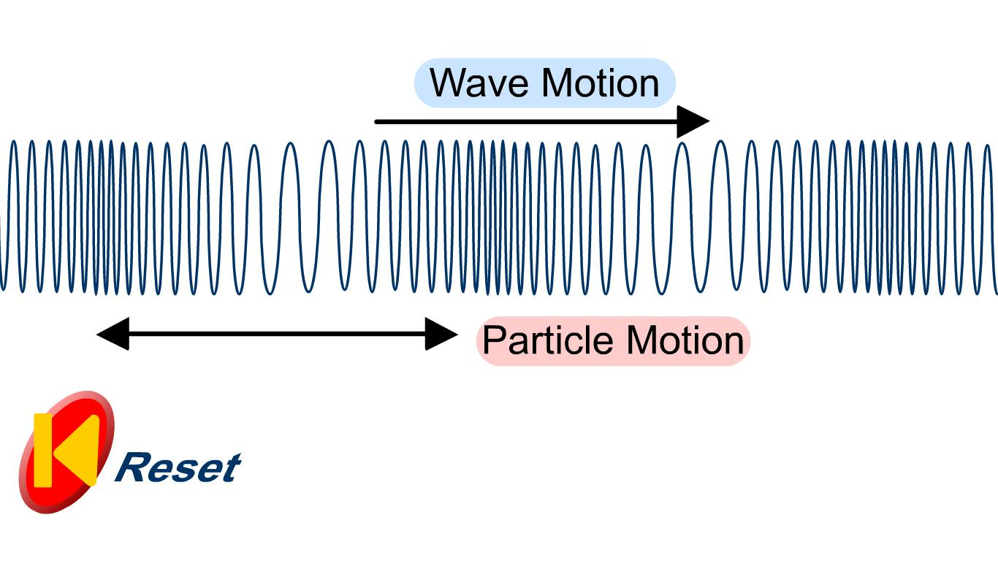
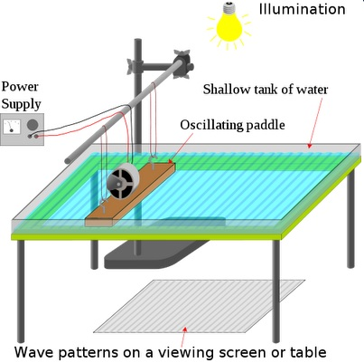
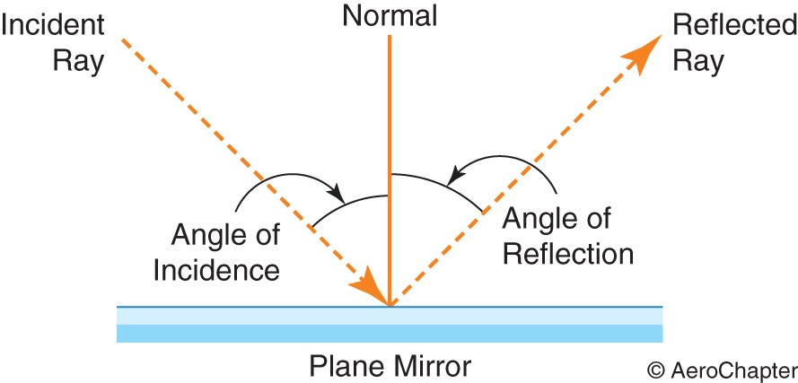
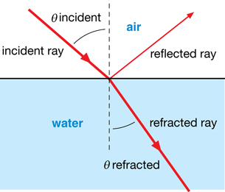
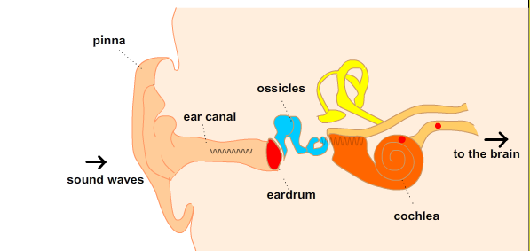
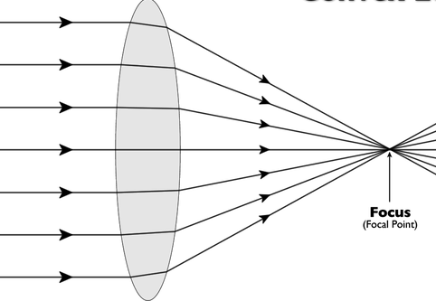
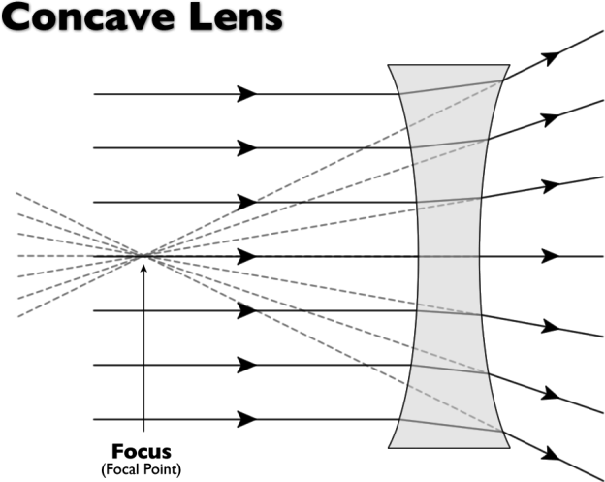
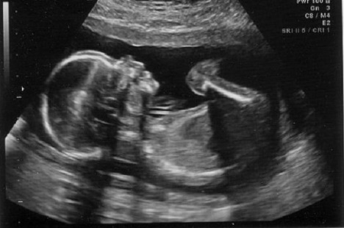
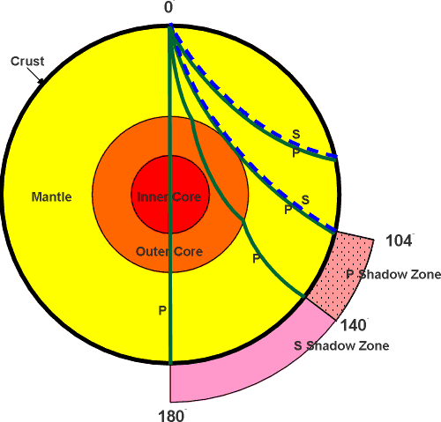
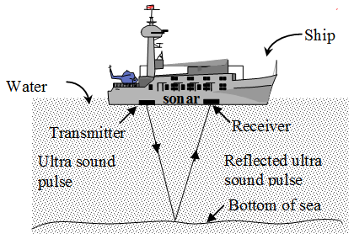
Wave speed | Wave speed = frequency X wavelength | V = $f X λ$
Wave period | Wave period = 1 ÷ frequency | T = 1 ÷ f
Speed | Speed = distance ÷ time | v = d ÷ t
Transverse wave | Vibration causing the wave is at right angles to the direction of energy transfer | Energy is carried outwards by the wave. | Water and light waves, S waves.
Longitudinal wave | Vibration causing the wave is parallel to the direction of energy transfer | Energy is carried along the wave. | Sound waves, P waves.
Wavelength | Distance from one point on a wave to the same point of the next wave
Amplitude | The maximum disturbance from its rest position
Frequency | Number of waves per second
Period | Time taken to produce 1 complete wave
Transverse and Longitudinal waves
Ultraviolet, visible light, infra-red radiation penetrate atmosphere and heat up Earth’s surface.
Energy lost is not at the same rate as energy being absorbed so Earth heats up.
Waves in air, fluids and solids
Black body radiation
PHYSICS ONLY
Earth and Global warming
In water, use a ripple tank.
Measuring speed
Properties
Longer wavelengths are radiated back, trapped by atmosphere.
In air, use echoes.
Sound waves travelling through different mediums, the frequency stay constant.
Air Water
AQA Waves
Black body radiation | All objects absorb or reflect infrared radiation | Hotter objects emit more infrared radiation.
Constant temperature | Rate of absorption = rate of radiation | Intensity and wavelength of energy affects temperature.
PHYSICS ONLY
Angle of incidence = angle of reflection (i) = (r)
e.g. Gamma
Electromagnetic waves
Short wavelengths have high frequency and high energy.
Reflection | Wave bounces off the surface.
Refraction | Waves changes direction at boundary.
Transmitted | Passes through the object.
Absorbed | Passes into but not out of, transfers energy and heats up the object.
Light refracts as it slows down in a denser substance
PHYSICS ONLY
 | Units
Distance | Metres (m)
Wave speed | Metres per second (m/s)
Wavelength | Metres (m)
Frequency | Hertz (Hz)
Period | Seconds (s)
Electromagnetic wave | Continuous spectrum of transverse waves
Magnification = image size ÷ object size
PHYSICS HIGHER ONLY
HIGHER: Lenses
Absorbed light changes into thermal energy store.
HIGHER: Properties
Convex | Real or virtual images.
Concave | Only virtual images.
Hearing | Frequencies between 20 – 20,000 Hz | Longitudinal waves cause ear drum to vibrate, amplified by three ossicles which creates pressure in the cochlea.
2F | Image same size, upside down, real.
2F - F | Image larger, upside down, real.
< F | Image bigger, right way, virtual.
Specular | Flat surface reflection.
Diffuse | Rough surface reflection.
Seismic waves
Black surfaces | Good emitters, good absorbers
White surfaces | Poor emitters, poor absorbers
Shiny surfaces | Good reflectors
P wave | S wave | Seismograph
Longitudinal | Transverse | Shows P and S waves arriving at different times.
Fast | Slow
Travel through solids and liquids | Travels through solids | By using the times the waves arrive at the monitoring centres, the epicentre of earthquake can be found. (v = x ÷ t).
Produced by earthquakes.
EM wave | Danger | Use
Radio | Safe. | Communications, TV, radio.
Microwave | Burning if concentrated. | Mobile phones, cooking, satellites.
Infrared |  | Heating, remote controls, cooking.
Visible | Damage to eyes. | Illumination, photography, fibre optics.
Ultra violet | Sunburn, cancer. | Security marking, disinfecting water.
X-ray | Cell destruction, mutation, cancer. | Broken bones, airport security.
Gamma |  | Sterilising, detecting and killing cancer.
Low frequency, long wavelength.
White | Wave lengths reflected
Black | Wave lengths absorbed
EM waves refract
Ultra sound | Partially reflected off boundary | Used for medical and foetal scans.
Sonar | Reflected off objects | Used to determine depth of objects under the sea.
High frequency, short wavelength

Slide 2
 | Wave speed = frequency X wavelength | V = $f X λ$
 | Wave period = 1 ÷ frequency | T = 1 ÷ f
 | Speed = distance ÷ time | v = d ÷ t
 | Vibration causing the wave is at right angles to the direction of energy transfer | Energy is carried outwards by the wave. | Water and light waves, S waves.
 | Vibration causing the wave is parallel to the direction of energy transfer | Energy is carried along the wave. | Sound waves, P waves.
 | Distance from one point on a wave to the same point of the next wave
 | The maximum disturbance from its rest position
 | Number of waves per second
 | Time taken to produce 1 complete wave
Transverse and Longitudinal waves
Ultraviolet, visible light, infra-red radiation penetrate atmosphere and heat up Earth’s surface.
Energy lost is not at the same rate as energy being absorbed so Earth heats up.
Waves in air, fluids and solids
Black body radiation
PHYSICS ONLY
Earth and Global warming
In water, use a ripple tank.
Measuring speed
Properties
Longer wavelengths are radiated back, trapped by atmosphere.
In air, use echoes.
Sound waves travelling through different mediums, the frequency stay constant.
Air Water
AQA Waves
 | All objects absorb or reflect infrared radiation | Hotter objects emit more infrared radiation.
 | Rate of absorption = rate of radiation | Intensity and wavelength of energy affects temperature.
PHYSICS ONLY
Angle of incidence = angle of reflection (i) = (r)
e.g. Gamma
Electromagnetic waves
Short wavelengths have high frequency and high energy.
 | Wave bounces off the surface.
 | Waves changes direction at boundary.
 | Passes through the object.
 | Passes into but not out of, transfers energy and heats up the object.
Light refracts as it slows down in a denser substance
PHYSICS ONLY
 | Units
 | Metres (m)
 | Metres per second (m/s)
 | Metres (m)
 | Hertz (Hz)
 | Seconds (s)
 | Continuous spectrum of transverse waves
Magnification = image size ÷ object size
PHYSICS HIGHER ONLY
HIGHER: Lenses
Absorbed light changes into thermal energy store.
HIGHER: Properties
 | Real or virtual images.
 | Only virtual images.
 | Frequencies between 20 – 20,000 Hz | Longitudinal waves cause ear drum to vibrate, amplified by three ossicles which creates pressure in the cochlea.
 | Image same size, upside down, real.
 | Image larger, upside down, real.
 | Image bigger, right way, virtual.
 | Flat surface reflection.
 | Rough surface reflection.
Seismic waves
 | Good emitters, good absorbers
 | Poor emitters, poor absorbers
 | Good reflectors
Longitudinal | Transverse | Shows P and S waves arriving at different times.
Fast | Slow
Travel through solids and liquids | Travels through solids | By using the times the waves arrive at the monitoring centres, the epicentre of earthquake can be found. (v = x ÷ t).
Produced by earthquakes.
 | Danger | Use
 | Safe. | Communications, TV, radio.
 | Burning if concentrated. | Mobile phones, cooking, satellites.
 |  | Heating, remote controls, cooking.
 | Damage to eyes. | Illumination, photography, fibre optics.
 | Sunburn, cancer. | Security marking, disinfecting water.
 | Cell destruction, mutation, cancer. | Broken bones, airport security.
 |  | Sterilising, detecting and killing cancer.
Low frequency, long wavelength.
 | Wave lengths reflected
 | Wave lengths absorbed
EM waves refract
 | Partially reflected off boundary | Used for medical and foetal scans.
 | Reflected off objects | Used to determine depth of objects under the sea.
High frequency, short wavelength

Slide 3
Wave speed
Wave period
Speed
Transverse wave
Longitudinal wave
Wavelength
Amplitude
Frequency
Period
Transverse and Longitudinal waves
Waves in air, fluids and solids
Black body radiation
PHYSICS ONLY
Earth and Global warming
Properties
.
.
Air Water
AQA Waves
Black body radiation
Constant temperature
PHYSICS ONLY
e.g. Gamma
Electromagnetic waves
Short wavelengths
Reflection
Refraction
Transmitted
Absorbed
PHYSICS ONLY
Distance
Wave speed
Wavelength
Frequency
Period
Electromagnetic wave
Magnification
PHYSICS HIGHER ONLY
HIGHER: Lenses
HIGHER: Properties
Convex
Concave
Hearing
2F
2F - F
< F
Specular
Diffuse
Seismic waves
Black surfaces
White surfaces
Shiny surfaces
P wave | S wave | Seismograph
EM wave | Danger | Use
Radio
Microwave
Infrared
Visible
Ultra violet
X-ray
Gamma
.
White
Black
EM waves refract
Ultra sound
Sonar

Slide 4
Transverse and Longitudinal waves
Waves in air, fluids and solids
Black body radiation
PHYSICS ONLY
Earth and Global warming
Properties
.
Air Water
PHYSICS ONLY
AQA Waves
Electromagnetic waves
PHYSICS ONLY
PHYSICS HIGHER ONLY
HIGHER: Lenses
HIGHER: Properties
Seismic waves
.
.

