Slide 1
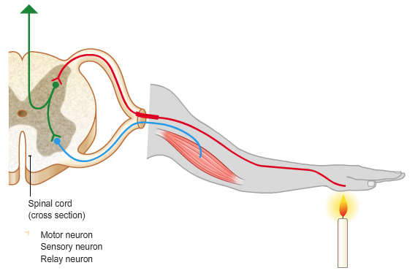
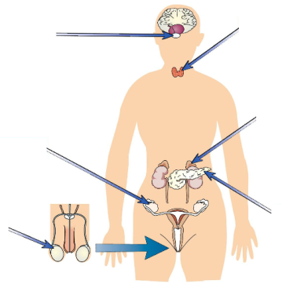
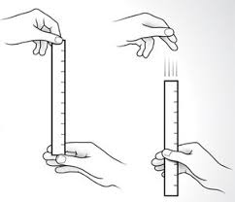
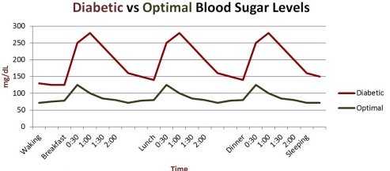
B5 Homeostasis and response AQA Trilogy | Define homeostasis List 3 things that need to be kept in homeostasis in the human body | Draw a flow chart to show the action of the reflex arc below. | Why is the reflex arc important? Name the 3 types of neurone in the reflex arc What is a synapse and how does it work?
RPA 7: Reaction times Explain why using a computer to measure reaction times is better than the ruler drop method. | Define the term hormone. | Complete the labels | Explain why the pituitary gland is often called the master gland.
Explain how glucagon interacts with insulin in a negative feedback cycle to control blood glucose levels | Describe what occurs if blood glucose levels are too low KW: glucagon, glycogen, pancreas | Where is blood glucose monitored? Describe the two roles of insulin in lowering blood glucose levels | Describe the effect of insulin on people with and without diabetes
Compare the causes and treatment of Type 1 and Type 2 diabetes.

Slide 2
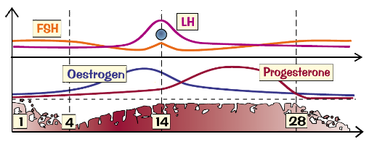
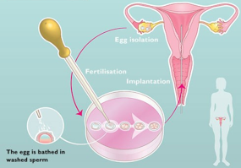
B5 Homeostasis and response AQA Trilogy | What is the endocrine system and how does it work? Describe the role of the pituitary gland | Water levels are controlled by the hormone _____. It is released by the ______________ gland into the ________ and affects the permeability of the _________ tubules. ADH causes __________ water to be absorbed back into the blood. It is controlled by _____________ feedback | List 3 ways that water is lost from the body Name 2 ways that urea and ions are lost from the body
Explain the roles of the following hormones: Thyroxine Adrenaline | State 2 ways in which the effects of the nervous system differ from the nervous system. | Where are the following hormones produced and what are their functions? Oestrogen Testosterone | What is meant the term secondary sex characteristics and what causes these to occur?
What do the following acronyms stand for: IVF FSH LH | List the 4 hormones involved in the menstrual cycle and give their functions | Explain how hormones interact to control the menstrual cycle | Describe the steps involved in IVF treatment
List three negative impacts of fertility treatment on a couple | Explain how the following contraceptives work: Oral contraceptives Injection/ implant/ skin patch | Explain how the following contraceptives work: Barrier methods (condoms/ diaphragms) Spermicidal agents | Explain how the following contraceptives work: IUD Abstianing Surgical methods

