Slide 1
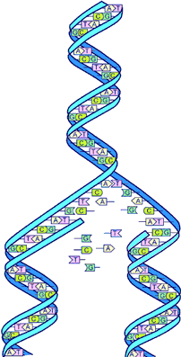
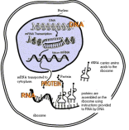
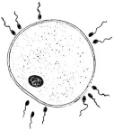
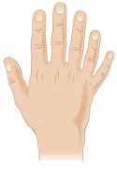
B6 Inheritance variation and evolution AQA Triple science | Define the following terms: Gene Chromosome Genome Allele | Define the following terms: Dominant Recessive Homozygous Heterozygous | Draw a genetic cross for gender
Describe the difference between sexual reproduction and asexual reproduction | Discuss the importance of understanding the human genome | Describe the process of protein synthesis | Describe the Theory of Evolution by Natural Selection
Describe the process of meiosis and explain why it is important for sexual reproduction | Explain the differences between how cystic fibrosis and polydactyly are passed on to offspring. | Describe 3 types of mutation | What are fossils and how can they be used to learn more about how life has changed on Earth?
Draw a fully labelled diagram to show the structure of DNA | Draw a Punnett square to work out the probability that a child will inherit polydactyly if the parents have the genotypes Pp and pp | Explain what is meant by speciation | What was Lamarck’s theory and why was it discredited?

Slide 2
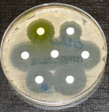
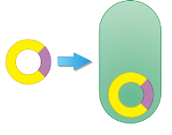
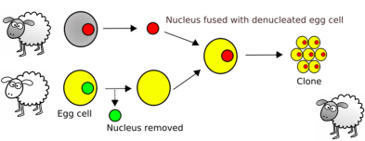
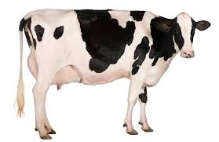
B6 Inheritance variation and evolution AQA Triple science | Outline: Tissue culture Cuttings | Describe the process of selective breeding (artificial selection) | Explain how bacteria can become resistant to certain antibiotics
Describe genetic engineering | Describe the process of artificial embryo twinning | Give 4 examples of characteristics that may be selected for | How can we reduce the number of bacteria becoming resistant to certain antibiotics
Give uses of genetic engineering | Describe the process of adult cell cloning | Give some of the negative impacts of selective breeding | Complete for the D K P C O F G S
Outline some of the pros and cons of GM crops | Describe the main issues surrounding cloning | Imagine you are a farmer, describe how you would selectively breed cows to produce high volumes of milk | Why do scientists use the binomial naming system?

