Slide 1
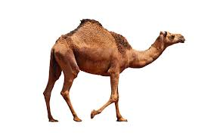
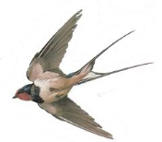
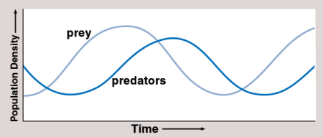
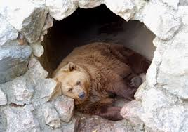
B7 Ecology AQA Trilogy | Explain what is meant by a producer in a food chain or web | Give examples of structural adaptations | RPA 9: measuring population size with quadrats Describe how to use a quadrat to measure the distribution of daisies on the school field
Define the terms: Habitat Population Community Ecosystem | Define the terms: Primary consumer Secondary consumer Tertiary consumer | Give examples of behavioural adaptations | RPA 9: measuring population size with transects Describe how to use a transect and a quadrat to measure the distribution of organisms on the seashore.
List abiotic (non-living) factors | Describe the relationship between predators and prey | Give examples of functional adaptations | Anna counted the number of daisies in 7 quadrats. Her results were: 18, 20, 22,23, 23,23,25. Calculate the: Mean Mode Median
List biotic (living) factors | Define the terms: Predator Prey Biomass | Give examples of extremophiles | Students used 0.5m² quadrats to randomly sample daisies on the school field. Their mean number of daisies per quadrat was 10.5 and the field has an area of 800m². Estimate the population of daisies on the field

Slide 2
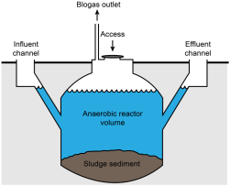
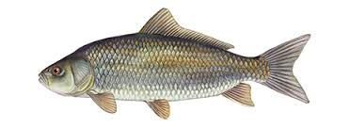
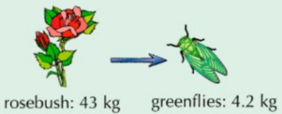
B7 Ecology AQA Trilogy | Describe how a biogas generator produces methane | How can pollution occur: In water On land In the air
How is carbon removed from the atmosphere? List 3 ways that CO₂ is released into the atmosphere | What is interdependence? What is the limitations of food chains? | Give examples of programmes put in place to reduce the negative impacts of humans on ecosystems and biodiversity | How can we prevent the fish stocks in the oceans from declining?
Define the following terms: Evaporation Condensation Transpiration Precipitation | Describe examples of how we can maintain biodiversity | Draw and label a typical pyramid of biomass | Give examples of biotechnology in providing for an increasing population
Explain the importance of decomposition List factors that affect the rate of decomposition | Define the term biodiversity How are humans reducing the land available for animals and plants? | Explain why only ~10% of energy is transferred to the next trophic level | Write the equation for working out efficiency. Calculate the efficiency of the transfer from the ladybird to the greenfly

