Slide 1
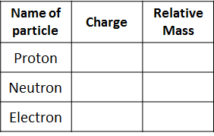
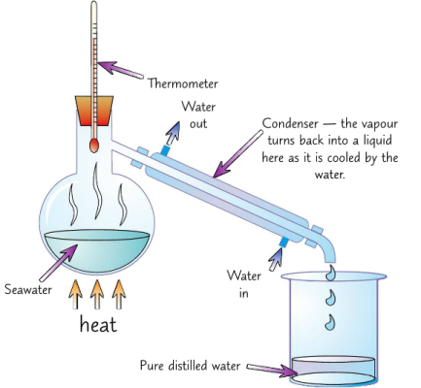
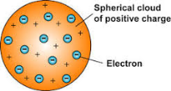
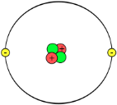
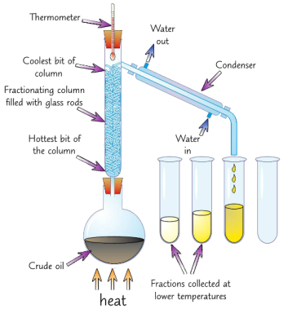
C1 Atomic Structure and the Periodic Table AQA Trilogy | Write the word equation for: Burning magnesium in air Can you write the balanced symbol equation? | Explain crystallisation as a separation technique
Define the following terms: Atom Element Compound Mixture | Balance the symbol equations below: H₂SO₄ + NaOH → Na₂SO₄ + H₂O Zn + O₂ → ZnO CH₄ + O₂ → CO₂ + H₂O | Draw a diagram to illustrate chromatography as a separation technique | Number of protons = Number of neutrons = Number of electrons =
Write the symbols for the following elements: Oxygen Carbon Sodium Magnesium Chlorine Copper |  | Explain simple distillation as a separation technique, shown in the diagram | Describe the difference between the plum pudding and the nuclear model of an atom
Write the name of the compound: CO₂ H₂O NaCl CuSO₄ |  | Explain fractional distillation as a separation technique | Where in an atom are the neutrons and proton? The number of protons = the number of_________ Atomic number is the number of _________ Mass number is the number of ________ + the number of _________ Isotopes have a different number of ____________
Simple distillation
fractional distillation

Slide 2
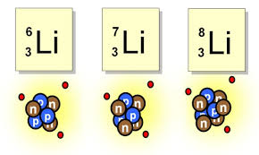
C1 Atomic Structure and the Periodic Table AQA Trilogy | In the periodic table, the elements are arranged in order of their ___________ number Elements in the same group, have the same number of ______________ Groups go ____________ Periods go ___________ | When developing the periodic table, Why did Medeleev leave gaps? Approximately how may elements are in the periodic table? | Properties of metals
Draw the electron structure for sodium | What is group 1 also known as? As you go down group 1, what happens to the reactivity? How many electrons are in the outer shell of a group 1 metal? | Delete as appropriate: If you remove electrons from an atom is becomes positive/ negative If you add electrons to an atom it becomes positive/negative | Properties of non-metals
Draw the electron structure for chlorine | What is group 7 also known as? As you go down group 7, what happens to the reactivity? What happens to melting point and boiling point as you go down the group? How many electrons are in the outer shell of a group 7 element? | What is an isotope? | To work out the relative atomic mass using the abundance of isotopes we can use the following calculation: (% of isotope 1 × mass of isotope 1) + (% of isotope 2 × mass of isotope 2) ÷ 100
Draw the electron structure for chlorine | What is group 0 also know as? In group 0, how many electrons are in the outer shell? How is boiling point affected as you go down the group? | Copper has two stable isotopes Cu-63 which has an abundance of 69.2% and Cu-65 which has an abundance of 30.8% Calculate relative atomic mass to 1dp. | In any sample of Chlorine 25% will be ₃₇Cl and 75% ₃₅Cl. Calculate the relative atomic mass to 1dp.

