Slide 1
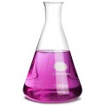
C4 Chemical changes AQA Trilogy | Delete as appropriate: When metals react they form positive / negative ions The more reactive a metal the more / less likely it is to form an ion Aqueous solutions of alkalis contain hydrogen / hydroxide ions | Define the following key terms: Oxidation Reduction Redox reaction Alkali Neutralisation | Define the following key terms: Ore Displacement Electrolysis
Metal + oxygen → Metal oxide Magnesium + oxygen → Zinc + oxygen → The above are oxidation reactions. Explain why | Reactive metal + water → metal hydroxide + hydrogen Lithium + water → Potassium + water → Calcium + water → Less reactive metals won’t react with water | Metal + acid → salt + hydrogen Magnesium + hydrochloric acid → Zinc + sulfuric acid → Iron + hydrochloric acid → | Metal oxide + acid → salt + water Copper oxide + hydrochloric acid → Zinc oxide + sulfuric acid → Magnesium oxide + nitric acid →
Acid + base → salt + water Hydrochloric acid + sodium hydroxide → H⁺ _{(aq)} + OH⁻ _{(aq)}→ | Metal carbonate + acid → salt + water + carbon dioxide Calcium carbonate + hydrochloric acid → Copper carbonate + sulfuric acid → | Metal hydroxide + acid → salt + water Lithium hydroxide + hydrochloric acid → Sodium hydroxide + sulfuric acid → Potassium hydroxide + nitric acid → | RPA 8: Describe how to prepare a pure, dry sample of a soluble salt
Name the salt produced when you use: Hydrochloric acid Sulfuric acid Nitric acid | The pH scale goes from ___ to ___ Numbers of pH less than 7 are __________ pH 7 is _________ Numbers of pH above 7 are ___________ | In relation to acids define the following terms: Dilute Concentrated Weak Strong | Write the symbols for: Hydrochloric acid Sulfuric acid Nitric acid

Slide 2
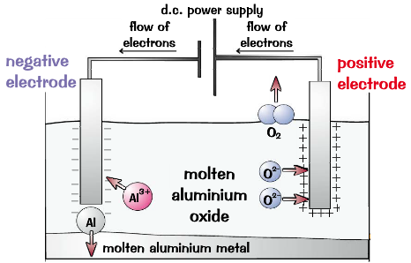
C4 Chemical changes AQA Trilogy | Write the reactivity series below and add on the symbols for each element | Electrolysis key terms: Electrolyte Cathode Anode Inert | In the electrolysis of lead bromide: What forms at the cathode? What forms at the anode? For electrolysis to occur the lead bromide must be solid/ molten
Unreactive metals such as _______ are found in the Earth as the metal itself. More reactive metals such as ________ are found in __________. Metals less reactive than carbon can be extracted using _________ with carbon. | Where does carbon fit into the reactivity series? Which metals can be extracted using carbon? | Using electrolysis to extract aluminium Why is aluminium oxide (bauxite) mixed with cryolite? Why must the positive electrode (anode) be continually replaced? What forms at the anode? What forms at the cathode? | RPA 9: Electrolysis – investigate what happens when aqueous solutions are Electrolysed. In solutions that do not contain a halide ion (Cl⁻,Br⁻,I⁻) Which gas is produced at the: Anode Cathode In solutions that contain a halide ion (Cl⁻,Br⁻,I⁻) Which gas is produced at the: Anode Cathode
Oxidation and reduction O I L R I G | Redox reactions The ionic equation for iron reacting with dilute hydrochloric acid is shown below Fe + 2H⁺ → 2Fe²⁺ + H₂ Iron is oxidised / reduced Fe-2e⁻ → Fe²⁺ Hydrogen is oxidised / reduced 2H⁺ + 2e⁻ → H₂ | Using electrolysis to extract aluminium | An aqueous solution of CuCl₂ is electrolysed using inert electrodes. Write the half equations for the anode cathode
Oxidation or reduction Mg + O₂ → 2MgO The magnesium is oxidised / reduced 2CuO + C → 2Cu + CO₂ The copper is oxidised / reduced | Displacement reactions More reactive metal will displace a less reactive metal Iron + copper sulfate → Magnesium + zinc chloride → Iron + zinc sulfate → | Write the words for the compounds below: NaOH CuCl₂ KSO₄ CaCO₃ MgO | Write the words for the compounds below: HCl H₂SO₄ HNO₃ Fe₂O₃ Ca(OH)₂

