Slide 1
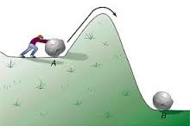
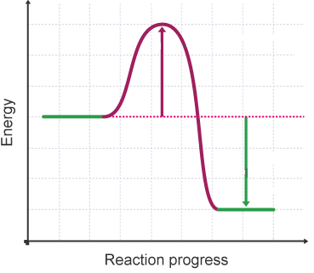
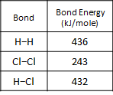
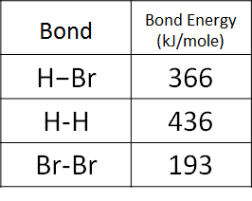
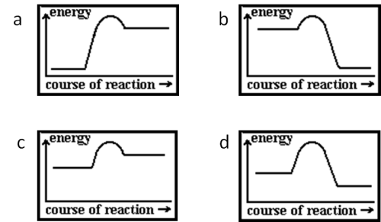
C5 Energy changes AQA Trilogy | Chemical reactions only occur if… | Activation energy is | The overall energy change of a reaction = The sum of the energy needed to break the bonds in the reactants - The sum of the energy needed to make the bonds in the products
Exothermic reactions What is an exothermic reaction Give examples of exothermic reactions Give useful applications of exothermic reactions | Delete as appropriate: Energy is released when bonds are made / broken. This is exothermic / endothermic Energy needs to be supplied when bonds are made / broken This is exothermic / endothermic | Energy level diagram label on: reactants, products, activation energy & energy change | Hydrogen and chlorine react to form hydrogen chloride gas: H₂ + Cl₂ → 2HCl Calculate energy change.
Endothermic reactions What is an endothermic reaction Give examples of endothermic reactions Give useful applications of endothermic reactions | In an exothermic reaction, the energy ________ from forming new bonds is greater than the energy needed to break existing bonds In an endothermic reaction, the energy needed to ________ existing bonds is greater than the energy released from forming new bonds | Sketch an energy level diagram to show an exothermic reaction with labels | Hydrogen bromide decomposes to form hydrogen and bromine: 2HBr → H₂ + Br₂ Calculate energy change
RPA 10: Temperature changes Describe how to tell is a reaction is exothermic or endothermic What measurements need to be taken? Why might the reaction mixture be placed in a polystyrene cup rather than a glass beaker? | Claire puts 25cm³ of ethanoic acid into a polystyrene cup with 25cm³ of potassium hydroxide. Both liquids started at 21ºC. After 2 minutes the temperature of the reaction mixture is 28.5ºC. Is the reaction endothermic or exothermic? | Sketch an energy level diagram to show an endothermic reaction with labels | State is the diagrams show endo or exothermic reactions

