Slide 1
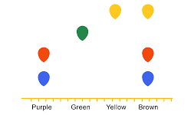
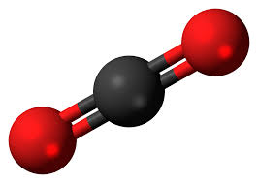
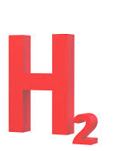
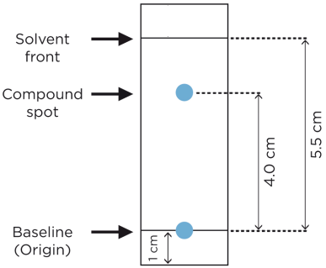
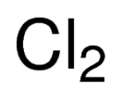
C8 Chemical Analysis AQA Trilogy | Describe how chromatography can be used to identify substances | Define the terms: Soluble Insoluble | Describe how you can use melting points and boiling points to distinguish between pure and impure substances
Define the terms: Pure substance Pure compound | RPA 12: Chromatography Explain why the line at the bottom of the chromatogram should be drawn in pencil Explain why the solvent should be below the sample | RPA 12: Chromatography What are the two phases of chromatography? How many spots will appear for a pure substance? | Which colours are present in brown ink?
What is meant by the term formulation | Describe how to calculate an R_{f} value | Describe the test for carbon dioxide gas | Describe the test for hydrogen gas
Give examples of formulations | Calculate the Rf value | Describe the test for chlorine gas | Describe the test for oxygen gas

