Slide 1
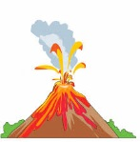
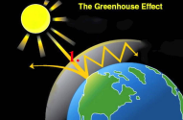
C9 Chemistry of the atmosphere AQA Trilogy | What proportion of the Earth’s atmosphere is: Nitrogen Oxygen Water vapour Carbon dioxide Argon | Give examples of human activities that increase the amounts of greenhouse gases in the atmosphere | Write the following as fractions in their simplest forms: 80% 75% 50% 12.5%
During the first billion years of the Earth’s existence, there was a lot of volcanic activity. How did this change the atmosphere? | Write the word and balanced symbol equations for photosynthesis | Describe four effects of climate change | Explain how carbon monoxide can be produced and describe the dangers of carbon monoxide
How did the formation of the oceans affect the carbon dioxide levels? | Name 3 greenhouse gases | Describe actions we can take to reduce the emissions of CO₂ and methane | Give problems associated with Sulfur dioxide Particulates
How have algae and plats affects the composition of the atmosphere? | Describe what is meant by the term greenhouse effect | Explain why the actions we can take to reduce emissions may be limited | Explain what is meant by peer review

