Slide 1
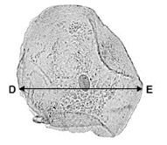
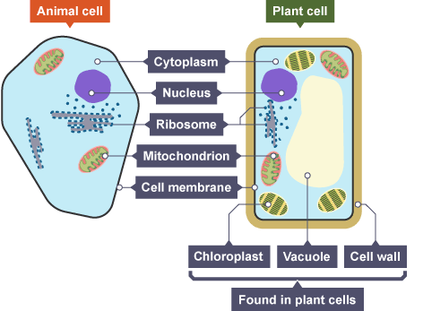
GCSE Science Fold & Solve – Cell Structure
Fold the answers and work through the questions below.
Answers – Fold this over!
AO1
A = Cell Wall
B = Cytoplasm
C = Plasmid DNA
2.
Controls the activities of the cell.
Protein synthesis
Where energy is released during respiration.
3. Cells arranged vertically/large number of chloroplasts/
AO2
Respiration takes place in mitochondria/ release energy/ to use for active transport.
45mm so 45÷ 250 = 0.18mm 0.18x1000 = 180µm
AO3
Stage 4
Only one cell seen in this stage
Label the structure of the bacterial cell.
Describe the function of
Nucleus
Ribosomes
Mitochondria
3. How is a palisade leaf cell adapted for its function?
Suggest why root hair cells contain more mitochondria than other cells.
Calculate the width of the cheek cell in micrometres if it has been magnified 250 times.
AO1
AO2
Each stage of the cell cycle takes a different amount of time.
Which stage is the fastest in the cell cycle?
Give a reason for your answer.
AO3

