Slide 1
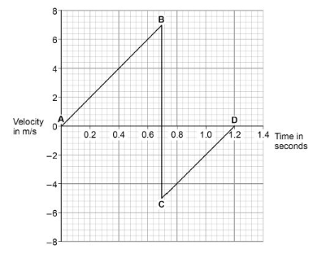
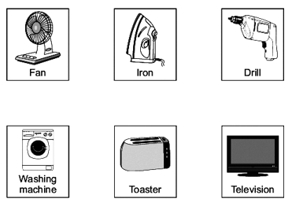
GCSE Science Fold & Solve – Energy Stores & Transfers
Fold the answers and work through the questions below.
Answers – Fold this over!
AO1
Chemical/Gravitational/Elastic/Magnetic/Kinetic/
Heat/Light/Sound/Kinetic/Electrical
Chemical/Kinetic
Fan/Drill/Washing Machine
AO2
48% or 0.48
E_{p} = 50 × 9.8 × 20
9800 (J)
AO3
Velocity just after bounce is less than just before bounce
The height at the top of the bounce is less than the height from which it was dropped
So the ball has lost energy
Correct reference to (loss of) ke or (reduced) gpe
Total energy of ball and Earth / ground is constant
List 2 examples of stores of energy.
State 2 energy transfers.
As the cyclist accelerates, the _______________ energy store in the cyclist’s body decreases and the _____________ energy of the cyclist increases.
Three more of the appliances are also designed to transfer electrical energy to kinetic energy. Which three? Draw a ring around each correct appliance.
The total power input to the leaf blower is 750 W. The useful power output of the leaf blower is 360 W. Calculate the efficiency of the leaf blower.
The mass of the student is 50.0 kg. The gravitational field strength is 9.8 N / kg. Calculate the change in gravitational potential energy from the position where the student jumps to the point 20.0 m below.
AO1
AO2
Chemical Elastic Gravitational Kinetic
1. When the ball hits the ground, energy is transferred from the ball to the Earth.
Explain how the data in the graph above shows this energy transfer.
AO3

