Slide 1
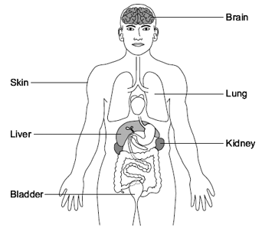
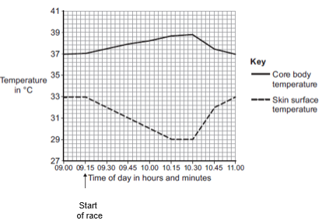
GCSE Science Fold & Solve – Homeostasis
Fold the answers and work through the questions below.
Answers – Fold this over!
AO1
Lungs
Kidney
Bladder
Insulin
Urea
Sweating
AO2
Evaporation of water
cools skin or uses heat from skin
cools blood / heat from blood (passing through skin)
Higher blood sugar level results in increased secretion of insulin
effect of insulin is to lower blood sugar
which in turn reduces rate of insulin secretion
overall result is to keep fluctuations in sugar level to a minimum
AO3
Increase in (core / body) temperature
(due to an) increase in respiration or more muscle contraction
releasing energy (as a waste product)
skin temperature decreases
(because there is) sweating
(which) evaporates and cools the skin
Carbon dioxide is removed from the body by the __________.
Urine is made in the ___________.
Urine is stored in the ___________.
Name the hormone that is responsible for the control of blood glucose.
Name a waste substance, carried in the blood, which is removed by the dialysis machine.
State how water is lost from the skin.
Explain how sweating helps to control body temperature
Explain, using insulin as an example, what is meant by negative feedback
AO1
AO2
Describe and explain the different patterns shown in the core body temperature and skin surface temperature between 09.15 and 10.15.
AO3

