Slide 1
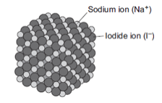
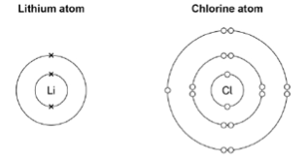
GCSE Science Fold & Solve – Ionic Bonding
Fold the answers and work through the questions below.
Answers – Fold this over!
AO1
Negative
Positive
Metal and Non Metals
Transferred
B
AO2
Sodium loses electron
Chlorine gains electron
1 electron.
The ions can move through the solution.
AO3
Na₂O
Lithium lose electron
Chloride gains electron
Electron is transferred
Lithium becomes positive.
Chloride becomes negative.
Electrostatic attraction between the ions.
Forms an ionic bond.
State the charge on an ion that has gained an electron.
State the charge on an ion that has lost an electron.
Ionic bonds exist between
In ionic bonding electrons are ____________ between elements.
Which diagram shows a Na⁺ ion?
Describe, in terms of electrons, what happens when a sodium atom reacts with a chlorine atom to produce sodium chloride.
Solid sodium iodide does not conduct electricity. Why does sodium iodide solution conduct electricity?
AO1
AO2
Metal and Metal
Metals and Non Metals
Non Metals and Non Metals
Sodium oxide contains Na⁺ ions and O2– ions. Give the formula of sodium oxide.
Predict what would happen during the reaction of a lithium ion and a chloride ion.
AO3
A
B

