Slide 1
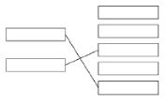
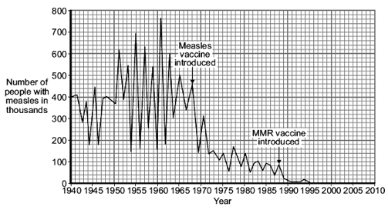
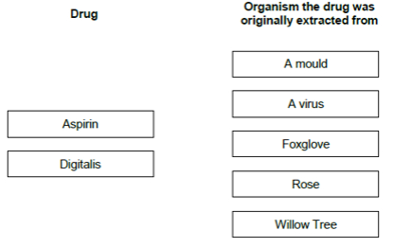
GCSE Science Fold & Solve – Pathogens and Response
Fold the answers and work through the questions below.
Answers – Fold this over!
AO1
Bacteria
Antibodies
Antitoxins
AO2
Check for safety/check for effectiveness/check for side effects.
Dead / inactive pathogen
White blood cells respond
Produce antibodies
Antibodies are specific to pathogen
Antibodies produced quickly (on reinfection) / rapid response
AO3
Both lead to a reduction/fall in cases of measles
Measles vaccine caused a big drop.
MMR vaccine wipes out measles or drops to almost zero.
Which pathogen can be treated by antibiotics?
The substances made by white blood cells to kill pathogens are called ________________________ . The substances made by white blood cells to counteract poisons produced by pathogens are called ______________________ .
Draw one line from each drug to the organism it was originally extracted from.
New drugs must be tested before they can be used. Give one reason why drugs should be tested.
Explain how a vaccination can prevent an illness.
AO1
AO2
Bacteria Fungi Protists Virus
Compare how effective introducing the measles vaccine was with introducing the MMR vaccine.
Use data from the graph.
AO3

