Slide 1
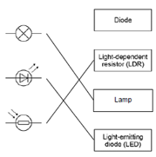
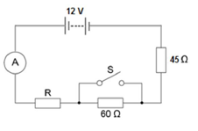
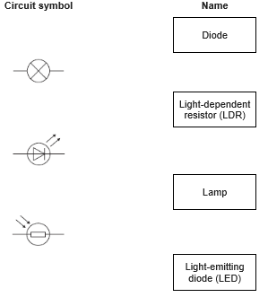
GCSE Science Fold & Solve – Series and Parallel
Fold the answers and work through the questions below.
Answers – Fold this over!
AO1
A continuous loop/components one after another.
Components connected alongside each other/ form extra loops (branches)
Split between components.
Total resistance = sum of all resistors.
Shared between components.
AO2
V = 0.10 × 45
4.5 (V)
R = 12 / 0.10
total resistance = 120 (Ω)
R = 120 – 105 = 15 (Ω)
AO3
connect the solar cells in parallel
(so that) the current has multiple paths it can take
Or the total resistance is less than the resistance of one solar cell
Draw one line from each circuit symbol to its correct name.
Define a series circuit.
Define a parallel circuit.
Identify how current behaves in a parallel circuit.
Identify how resistance behaves in a series circuit.
Identify how potential difference behaves in a series circuit.
The ammeter displays a reading of 0.10 A. Calculate the potential difference across the 45 Ω resistor.
Calculate the resistance of the resistor labelled R.
AO1
AO2
A householder has four solar cells.
Each of the solar cells has a resistance of 0.78 Ω.
Predict how the solar cells should be connected so that the total resistance is as low as possible.
AO3

