Slide 1
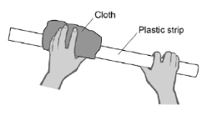
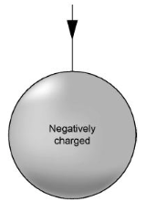
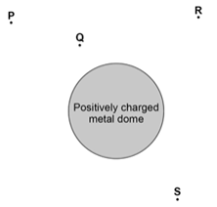
GCSE Science Fold & Solve – Static and Electric Fields
Fold the answers and work through the questions below.
Answers – Fold this over!
AO1
Electrons
Positive
Metal (or named metal)
Attraction
Repulsion
AO2
Transfer of electrons.
From the carpet to the student.
Three arrows perpendicular to sphere’s surface with all arrows directed inwards and distributed evenly around sphere.
AO3
Q
Closer to the positively charge.
Stronger force.
(Of) Repulsion
Rubbing the plastic strip with the cloth causes the strip to become negatively charged because ______________ move from the cloth onto the plastic strip.
The cloth is left with ____________________ charge.
State one material that an electric charge will move through easily.
When a positively charged object comes into contact with a negatively charged object, what is the response?
When a positively charged object comes into contact with a positively charged object, what is the response?
The student becomes negatively charged because of the friction between her socks and the carpet. Explain why the friction causes the student to become charged.
The student is negatively charged. The arrow shows part of the electric field around the student’s head. Draw three more arrows on Figure 2 to complete the electric field pattern
AO1
AO2
electrons | neutrons | protons
a negative | a positive | zero
A positively charged object was placed in the electric field. Predict which position (letter) would experience the greatest force and explain your answer.
AO3

