Slide 1
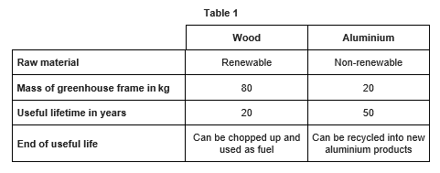
GCSE Science Fold & Solve – Using Resources
Fold the answers and work through the questions below.
Answers – Fold this over!
AO1
An alloys is a mixture made from two or more metals.
Sodium Chloride (Salt)
Alloy
Chlorine
Filtration
AO2
Filter
To remove solids
Add chlorine
Sterilise/reduce the levels of bacteria.
Visual Pollution
Noise pollution
Dust pollution
Habitat destruction.
AO3
Raw material
wood will not run out
aluminium (ore) will run out
more expensive to process
aluminium from its raw material
Mass of frame
wooden frame more expensive to transport
wooden frame uses more fuel to transport
wooden frame more difficult to handle / erect
Useful lifetime
wooden greenhouse would need replacing more often
fewer aluminium greenhouses needed over time
End of useful life
both materials can be put to further use
aluminium can be recycled repeatedly
What is an alloy?
Name the substance removed from sea water by desalination.
Nitinol is a shape memory
What substance is added to sterilise drinking water?
What is the name of the process used to remove solid particles in Stage 1?
What are the two main steps used to treat water from reservoirs? Give one reason for each step.
Give two reasons why quarrying is bad for the environment.
AO1
AO2
alloy.
catalyst.
polymer
Evaluate the use of each material for making greenhouse frames. Use Table 1.
AO3

