Slide 1
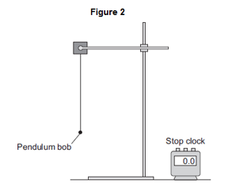
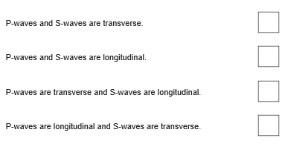
GCSE Science Fold & Solve – Waves
Fold the answers and work through the questions below.
Answers – Fold this over!
AO1
K
Wave speed = frequency x wavelength.
Transverse
Longitudinal
Frequency
4th box is ticked.
AO2
Count the number of waves.
That pass a point in 1 second.
The oscillation
For transverse is perpendicular to the direction of energy transfer.
For longitudinal is parallel to the direction of energy transfer.
8 x 0.015 = 0.12m/s
AO3
Measure over a wider number of lengths.
Measure over a wider range of masses.
Measure the number of swings over a greater period of time.
Repeat each measurement and calculate a mean.
Start the swings at the same height.
Which letter shows the amplitude of the wave?
Write the equation that links frequency, wavelength and wave speed.
What is the name of the wave in the diagram?
What is the name of the wave in the diagram?
____________ is the number of waves passing a point every second.
Which one of the statements about P-waves and S-waves is correct? Tick one box
Describe how the frequency of the water waves in the ripple tank can be measured
Describe the differences between longitudinal waves and transverse waves
Every second, 8 waves pass through the gap in the barrier. The waves have a wavelength of 0.015 metres. Calculate the speed of the water waves and give the unit.
AO1
AO2
A student investigated the factors affecting the oscillation of a pendulum. The student set up a pendulum as shown in Figure 2. The student investigated how many complete oscillations the pendulum made for different lengths of the pendulum and different masses of the pendulum bob
Suggest two ways in which the investigation could be improved
AO3

