Slide 1
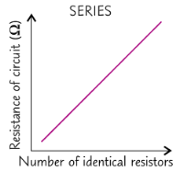
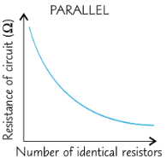
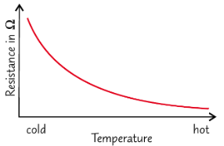
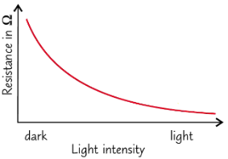
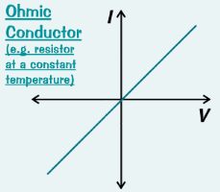
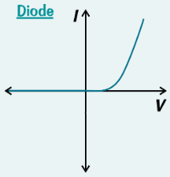
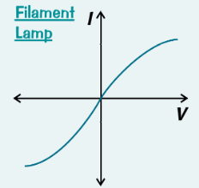
P2 Electricity AQA Trilogy | Write the equation for calculating charge flow What do the letters stand for? | A battery charger passes a current of 2.0 A through a cell over a period of 2.5 hours. How much charge is transferred to the cell? | RPA 15: Resistance How does increasing a length of wire affect the resistance in a circuit?
Draw the symbols for the following: Lamp Voltmeter Ammeter Fuse Diode LED | Write the equation for calculating potential difference What do the letters stand for? | A 4 Ω resistor in a circuit has a potential difference of 6.0V across it. What is the current through the resistor? You’ll need to rearrange the equation | RPA 15: Resistance Describe the difference between resistance in a series and parallel circuit.
Draw the symbols for the following: Resistor Variable resistor Thermistor LDR | How does the resistance of a thermistor change as temperature increases? Give a use of a thermistor | How does the resistance of an LDR change as light intensity increases? Give a use of an LDR | RPA 16: I-V characteristics Describe the resistance through an ohmic conductor
Define the term electric current | Draw a series circuit diagram that consists of 2 cells and a lamp and show the set up to measure current going through the circuit and voltage across the lamp | RPA 16: I-V characteristics Describe the resistance through a diode | RPA 16: I-V characteristics Describe the resistance through a filament lamp

Slide 2
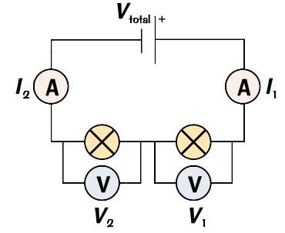
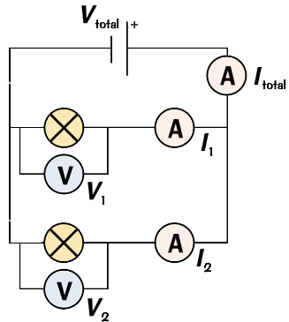
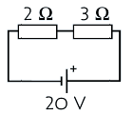
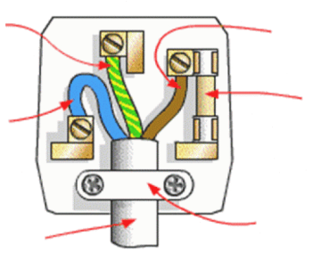
P2 Electricity AQA Trilogy | For components connected in series: The current through each component is the _________ The total potential difference of the power supply is ___________ between the components The total resistance of two components is the _______ of each component R_{total}= R₁ ₊ R₂ | For components connected in parallel: The total current through the whole circuit is the _______ of the currents through the separate components The potential difference across each component is the ________ The total resistance of two components is _______ than the resistance of the smallest individual resistor | A 600W microwave I used for minutes. How long would a 750W microwave take to do the same amount of work? Energy transfer (J) = Power (W) x time (s)
Draw a parallel circuit with 2 cells and 3 lamps that can be switched on and off independently | Series circuit | Parallel circuit | The motor in an electric toothbrush is attached to a 3 V battery. 140 C of charge passes through the circuit as it is used. Calculate the energy transferred. Energy transferred (J) = Charge flow (Q) x pd (V)
For the circuit diagram, calculate the current passing through the circuit. | Two 12V cells are connected in series with three resistors. 2Ω, 5Ω and 7Ω. Calculate the current through the circuit. | Write the two equations to work out power | Why is the national grid an efficient way to transfer energy?
Mains electricity Is it ac or dc? What is the frequency? What is the voltage? Describe the difference between ac and dc | Write the colour and function of the wires below: Live wire Neutral wire Earth wire | Label the diagram of a 3 pin plug | Describe the role of: Step up transformers Step down transformers

