Slide 1
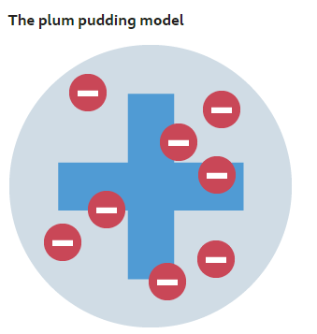
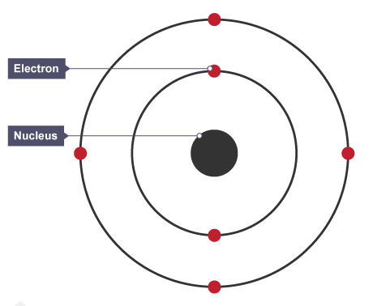
Atomic Structure & the Periodic Table
Sub-atomic particle | Mass | Charge | Position in atom
Proton
Neutron
Electron
Electronic Shell | Max No. Electrons
1
2
3
4
Label the sub-atomic particles found in an atom
Describe the differences between plum pudding and nuclear model of an atom
Key term | Definition
Atom
Element
Compound
Mixture
Mass number
Atomic number
Isotope
7
Li
3
What did James Chadwick provide evidence of?
How did Rutherford’s scattering experiment change our ideas about the atom
How did Niels Bohr adapt the nuclear model?
Give the formula for calculating relative atomic mass

Slide 2
Atomic Structure & the Periodic Table
How are elements arranged in the periodic table?
Key term | Definition
Group
Period
Metal
Non-metal
Label the periodic table to show the position of:
Metals
Non-metals
Alkali metals
Transition metals
Halogens
Nobel gases
1
2
3
4
5
6
7
0
H
He
Give the properties of metals
Give the properties of non- metals
Approximately how may elements are in the in the periodic table
Li
Be
B
C
N
O
F
Ne
Na
Mg
Al
Si
P
S
Cl
Ar
K
Ca
Sc
Ti
V
Cr
Mn
Fe
Co
Ni
Cu
Zn
Ga
Ge
As
Se
Br
Kr
Rb
Sr
Y
Zr
Nb
Mo
Tc
Ru
Rh
Pd
Ag
Cd
In
Sn
Sb
Te
I
Xe
Cs
Ba
La
Hf
Ta
W
Re
Os
Ir
Pt
Au
Hg
Tl
Pb
Bi
Po
At
Rn
Fr
Ra
Ac
Rf
Db
Sg
Bh
Hs
Mt
?
?
?
Give the products for the following reactions
Metal + water →
Metal + oxygen →
Metal + chlorine →
How were the elements arranged by Mendeleev?
Why did he leave gaps?
Explain the following statements:
Reactivity increases going down group 1 (alkali metals)
Reactivity decreases going down group 7 (halogens)
Group 0 (Noble gases) are very unreactive
What is a displacement reaction?
Write the equation to show Cl₂ reacting with KBr

Slide 3
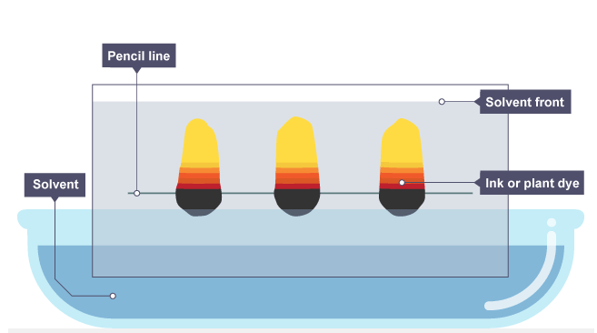
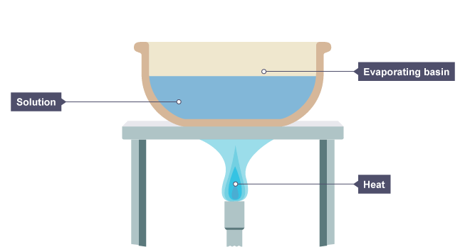
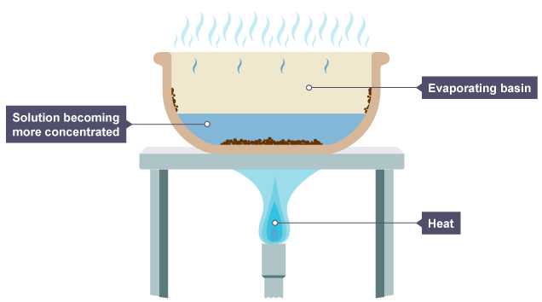
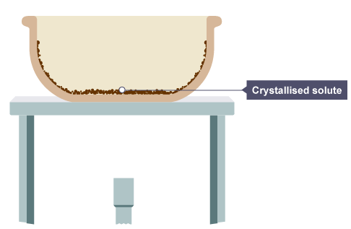
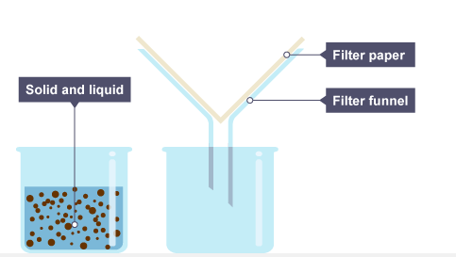
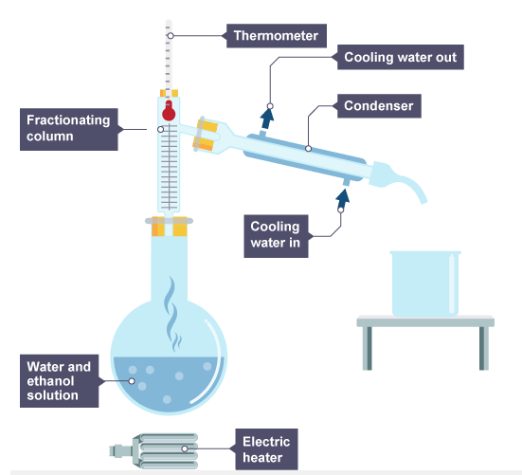
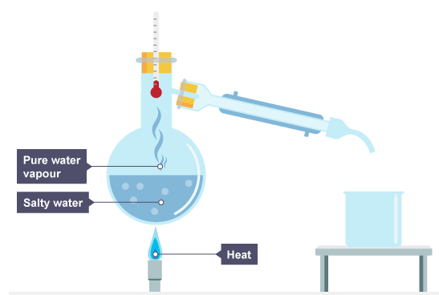
Atomic Structure & the Periodic Table
Explain crystallisation as a separation technique
Explain chromatography as a separation technique
Separation Techniques
Explain simple distillation as a separation technique
Explain filtration as a separation technique
Explain fractional distillation as a separation technique

Slide 4
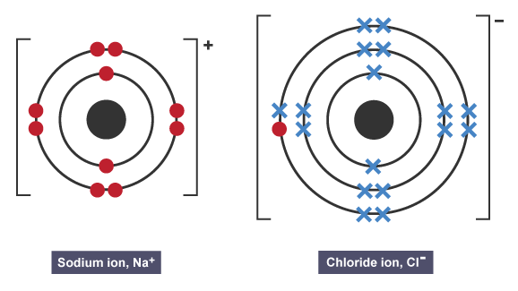
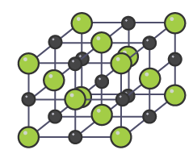
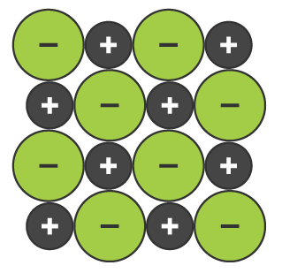
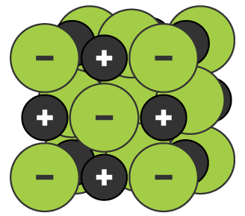
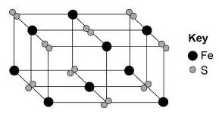
Bonding – ionic
Give the charge of the following atoms when they form ions
Na
Mg
K
O
Cl
Br
S
Ca
Give the limitations for each of the following models
Dot and cross Limitations | Ball and stick Limitations | 2D Limitations | 3D Limitations
Key term | Definition
Ion
Ionic bond
Electrostatic attraction
Giant lattice
What are the properties of ionic compounds?
Sodium chloride (NaCl) has a regular structure – a giant ionic lattice. Explain what this means.
The diagram shows a structure for iron pyrites. Give the formula
Explain why ionic compounds have high melting/boiling points
Draw the dot and cross diagram for magnesium oxide (MgCl₂)
Explain why NaCl conducts electricity when molten/in a solution but does not when solid.
Describe, in terms of electrons, how magnesium atoms and chlorine atoms change into ions to produce magnesium chloride
What happens to metals in ionic bonding?
What happens to non-metals in ionic bonding

Slide 5
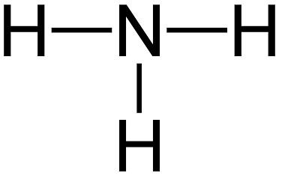
Bonding – Simple Covalent
Draw the dot and cross diagram to show the covalent bonding in Cl₂
Draw the dot and cross diagram to show the covalent bonding in O₂
Key term | Definition
Covalent bond
Molecule
Polymer
Polymers are covalently bonded substances with large molecules. Draw a diagram to show the repeating unit of poly(ethane)
Draw the dot and cross diagram to show the covalent bonding in H₂O
Explain the following properties of covalently bonded substances
Low melting and boiling point (molecules) | Do not conduct electricity | Large molecules have higher melting and boiling points
Draw the dot and cross diagram to show the covalent bonding in CH₄
Draw the dot and cross diagram to show the covalent bonding in N₃
Give the formula of some common molecules:
Hydrogen
Water
Oxygen
Chlorine
Hydrogen chloride
Ammonia
Methane
The diagram shows a structure for ammonia. Give the formula

Slide 6
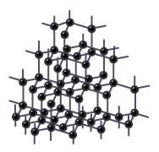
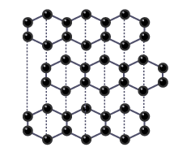
Bonding – Giant Covalent
Name 3 giant covalent substances
State three properties that are typical of substances with giant covalent structures
Does it conduct electricity?
Name the giant covalent structure
Name the giant covalent structure
Does it conduct electricity?
How many covalent bonds does each carbon atom form?
How many covalent bonds does each carbon atom form?
What is the melting point like?
What single element are graphite and diamond made from?
Explain your answer
What do the dotted lines in the diagram represent?
What is the name given to the structure that carbon atoms form?
Give a property of diamond
Why does this make it useful for cutting tools
How are the carbon atoms arranged?
Why does this property make graphite useful as a lubricant?
What is Buckminsterfullerene?
Explain its low melting point.
What is graphene?
Give some properties
What are fullerenes?
Give two examples
What is a nanotube?
Why are they useful in nanotechnology?

Slide 7
Quantitative
What is relative formula mass?
Calculate the RFM for CO₂
Calculate the RFM for H₂O
Give the formula for calculating the number of moles
Calculate the RFM for NaCl
Calculate the RFM for NaCl
The mass of one substance in a reaction can be calculated if the masses of the other substances are known. Complete
? Calcium carbonate → 28 g Calcium oxide + 22 g Carbon dioxide
Define ‘uncertainty’
Give the definition for the ‘law of conservation of mass’
What is a closed system?
Give two ways of estimating uncertainty
When magnesium burns in oxygen the mass increases. Explain why
Write the symbol equation for this reaction
Define ‘concentration’
How can we estimate uncertainty from a set of repeat measurements?
When calcium carbonate thermally decomposes the mass decreases. Explain why.
Write the symbol equation for this reaction
8 g of sodium hydroxide is dissolved in 2 dm³ of water. Calculate the concentration of the sodium hydroxide solution formed.
Give the formula to calculate the concentration of a solution
Give the unit for volumes used in concentrations
How do you convert cm³ to dm³ ?
How do you convert dm³ to cm³ ?

Slide 8
Chemical Changes
Metal + oxygen → ________ _________
Magnesium + oxygen → ________ _________
Zinc + oxygen → ________ _________
Why are carbon and hydrogen included in the reactivity series?
Acid name | Salt name
Hydrochloric
Sulphuric
Nitric
Write down the reactivity series in order (add symbols for each element)
Metal + water → ________ _________ + _______
Lithium + water → ________ _________ + _______
Calcium + water → ________ _________ + _______
Carbon
How is a metal above carbon extracted?
How is a metal below carbon extracted?
Which metals can be extracted by electrolysis?
Metal + acid → _________________ + ______________
Magnesium + Hydrochloric acid → _________________ + _______
Zinc + Sulphuric acid → _________________ + ______________
Hydrogen
Which metals can be extracted by carbon?
Explain what the reactivity series is.
Metal oxide + acid → _________________ + _______________
Copper oxide + Hydrochloric acid → _________________ + ___________
Zinc oxide + Nitric acid → _________________ + ______________
What is a positive ion?
Key term | Definition
Metal oxide
Displacement reaction
Oxidation
Reduction
Metal carbonate + acid → _________________ + ______________ + ______________
Calcium carbonate + hydrochloric acid → _________________ + ______________ + ______________
Copper carbonate + sulphuric acid → _________________ + ______________ + ______________

Slide 9
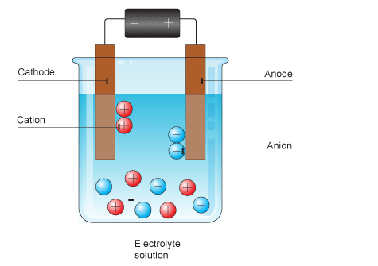
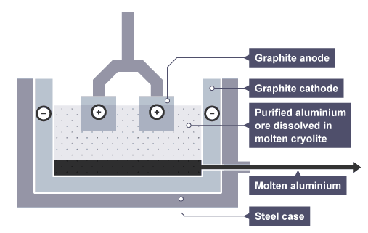
Chemical Changes
In the electrolysis of lead bromide:
What forms at the cathode?
What forms at the anode?
For electrolysis to occur why must the lead bromide be molten?
Key term | Definition
Electrolysis
Electrolyte
Electrode
Cathode
Anode
Inert
Label the diagram
Complete the half-equations:
At the cathode:
At the anode:
At the negative electrode what will be produced if:
Less reactive than hydrogen?
More reactive than hydrogen
Required practical: Investigate what happens when aqueous solutions are electrolysed using inert electrodes.
Extracting aluminium
Why does the aluminum ore need to be purified?
Why does aluminum oxide need to be molten?
What forms at the anode?
What forms at the cathode?
Why must the electrode (anode) be continually replaced?
Solution | Positive electrode (anode) Element formed | Negative electrode (cathode) Element formed
Copper (II) chloride
Copper (II) sulfate
Sodium chloride
Sodium sulfate
Explain why covalent compounds cannot act as electrolytes?
Complete the half-equations:
At the cathode:
At the anode:

Slide 10
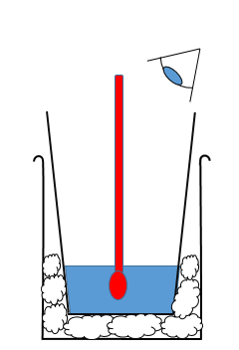
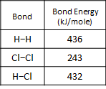
Energy Changes
Give examples of exothermic reactions
Name some useful applications of exothermic reactions?
Key term | Definition
Conservation of energy
Exothermic
Endothermic
Activation energy
Give examples of endothermic reactions
Name some useful applications of endothermic reactions?
Why is a polystyrene beaker used?
Why is cotton wool used?
Suggest an improvement?
Required practical: investigate the variables that affect temperature changes in reacting solutions such as, e.g. acid plus metal, acid plus carbonates, neutralisations, displacement of metals
Method:
①
②
③
④
⑤
Independent variable:
Dependent variable:
Control variables:
What results would you expect from your method?
How can you make your results more reliable?
Draw and label a reaction profile to show an exothermic reaction
Draw and label a reaction profile to show an endothermic reaction
Explain, using ideas about energy, what happens in a reaction when:
bonds are broken
bonds are made
Hydrogen and chlorine react to
form hydrogen chloride gas:
H₂ + Cl₂ → 2HCl
Calculate energy change

Slide 11
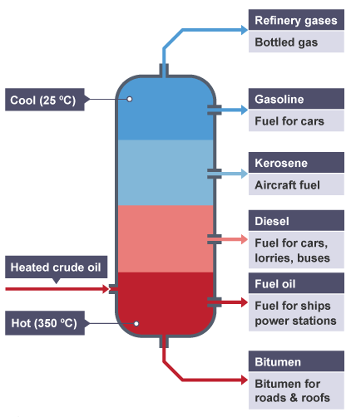
Organic chemistry
Name the process by which crude oil can be separated.
Key term | Definition
Boiling point
Volatility
Viscosity
Flammability
What is crude oil?
Crude oil is a finite resource. What does this mean?
Complete the diagram to show the uses of each fraction
Describe the stages of fractional distillation in the flow diagram
What are hydrocarbons?
What is an alkane?
Compare the properties of long and short chain hydrocarbons
Short chain |  | Long chain
 | Boiling point
 | Volatility
 | Viscosity
 | Flammability
Give examples of useful materials produced by the petrochemical industry
v

Slide 12
Organic chemistry
No. Carbon Atoms | Name | Formula | Diagram displayed formula
1
2
3
4
Define combustion
Write the word equation for the complete combustion of methane
Give the symbol equation for the above reaction
What is an alkane?
Give the general formula for an alkane
What is cracking?
What is the importance of cracking a long chained hydrocarbon?
Cracking produces an alkane and another hydrocarbon. What are these called?
Key term | Definition
Combustion
Complete combustion
Incomplete combustion
Alkene
Bromine water
Cracking
Compare the two methods of cracking
Catalytic | Steam
Give the details of a test that can be done to determine if a hydrocarbon is an alkane or an alkene.
Test:
Presence of alkane
Presence of alkene
Compare alkanes to alkenes:
What's the same?
What's different?

Slide 13
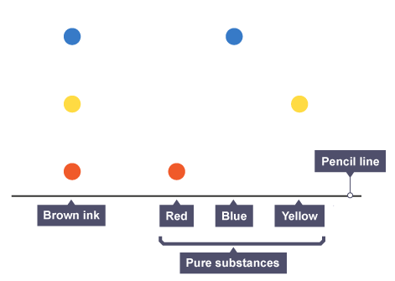
Chemical analysis
Describe how you can use melting and boiling point data to distinguish pure from impure substances.
Required practical: Investigate how paper chromatography can be used to separate and tell the difference between coloured substances.
Method (include a labelled diagram):
Why must the start line be drawn in pencil not ink?
Why must the start line be above the solute line?
Suggest why a lid is placed on the container?
How do you calculate the R_{f} value?
Define pure substance in chemistry
Define the term ‘soluble’
Define the term ‘insoluble’
Define pure substance in everyday language
What is a formulation?
Describe how chromatography can be used to identify substances.
What are the two phases?
Testing for common gases
Gas | Test | Positive result
Hydrogen
Oxygen
Carbon dioxide
Chlorine
Give some examples of formulations
What colours are present in the brown ink?
What is a mixture?
How do you know the other colours are ‘pure’?

Slide 14
Chemistry of the atmosphere
Theories about the Earth’s early atmosphere have changed over time. Why?
During the first billion years of the Earth’s existence one theory suggests that there was a lot of volcanic activity. How did this change the atmosphere?
What proportion of the Earth’s atmosphere is:
Nitrogen
Oxygen
Water vapour
Carbon dioxide
Argon
How did the oceans form?
How did the formation of the oceans affect the carbon dioxide levels?
What gases are believed to have been released from volcanoes during the first billion years?
Which organisms increased the amount of oxygen in the Earth’s atmosphere?
How did the appearance of animals and plants affect the carbon dioxide levels?
Name 3 green house gases
Human activities that increase greenhouse gases in the atmosphere
Methane | Carbon dioxide
Give the word and symbol equation for photosynthesis
Explain how the interaction between short and long wavelength interaction with matter creates the greenhouse effect.
How is an increase in greenhouse gases affecting global temperatures?
CO₂ is a product of combustion. Write the word equation for complete combustion on methane, CH₄
Define ‘carbon footprint’
Describe how we can reduce the emissions of CO₂ and CH₄
Pollutant | Affect
Carbon monoxide
Sulphur dioxide
Particulates

Slide 15
Using resources
Define ‘finite’
Give some examples of finite resources
Define renewable resource?
What is meant by the term ‘sustainable development’?
Give the 4 ways that humans use the Earth’s resources
Natural resource | Use | Alternative synthetic product
Wool
Cotton
Silk
Linseed oil
Rubber
Wood
Describe the process of phytomining
Describe the process of bioleaching
What is an ore?
Why do we need use alternative methods for metal extraction?
What is meant by a Life cycle assessment (LCA)?
Give the 4 stages that are assessed as part of an LCA
What three things can we do to reduce the use of limited resources?
Describe how metals can be recycled
Name three materials that can be produced from limited resources
Describe how glass can be recycled

Slide 16
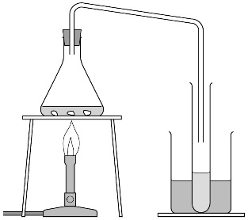
Using resources
How is potable water different from ‘pure’ water
Give two methods used to obtain potable water
Required practical: Analysis and purification of water samples from different sources, including pH, dissolved solids and distillation
Describe how to determine the pH of sample of water.
Describe how to determine the mass of dissolved solids in a sample of water
Describe how you would test for sodium chloride:
Test for sodium ions:
Test for chloride ions:
Label the equipment
Explain the science behind this process
Define ‘potable’ water
Describe the stages of treating waste water in the flow diagram
Name some sterilising agents
How is most potable water produced in the UK?
Explain why it is important that water has:
Low levels of dissolved salts
Low levels of microbes
What is desalination?
Why does sewage and agricultural waste need to be treated?
Why does industrial waste need to be treated?
Name two methods used for the desalination of salty water.

Slide 17
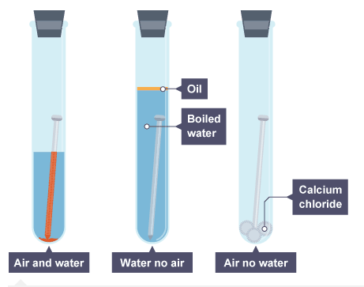
Using resources CHEMIISTRY
Rusting is an example of corrosion. In what two metals will rusting occur?
What needs to be present for iron to rust?
Give the word equation for when iron rusts
Define ‘corrosion’
Is rusting an oxidation or reduction reaction?
A student investigated the conditions needed for rusting. Why is calcium chloride used in tube C ?
Explain how painting/oiling and greasing/ coating with plastic prevents corrosion
Define ‘alloy’
A
B
C
24 carat gold contains what % of gold in the alloy?
12 carat gold contains what % of gold in the alloy?
Why is gold alloyed with other metals to make jewellery?
Name the metals in the following alloys:
Brass:
Bronze:
Explain how electroplating prevents corrosion
Calculate the % of gold in 14 carat gold
Complete for the electroplating of a steel object
Cathode:
Anode:
Electrolyte:
Define ‘electrolysis’
Define ‘malleable’
Explain ‘sacrificial protection’
Explain ’galvanization’
Alloy steel | Elements in addition to iron | Properties
High carbon steel
Low carbon steel
Stainless steel

Slide 18
Using resources CHEMIISTRY
What is a polymer?
Draw a diagram to represent the two types of polymer and list their properties
Give three properties of glass?
How is soda-lime glass made?
Thermosetting | Thermosoftening
Why is borosilicate glass more suitable to make a boiling tube?
What affects the properties of a polymer?
How is borosilicate glass made?
How are clay ceramics made?
Why are clay ceramics coated with a glaze?
Polymer | Properties | Uses
Low density poly(ethane), LDPE
High density poly(ethane), HDPE
What is a ‘composite’?
Give some examples of composites
Give a definition for the two components of composites
Reinforcement:
Matrix:
Why is carbon fibre reinforced polymer used in the body panels of high performance cars?
What two components do most composites have?
How can concrete be improved?

