Slide 1
Title: Understanding Unit 3
Date: Monday 28th October
Lesson Objectives:
Bronze: L2P
Silver: L2M
Gold: L2D
Topics Covered:
LO1 – Know job roles involved in realising construction and built environment projects
LO2 – Understand how built environment development projects are realised
LO3 – Be able to plan built environment development projects

Slide 2
Title: Understanding Unit 3
Date: Monday 28th October
Lesson Objectives:
Bronze: L2P
Silver: L2M
Gold: L2D
LO1 – Know job roles involved in realising construction and built environment projects
What does this include?
Describe activities of those involved in construction projects
Describe the responsibilities of those involved in construction projects
Describe outputs of those involved in realising construction projects
What job roles are involved?
Clients team
Client, architect, engineer, quantity surveyor, project manager and designer.
Contractors team
Builder/site engineer, site supervisor, safety officer, trades person and specialist sub contractors.
Statutory personnel
Building inspector, town planner, public health inspector.
General
Administrator, finance officer, public liaison officer, purchasing/procurement officer, catering and security.

Slide 3
Title: Understanding Unit 3
Date: Monday 28th October
Lesson Objectives:
Bronze: L2P
Silver: L2M
Gold: L2D
LO2 – Understand how built environment development projects are realised
What does this include?
Describe processes used in built environment development projects
Different processes include: planning, construction, handover to client and maintenance
Calculate resources to meet requirements for built environment development projects
Calculations you need to be able to do: area, volume, percentages, scaling, best value, tolerances, VAT, tender price
Assess potential effects on project success
Internal factors that can effect the project – lack of qualified and certified key personnel, sourcing of finance or security
External factors that can effect the project – penalty clauses, weather conditions
Interpret sources of information
Sources of information – drawings, catalogues, spreadsheets, suppliers material lists and specifications

Slide 4
Title: Understanding Unit 3
Date: Monday 28th October
Lesson Objectives:
Bronze: L2P
Silver: L2M
Gold: L2D
LO3 – Be able to plan built environment development projects
What does this include?
Sequence processes to be followed
Processes used in projects – planning, construction and handover
Apportion time to processes
Set project tolerances
Project tolerances are time and cost

Slide 5
Title: Understanding Unit 3
Date: Monday 28th October
Lesson Objectives:
Bronze: L2P
Silver: L2M
Gold: L2D
How will this Unit be tested?
This unit is a 2 hour exam with a total of 60 marks available in the paper.
It is an on screen assessment with a selection of short and extended answer questions based around applied situations.
If you would prefer a paper assessment please speak to me today.
You will need to take a calculator to this exam!
How are the marks broken down?

Slide 6
Title: LO1 – Job Roles and Responsibilities
Date: Monday 28th October
Lesson Objectives:
Bronze: L2P
Silver: L2M
Gold: L2D
Job Roles in Construction
Client, architect, engineer, quantity surveyor, project manager and designer.
Builder/site engineer, site supervisor, safety officer, trades person and specialist sub contractors.
Building inspector, town planner, public health inspector.
Administrator, finance officer, public liaison officer, purchasing/procurement officer, catering and security.
Task 1
From the list of job roles you need to pick one from each category and answer the following questions about the job roles:
Describe what their job role includes
What is this person responsibly for when on a construction site?
What is the outcome of this persons work?
Extension
From the jobs above pick one that you are most interested in and research what qualifications you would need to complete this job, what is the salary of this job role?

Slide 7
Title: LO1
Date: Monday 4th November
Lesson Objectives:
Bronze: L2P
Silver: L2M
Gold: L2D
To be able to explain the types of construction projects
Create a definition for the two following types of construction projects:
Refurbishment
Extension
Refurbishment
he renovation and redecoration of something, especially a building.
Extension
a part that is added to something to enlarge or prolong it.

Slide 8
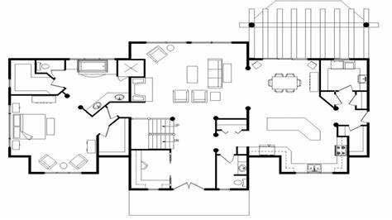
Title: LO1
Date: Monday 4th November
Lesson Objectives:
Bronze: L2P
Silver: L2M
Gold: L2D
Task 1
In teams (tables) you have been asked to refurbish the ground floor of a house. They have asked that you include an entertainment area for the family.
Below is the current floor plan of the house, you can remove and rebuild how you wish to improve the house.

Slide 9
Title: LO2
Date: Monday 4th November
Lesson Objectives:
Bronze: L2P
Silver: L2M
Gold: L2D
Describe processes used in built environment development projects
Area 1: Planning
The planning process of construction starts with Design and Project Planning.
Use the following link to complete the work sheet.
https://www.designingbuildings.co.uk/wiki/Building_design_process
Extension:
Create a definition of the term procurement in construction
Helpful Links:
https://www.thenbs.com/knowledge/new-procurement-methods-coming-to-a-project-near-you
https://www.designingbuildings.co.uk/wiki/Procurement_route
Procurement - Procurement is the process of purchasing goods or services. There are many different routes by which the design and construction of a building can be procured. The selected route should follow a strategy which fits the long-term objectives of the client's business plan.

Slide 10
Title: LO2
Date: Thursday 7th November
Lesson Objectives:
Bronze: L2P
Silver: L2M
Gold: L2D
Describe processes used in built environment development projects
Area 1: Construction
This area is split into four topics: secure site, site clearance, substructure and superstructure.
In todays lesson we will be looking into Site Security
Common construction security Risks:
Theft of machinery
The presence of expensive equipment is tempting for many criminals. Theft of construction machines like backhoes, generators, skid steer loaders and excavators has been called “low-risk” for criminals for a variety of reasons. First, construction sites are often easy to access (the ones with light security, at least), meaning criminals are unlikely to be caught. Second, the machines themselves have few security features. Some even have one-key-fits-all ignitions. Unlike other vehicles, most construction vehicles are not registered, making them difficult to track down if they are stolen, and therefore easy to sell on without consequence.
Theft of materials and fuel
With crimes like metal theft on the rise, thieves are heading to construction sites to steal these valuable materials. Copper tubing and wire cable in particular, have been widely targeted by thieves. Fuel, too, is a valuable commodity, and often the target of construction site theft, whether stolen from storage or from vehicles themselves.
Vandalism and arson
On top of the many kinds of theft, building sites are also under threat from vandalism and arson attacks. Both of these things can occur for a number of reasons, notably political objection to the building project, and a general desire to cause violence.
Break-ins to existing buildings
Construction sites aren’t always creating buildings from scratch. When construction is taking place on an existing building, there is the risk of intruders breaking in through the building site, which may have created new points of entry or compromised existing ones.
https://www.bridgersecurity.co.uk/physical-security/construction-site-security

Slide 11
Title: LO2
Date: Thursday 7th November
Lesson Objectives:
Bronze: L2P
Silver: L2M
Gold: L2D
Describe processes used in built environment development projects
Area 1: Construction
This area is split into four topics: secure site, site clearance, substructure and superstructure.
In todays lesson we will be looking into Site Security
How to Secure a construction Site:
Security Patrols
Hiring security guards to patrol a construction site is one of the most effective methods of preventing break-ins, theft and vandalism. This is especially helpful overnight, or when the site is unattended for any significant period of time.
CCTV
Frequently used in retail stores and public places, CCTV also functions as an effective deterrent for construction site-based crime. Placing security cameras around the perimeter of a building site will both discourage burglars and vandals from targeting it and help identify any perpetrators who do.
Monitoring CCTV images on-site can help security guards rapidly respond to any infiltrations, but the footage can also be used in court to help prosecute any offenders who do manage to steal from or damage the site. Bridger Security offers a wide range of CCTV systems that are ideal for construction sites as they offer an array of features including night vision (day to night infrared cameras), resistance to adverse weather conditions and vandalism, and various different camera types, suitable both for internal and external use.
Lighting
Perhaps not always associated with security, lighting can make a huge difference to the safety of a construction site. Illuminating site entrances at all times is advisable for smaller projects. Larger sites should brighten areas that could potentially act as points of entry. As well as discouraging intruders, this will lead to better quality CCTV images, and assist security guards to easier identify perpetrators or other threats.
Alarms
Padlocks/ Locking System

Slide 12
Title: LO2
Date: Thursday 7th November
Lesson Objectives:
Bronze: L2P
Silver: L2M
Gold: L2D
Describe processes used in built environment development projects
Area 1: Construction
This area is split into four topics: secure site, site clearance, substructure and superstructure.
In todays lesson we will be looking into Site Security
How to Secure a construction Site:
Alarms
Though most often used permanently to protect constructed properties, temporary burglar alarms are highly effective in securing construction sites. Larger sites in particular can benefit from intruder alarms, which will draw guards’ or workers’ attention to break-ins that may otherwise have gone unnoticed. Furthermore, installing a burglar alarm during the construction phase will provide you with the option to easily repurpose it later, when the building’s ready.
Padlocks/ Locking System
Ideally, the exterior of a construction site will be so secure that specific on-site security measures would not be needed. However, to ensure optimum safety, it is imperative to give individual vehicles, fuel stores, and other on-site equipment their own protection.
Larger machines like tower cranes should be secured at the base with a combination of locks and padlocks. Secure safes could also be used to protect any valuables or important documents that may need to be kept on-site 24/7.

Slide 13
Title: LO2
Date: Thursday 7th November
Lesson Objectives:
Bronze: L2P
Silver: L2M
Gold: L2D
Task 1
You have been asked to create a presentation for new employees about the risks and preventative measures used in the security of the construction site.
You need to include information on the possible risks for site security and explain each, and preventative measures that can be put into place to prevent the risks.
Use the information you have gained to complete this.
Extension Task
Complete the past paper questions that are linked to site security.

Slide 14
Title: LO2
Date: Friday 1st November
Lesson Objectives:
Bronze: L2P
Silver: L2M
Gold: L2D
Create a definition for Substructure and super structure Superstructure
1. It is the structure part that is on top of the ground level, and which provided for its intended use.
2. This superstructure part is situated between ground level and plinth.
3. For this construction timber, concrete, and steel materials are utilized.
4. This structure includes a frame, upper floors, windows, roof, doors, and external wall openings, stairs and ramps, partitions, internal walls, balustrades, cubicles, lintel, parapet, and movable room dividers, doors, hatches, sunshade, etc.
5. It excludes finishes, furnishings, substructure, and equipment and services.
Substructure
Or Foundation is the lower portion of the building, usually located below the ground level, which transmits the loads of the super-structure to the supporting soil. A foundation is therefore that part of the structure which is in direct contact with the ground to which the loads are transmitted.

Slide 15
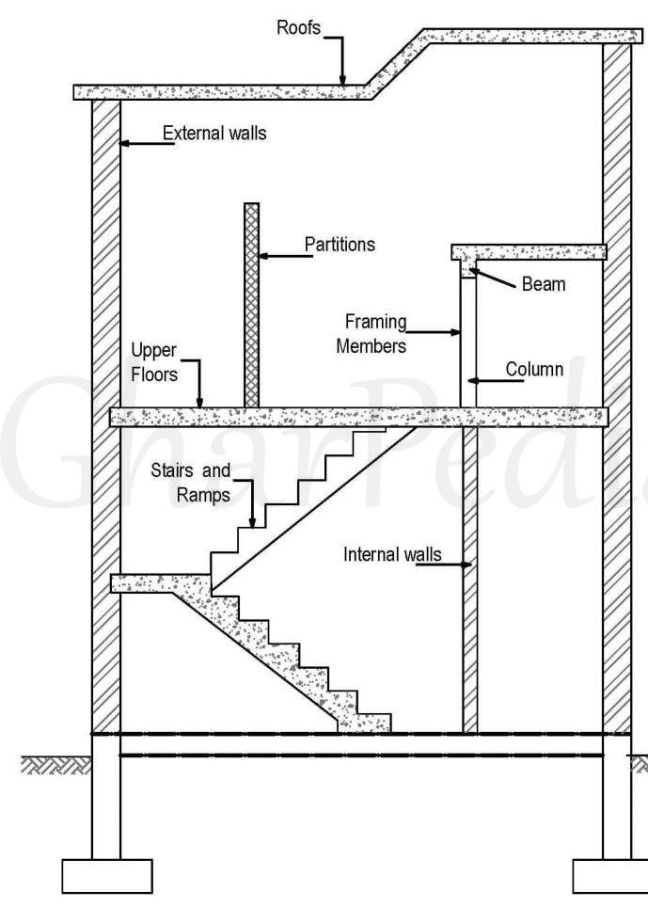
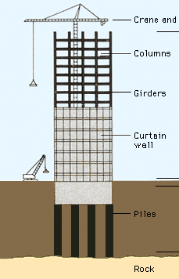
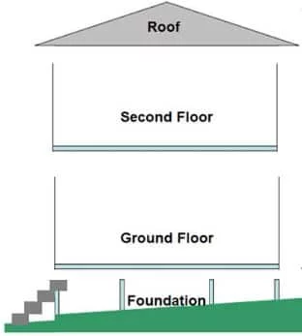
Title: LO2
Date: Friday 1st November
Lesson Objectives:
Bronze: L2P
Silver: L2M
Gold: L2D
Label the following diagrams which sections are substructure and super structure

Slide 16
Title: LO2
Date: Friday 1st November
Lesson Objectives:
Bronze: L2P
Silver: L2M
Gold: L2D
Different types of loads in buildings:
Dead – this is a load that does not move, such as the weight of the building itself
Dynamic – these are loads that change during the use of a building, such as the load from people and furniture
Impact – this is when something hits a building or falls on it, such as a heavy object
Complete your diagram of the building showing how its dynamic load is transferred

Slide 18
Title: LO2
Date: Monday 11th November
Lesson Objectives:
Bronze: L2P
Silver: L2M
Gold: L2D
Understanding the terms used in the construction industry
Commissioning ensures that the new building operates initially as the owner intended and that building staff are prepared to operate and maintain its systems and equipment.
Project commissioning is the process of assuring that all systems and components of a building or industrial plant are designed, installed, tested, operated, and maintained according to the operational requirements of the owner or final client.
Retro-commissioning is the application of the commissioning process to existing buildings.

Slide 19
Title: LO2
Date: Monday 11th November
Lesson Objectives:
Bronze: L2P
Silver: L2M
Gold: L2D
Understanding the terms used in the construction industry
The Hand Over Process
The handover of the site to the client takes place once the contract administrator has confirmed that the works defined in the contract are complete. However, it should be planned well in advance, and any special requirements included in appointment documents and contracts.
Handover may take place during a handover meeting following an inspection of the site.
During handover the client should be issued with:
Keys, fobs and transmitter controls for the development.
The health and safety file.
The draft building owner's manual.
The building log book.
A building user's guide.
Up to date testing and commissioning data.
All certificates and warranties in respect of the works.
As-built drawings from consultants and specialist suppliers and contractors (or as manufactured and installed). Or an as-constructed building information model.
Copies of statutory approvals, waivers, consents and conditions.
Equipment test certificates for lifts, escalators, lifting equipment, cradle systems, boilers and pressure vessels.
Licences such as licences to store chemicals and gases and to extract groundwater from an artesian well.

Slide 20
Title: LO2
Date: Monday 11th November
Lesson Objectives:
Bronze: L2P
Silver: L2M
Gold: L2D
Task 1
Using the information given, create a powerpoint that could be sent to a client to inform them of what to expect to receive in the hand over meeting of their new property.
The Hand Over Process
The handover of the site to the client takes place once the contract administrator has confirmed that the works defined in the contract are complete. However, it should be planned well in advance, and any special requirements included in appointment documents and contracts.
Handover may take place during a handover meeting following an inspection of the site.
During handover the client should be issued with:
Keys, fobs and transmitter controls for the development.
The health and safety file.
The draft building owner's manual.
The building log book.
A building user's guide.
Up to date testing and commissioning data.
All certificates and warranties in respect of the works.
As-built drawings from consultants and specialist suppliers and contractors (or as manufactured and installed). Or an as-constructed building information model.
Copies of statutory approvals, waivers, consents and conditions.
Equipment test certificates for lifts, escalators, lifting equipment, cradle systems, boilers and pressure vessels.
Licences such as licences to store chemicals and gases and to extract groundwater from an artesian well.

Slide 21
Title: LO2
Date: Friday 15th November
Lesson Objectives:
Bronze: L2P
Silver: L2M
Gold: L2D
The Maintenance Industry within Construction
Maintenance Manager
This role starts when the building is handed over to a client and is occupied by the workers. The building will then need to be maintained and managed so it is safe to use and operate. The maintenance team will do day to day repairs that are reported as well as planned maintenance.
Managing the maintenance of a building also includes:
Lifecycle costing – this involves examining the costs of a building over its whole life, including its maintenance costs.
Energy management – this involves reducing the energy costs of a building to the lowest possible level.

Slide 22
Title: LO2
Date: Monday 11th November
Unblocking rainwater gutters, downpipes and drains
Maintaining Boilers and Heating
Testing portable electrical devices
Planned Maintenance
Maintaining Floor surfaces
Maintaining lifts and escalators
Servicing air conditioning
Servicing and testing fire alarms and fire fighting equipment
Maintaining lighting

Slide 23
Title: LO2
Date: Friday 15th November
Lesson Objectives:
Bronze: L2P
Silver: L2M
Gold: L2D
Your Task
Create a job description for the job role of Maintenance Manager.
You need to have a description of the job role and the responsibilities of the maintenance manager.
You will also need to include information about the rate of pay. You will need to research this, do they get paid by the hour or are they on a salary etc.

Slide 24
Title: LO2
Date: Monday 18th November
Lesson Objectives:
Bronze: L2P
Silver: L2M
Gold: L2D
This section will be looking at the maths included in the exam.
Using BBC Bitesize create notes on the following topics, this can be in your books or on key cards. The key cards could be done on paper or on www.studystack.com this is a free site and saves your key cards.
The topics included are:
Area
Volume
Percentages
Scaling
Best value
Tolerances
VAT
Tender price

Slide 25
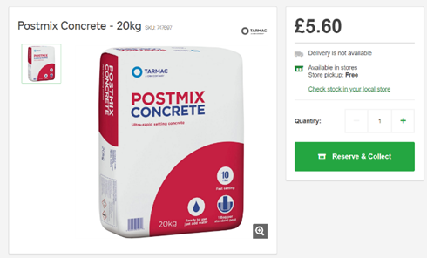
Title: LO2
Date: Monday 18th November
Calculating Best Value
You have been asked to work out which of the following quantities of concrete would be best value, you have been given the following four quotes for cement. For the task you need to have 400kg of cement, which one of the four quotes would be best value and how much would you save compared to the most expensive?
Extension Task
Using the laptops, can you find a better deal online that would be cheaper than your answer?
Try Jewsons, Wickes, Homebase or any other company you can think of.

Slide 26
Title: LO2
Date: Monday 18th November
Lesson Objectives:
Bronze: L2P
Silver: L2M
Gold: L2D
Assessing Potential Factors that could affect Project Success
There are two types of factors that can affect project success, they are internal and external factors.
Internal Factors
Lack of qualified and certified key personnel, sourcing of finance and security
External Factors
Penalty clauses and weather conditions
Task 1
Go through each of these factors and bullet point how they will affect the success of the project.
Once you have done this think about how you would overcome each of these factors

Slide 27
Title: LO2
Date: Monday 18th November
Lesson Objectives:
Bronze: L2P
Silver: L2M
Gold: L2D
Assessing Potential Factors that could affect Project Success
You have been asked by the project manager to write a report on why the project ran over by 2 months, pick two of the reasons that affected it from the table you have completed and explain how they affected the project.
This needs to be in the form of a letter, think about the layout and the information you will need to make it look professional.
Your Address
Brannel School, Rectory Road, St.Austell PL26 7RN
Their Address
Dowrglann, Stennack Road, Saint Austell PL25 3SW

Slide 28
Title: LO2
Date: Thursday 21st November
Lesson Objectives:
Bronze: L2P
Silver: L2M
Gold: L2D
Being able to interpret different sources of Information
You will need to be able to interpret different sources of information from the list below:
Drawings
Catalogues
Spreadsheets
Supplies material lists
Specifications
Task One
Interpreting a specification and creating relevant drawings.

Slide 29
Title: LO2
Date: Monday 25th November
Lesson Objectives:
Bronze: L2P
Silver: L2M
Gold: L2D
Interpreting Resources - Catalogues
You are going to work in teams of 4, you have been given a range of catalogues from different businesses/company's and you will need to come up with a price for a list of materials.
Think about the stock size you are buying in; does it offer a discount for bulk purchases? Do you get a discount because you are a school?
There is a prize for the team of four that come up with the lowest price possible for the resources needed.

Slide 30
Title: LO3
Date: Monday 25th November
Lesson Objectives:
Bronze: L2P
Silver: L2M
Gold: L2D
The Construction Process
Setting up a Site
First of all a construction site needs to be set up before construction can start. This involves making the site safe and creating welfare facilities for the workers like kitchen and toilet facilities. A well planned site means that work can progress smoothly and safely.
When planning you should consider
Accommodation – such as offices, welfare facilities and plant rooms
Storage of materials – in open areas or in sheds? How much material will you have on site at one time and does it need to be covered?
Car parking – how many people are working on site a day? Could you get visitors like planning officers who will need to park?
Security of the site – what sort of lighting, CCTV, fencing and signs will you need?
Temporary services – such as water, electricity and communication links. Will you need a generator?
Disposal of waste – how much waste do you think you might have and how will you remove it?

Slide 31
Title: LO3
Date: Monday 25th November
Lesson Objectives:
Bronze: L2P
Silver: L2M
Gold: L2D
The Construction Process
Groundworks
This involves clearing the site, removing topsoil and digging up the bushes and trees so that work can start, including demolishing existing buildings on the site. The topsoil is then removed so that the construction work starts on firm level ground.
Sub-structure
Is the underlying structure of the building, this includes all work below ground level such as foundations and drainage. . An important stage during this process is the excavation and construction of the foundations.
Superstructure
Is all parts of the building above the ground level. Internal services such as gas, electricity, telecommunications, drainage, hot and cold water are added during this stage.
External works
This is additional work done to the building. It includes the construction of paved areas, driveways and garden landscaping. It also includes routing utilities such as gas, electricity, drainage, telecommunications and water.
Finishes
These finishes are the final works that finish a building. This includes the installation of suspended ceilings and the flooring, as well as painting, decorating and tiling.

Slide 32
Title: LO3
Date: Monday 25th November
Lesson Objectives:
Bronze: L2P
Silver: L2M
Gold: L2D
The Construction Process
Gantt Charts
Look at the print out of the gantt chart, make sure this is stuck into your book.
A gantt chart shows the time allocated for each task or activity in the construction process. The time can be given in days, hours or weeks.
Gantt chart give the order of activities so it is obvious which tasks need to be done before the next task can be started. Gantt charts also show which acitivites can be done at the same time, this means that they can be used as the schedule and the order of work.
Interpreting gantt charts is an important skill for anyone working on a project. You need to know the sequence of activities as well as the time allocation.

Slide 33
Title: LO3
Date: Monday 25th November
Lesson Objectives:
Bronze: L2P
Silver: L2M
Gold: L2D
The Construction Process
Gantt Charts
Look at the print out of the gantt chart, make sure this is stuck into your book.
The gantt chart is for the construction of a bungalow. Use it to answer the following questions in your book:
When will the painting start?
How long will electrical installation take to complete?
When will the drainage be completed?
What other activities will happen at the same time as heating installation?
Why do you think drainage starts so early and happens in two phases?
How many weeks will it take before painting is completed?

Slide 34
Title: LO3
Date: Monday 25th November
Lesson Objectives:
Bronze: L2P
Silver: L2M
Gold: L2D
Advantages and disadvantages of Gantt Charts
This type of chart is popular with construction professionals because:
They are easy to use
Give a visual understanding of the project activities
Show the sequence of events
Are helpful when planning to arrange labour, plant and materials
Help monitor progress
However for larger projects they can be confusing as all the activities do not fit on one page.
Task One
Answer the following questions in your books:
Why is planning so important when preparing for a construction project?
How does a gantt chart represent time against a particular activity?
When do you think a gantt chart would not be suitable?

Slide 35
Title: LO3
Date: Monday 25th November
Lesson Objectives:
Bronze: L2P
Silver: L2M
Gold: L2D
Task Two
Complete assessment activity 4.1 in your books. For the first task right the letter and the task on each line (this can be used a revision), these will be marked so you have the correct answers in your books.
D – excavate and lay foundations

Slide 36
Title: LO3
Date: Monday 2nd December
Lesson Objectives:
Bronze: L2P
Silver: L2M
Gold: L2D
Types of foundations
Strip foundations
These are shaped like a strip, these are the most common types used in low rise construction like the construction of a house. These are designed to support the loads of continuous walls and transmit it to the ground.
Pad foundations
These support loads from columns and piers and transmit these loads to the ground. This sort of foundation is like a concrete pad or slab supporting a column, normally in the middle of a pad.
Raft foundations
These take the load from the whole building and transfer it to the ground. These are more expensive than strip or pad foundations. These are used when soil conditions are poor or variable.
Pile foundations
These are constructed when soil is very weak to support the load. Through piles, load is transferred deeper into the ground to a stronger base.
Task One
Using the internet, find out what sort of buildings might use each of these four types of foundations.

Slide 37
Title: LO3
Date: Monday 2nd December
Lesson Objectives:
Bronze: L2P
Silver: L2M
Gold: L2D
Floors
Floors make the building functional, allowing people to move around inside it. They also make it habitable, supporting any interior features and furniture. They are usually horizontal surfaces designed to:
Support both live loads and dead loads
Safely transfer these loads to either beams, columns or directly to the ground
Stop moisture from coming into the building from the ground
Fit in runs of mechanical and electrical lines
Give sound and thermal insulation
Be safe against fire
A solid floor is a solid concrete slab resting directly on the ground.
A suspended floor does not rest directly on the ground, but are supported by beams or joists. These can be constructed using a variety of materials, including concrete and timber.

Slide 38
Title: LO3
Date: Monday 2nd December
Lesson Objectives:
Bronze: L2P
Silver: L2M
Gold: L2D
Floors
Task One
Answer the two following questions on your work sheet.
Why do floors have to give sound insulation?
What kind of building would need this most?

Slide 39
Title: LO3
Date: Monday 2nd December
Lesson Objectives:
Bronze: L2P
Silver: L2M
Gold: L2D
Walls
Load-bearing walls
These are designed to take the load from other parts of the building. Usually, the external walls and some of the internal walls are load-bearing walls.
Non-load-bearing walls
These are only designed to enclose the space and are not capable of taking any load from other parts of the building.
Cavity walls
These are made up of two halves called leaves or skins, with a gap or cavity between them. External walls are generally constructed as cavity walls. The cavity stops moisture from travelling into the building and is usually filled with insulating materials that keep the building warm.

Slide 40
Title: LO3
Date: Monday 2nd December
Lesson Objectives:
Bronze: L2P
Silver: L2M
Gold: L2D
Roofs
Like walls, roofs make buildings comfortable and weatherproof. Roofs need a system of drains, gutters and downpipes to drain rainwater and melting snow. Roofs can either be constructed as flat or sloping.
Roofs are designed to:
Cover the internal space of a building, making it weather proof
Look attractive
Resist the force of wind and other weather
Take both dead loads, such as its own weight, and live loads, such as people moving over it
Protect against heat and cold

